Slide 1
Chapter 32
Maxwell’s Equations
Electromagnetic Waves

Slide 2
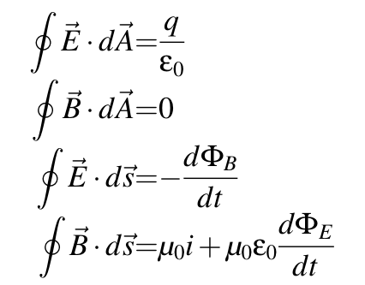
Maxwell’s Equations
Describe EVERYTHING in Electromagnetism
Notes:
\oint \vec E\cdot d \vec A &=& \frac{q}{\epsilon_0} \\ \oint \vec B\cdot d \vec A &=& 0 \\ \oint \vec E\cdot d \vec s &=& -\frac{d\Phi_B}{dt} \\ \oint \vec B\cdot d \vec s &=& \mu_0 i+\mu_0 \epsilon_0 \frac{d\Phi_E}{dt}
\Phi_E=\int \vec{E} \cdot dA

Slide 3
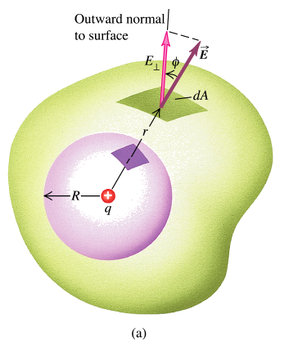
Gauss’ Law (Electric)

Slide 4
Gauss’ Law (Magnetic)
No magnetic monopole exists

Slide 5
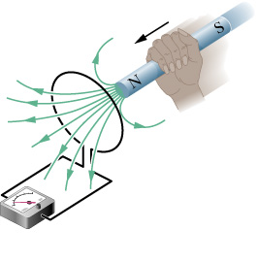
Faraday’s Law

Slide 6
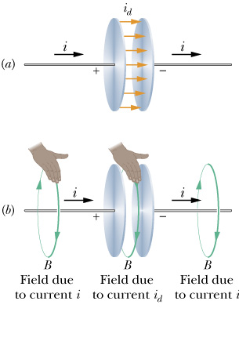
Ampere-Maxwell law

Slide 7
Displacement Current

Slide 8
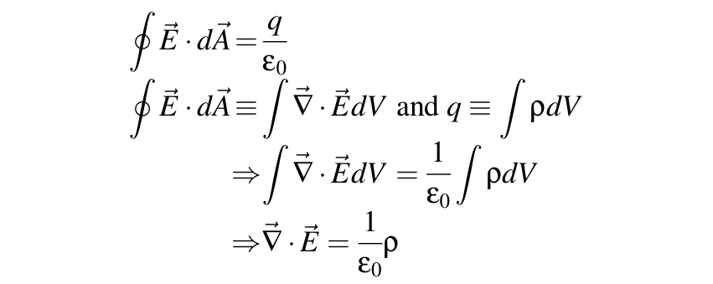
Rewriting the EQN
Notes:
\oint \vec E\cdot d \vec A &=& \frac{q}{\epsilon_0} \\
\oint \vec E\cdot d \vec A &\equiv& \int \vec \nabla \cdot \vec Ed V \textrm{ and } q\equiv\int \rho dV \\
&\Rightarrow& \int \vec \nabla \cdot \vec Ed V = \frac{1}{\epsilon_0} \int \rho dV \\
&\Rightarrow& \vec \nabla \cdot \vec E = \frac{1}{\epsilon_0} \rho

Slide 9
Another equation

Slide 10
Maxwell’s equations (second version)
Notes:
\vec \nabla \cdot \vec{E} &=& \rho/ \epsilon_0 \\ \vec \nabla \cdot \vec{B} &=& 0 \\ \vec \nabla \times \vec E &=& -\frac{\partial \vec E}{\partial t} \\ \vec \nabla \times \vec B &=& \mu_0 i + \mu_0 \epsilon_0 \frac{\partial \vec B}{\partial t}
\textrm{Displacement current density: }\\
\vec j_d=\epsilon_0 \frac{\partial \vec E}{\partial t} \\
\Rightarrow \vec \nabla \times \vec B &=& \mu_0 \vec j + \mu_0 \vec j_d=\mu_0(\vec j+\vec j_d)

Slide 11
Maxwell’s Equation (Two Versions)

Slide 12
Electromagnetic Wave
Light is represented by fluctuations in the magnetic and electric field called electromagnetic waves. EM wave is a consequence of the Maxwell’s Equation.
E
B

Slide 13
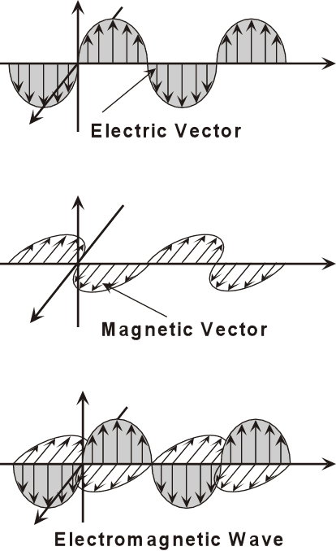
Basic Facts about EM waves in vacuum
Always travels at exactly the speed of light c.
E and B are always perpendicular.
E×B gives the direction of the wave.
|E|=|cB|
Two independent direction of polarization (later)

Slide 14
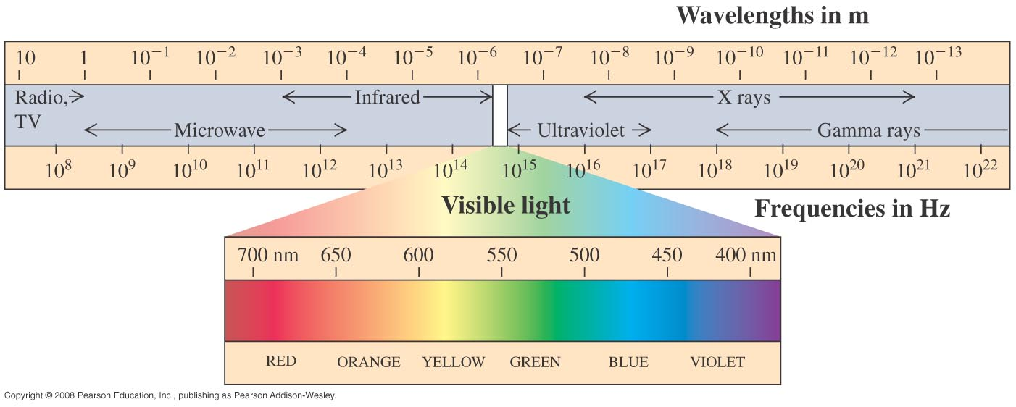
The electromagnetic spectrum

Slide 15
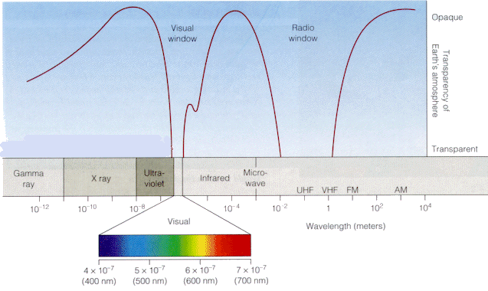
Why do we see colors?

Slide 16
Deriving EM waves in vacuum

Slide 17
Question
This is precisely the speed of light! Conclusive proof that light is a kind of EM wave.

Slide 18
Bible?
And God said,
Let there be light,
and there was light.
- Genesis 1:3

Slide 19
The Dual Nature of Light (Quantum Mechanics)
Sometimes waves
Sometimes particles (photons)

Slide 20
How to produce EM waves
Acceleration of charges
Electrons jumping in energy levels in atoms
Changing energy levels in molecules

