Slide 1
Phys 272
Alternating Current

Slide 2
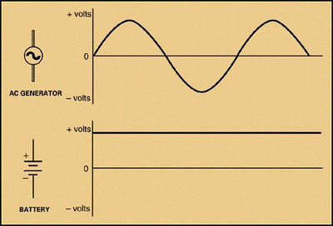
A.C. Versus D.C

Slide 3
(Natural) Frequency, Period, etc…

Slide 4
Alternating Current

Slide 5
Voltage and Current
US: 120V rms, 60Hz
Europe: 230V rms, 50Hz

Slide 6
Question

Slide 7
Question

Slide 8
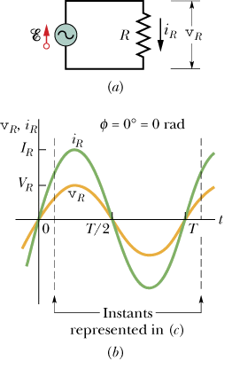
Resistive AC circuit

Slide 9
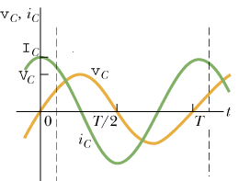
Capacitive AC circuit

Slide 10
Capacitive Reactance

Slide 11
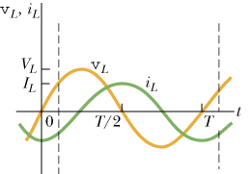
Inductive AC circuit

Slide 12
Inductive Reactance

Slide 13
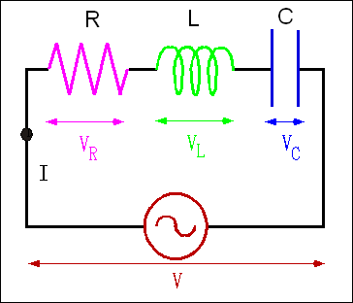
RLC

Slide 14
RLC Circuit and Impedance

Slide 15
Summary: Reactance and Impedance

Slide 16
RLC Circuit and Impedance

Slide 17
High Pass and Low Pass Filter

Slide 18
Resonance

Slide 19
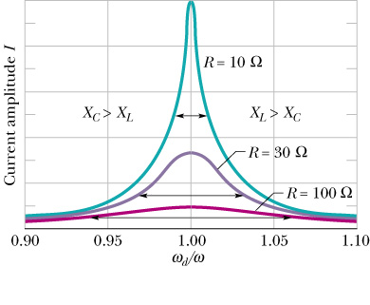
Resonance
Happens when driving frequency equals natural frequency

Slide 20
Find X_{L} and X_{R} at resonance

Slide 21
Root-mean-square

Slide 22
Power and rms

Slide 23
More rms

Slide 24
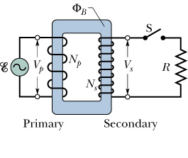
Transformer

Slide 25
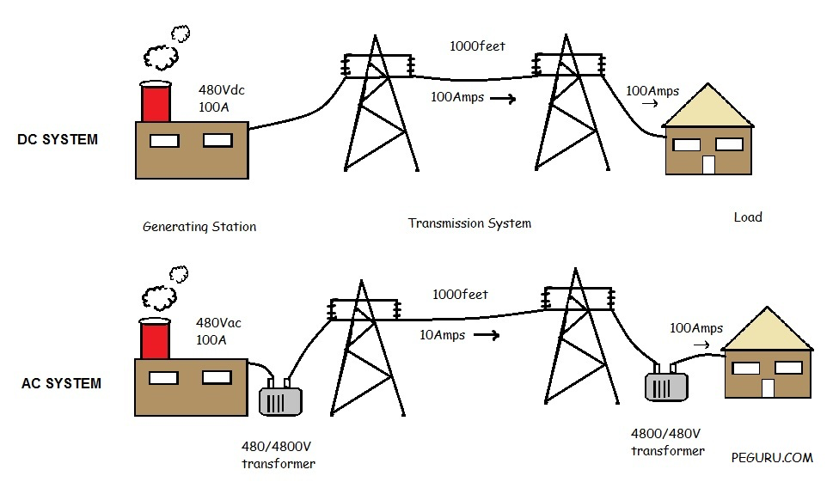
Reducing current during transmission

Slide 26
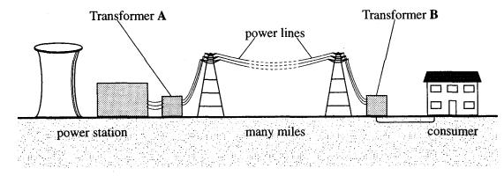
Saving energy, why?

Slide 27
Solution

Slide 28
Complex reactance: A more general “Ohm’s Law”

Slide 29
Complex reactance

Slide 30
Complex Numbers Review

Slide 31
Cos and Sin in Complex Number

Slide 32
Complex Plane

Slide 33
Complex Plane (Special Cases)

Slide 34
Finding Imaginary Part

Slide 35
Example: Rewrite in Polar Form

Slide 36
Finding Imaginary Part

Slide 37
Complex Conjugate

Slide 38
Conjugate to Modulus

Slide 39
Translating between Real and Complex Worlds

Slide 40
The Process

Slide 41
The Rule
Replace the voltage by complex version.
Use Ohm’s law to find the complex current. Pretend R, L, C are all resistors with complex reactance.
The imaginary part of the complex current gives you the real current I(t).
The magnitude of the complex current gives you the amplitude of the real current.

Slide 42
Capacitive Circuit

Slide 43
Inductive Circuit

Slide 44
RLC Circuit

Slide 45
RLC Circuit (amplitude)

Slide 46
RLC Circuit (full treatment)

Slide 47
Impedance and Reactance

Slide 48
Complex Number (Phasor)

Slide 49
Capacitive Reactance

Slide 50
Inductive reactance

Slide 51
RLC Circuit and Impedance

