Slide 1
Chapter 30
Inductance

Slide 2
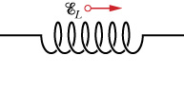
Inductor and Inductance
Capacitor: store electric energy
Inductor: store magnetic energy
Measure how effective it is at trapping magnetic energy

Slide 3
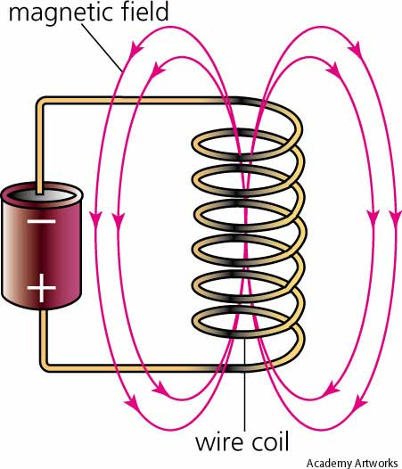
Inductance of a solenoid
l

Slide 4
Self-Induction
Always resists the change in current

Slide 5
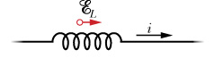
The sign of ξ_{L}
If ξ_{L} is positive, then the induced emf points in the same direction as the current.
If ξ_{L} is negative, then the induced emf points in the opposite direction as the current.

Slide 6
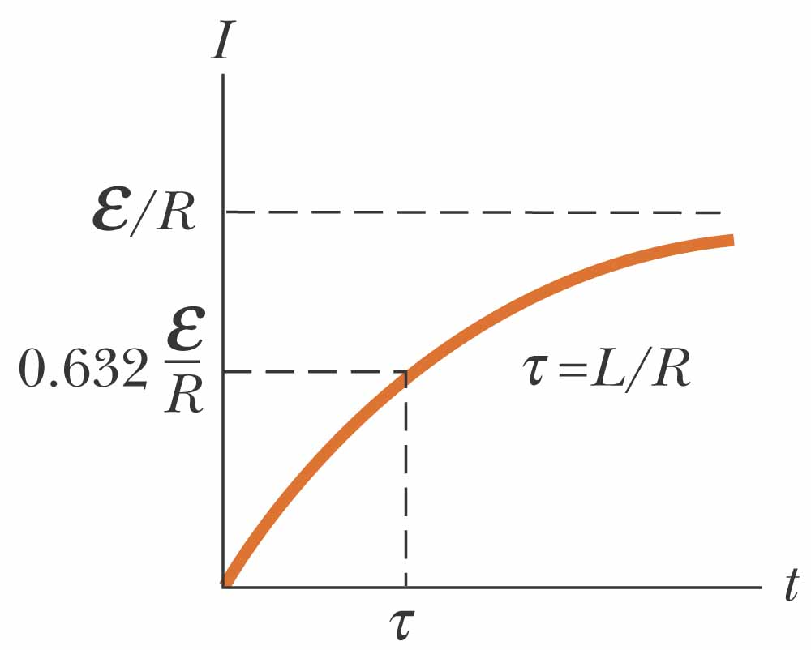
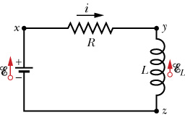
RL Circuits (“charging”)

Slide 7
Example

Slide 8
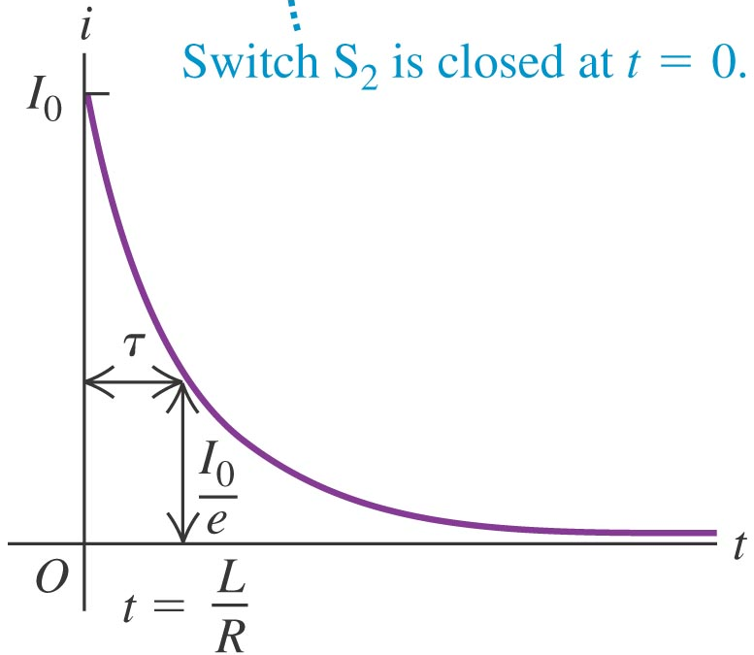
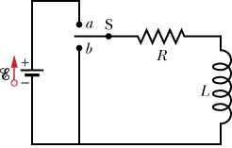
“Discharging”

Slide 9
Energy in an inductor

Slide 10
Magnetic and Electric energy density

Slide 11
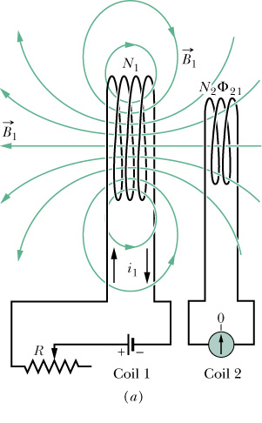
Mutual Inductance
Coil 2 with respect to 1:

Slide 12
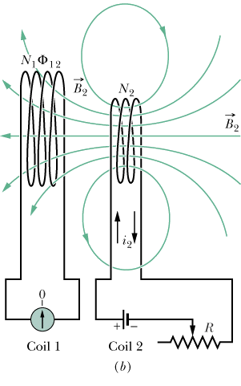
Coil 1 with respect to 2:

Slide 13
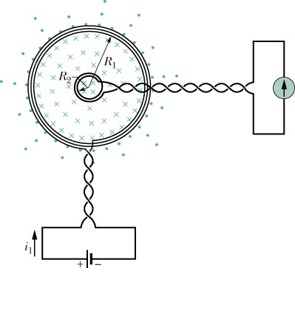
Example
Note that this equation is only true for a flat coil, not true for solenoid (which you will derive in the homework)

Slide 14
Reminder: Magnetic and Electric energy

Slide 15
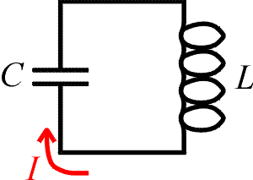
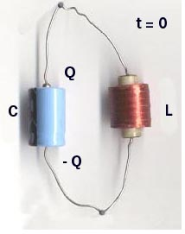
Electromagnetic Oscillations

Slide 16
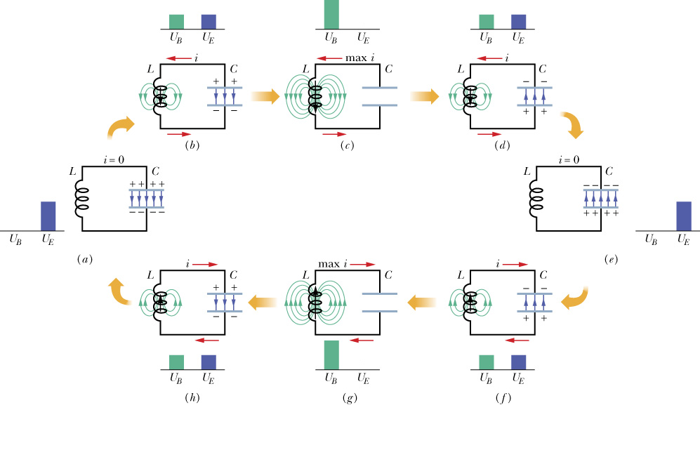
Electromagnetic Oscillations

Slide 17
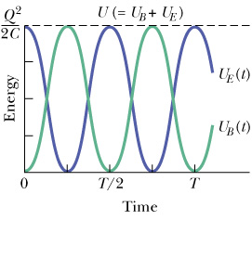
Energy conservation

Slide 18
Going around the loop

Slide 19
Simple Harmonic Oscillator
This is the same equation as all other simple harmonic oscillators

Slide 20
Solution

Slide 21
MasteringPhysics
In HW 30, the question “Oscillations in an LC circuit” Part C, use instead:
Reason: They wanted you to look at the magnitude of the current only, and without the minus sign I would have been negative.

Slide 22
Energy

Slide 23
Energy conservation

Slide 24
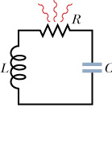
Damped Oscillations
Energy is dissipated by the resistor
Going around the loop:

Slide 25
Solution (damped)

Slide 26
(Natural) Frequency, Period, etc…

