Slide 1
Chapter 29
Electromagnetic Induction

Slide 2
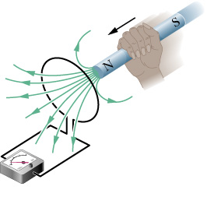
Induced current
You mean you can
generate electricity this way??!

Slide 3
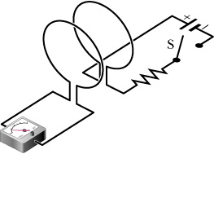
For my next magic act…
Note: No moving parts

Slide 4
Summary

Slide 5
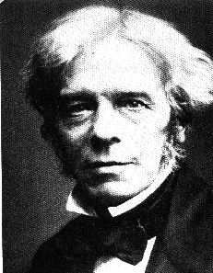
Faraday’s Law of Induction
An emf is induced when the number of magnetic field lines that pass through the loop changes

Slide 6
Magnetic Flux
Similar to electric flux

Slide 7
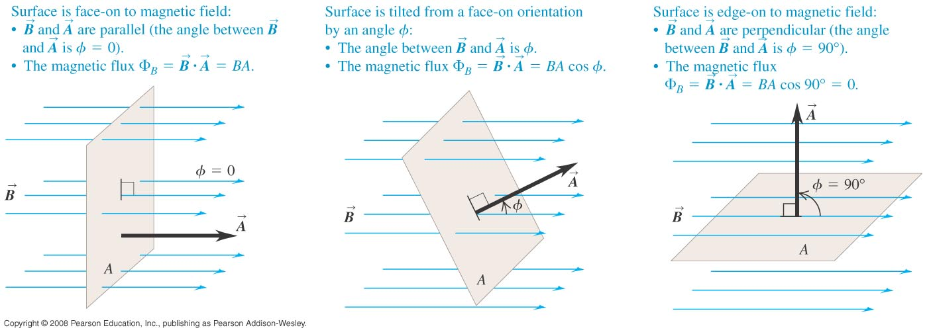
Magnetic Flux

Slide 8
Faraday’s Law (restated)
The minus sign will be explained later

Slide 9
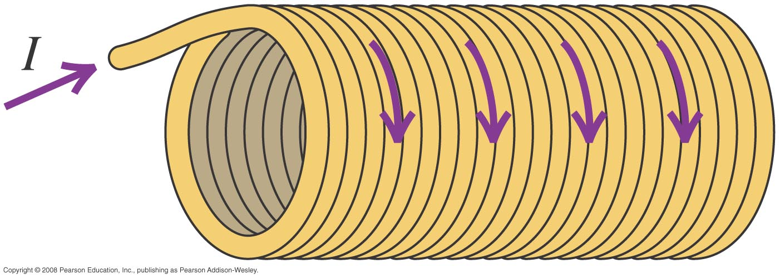
What if you have a coil?

Slide 10
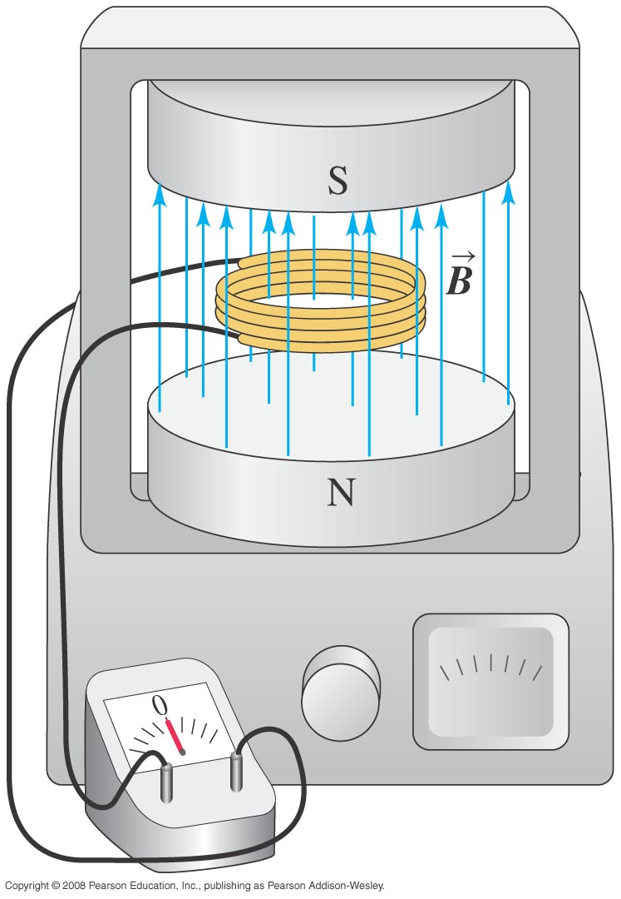
EMF induced in a solenoid
A=1m², N=2000 turns
An external magnetic field of B = 1mT is removed suddenly in 1s. What is the emf generated?

Slide 11
Solution
A=1m², N=2000 turns
An external magnetic field of B = 1mT is removed suddenly in 1s. What is the emf generated?

Slide 12
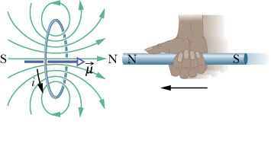
Lenz’s Law
An induced current has a direction such that the B field due to the current opposes the change in the magnetic flux

Slide 13
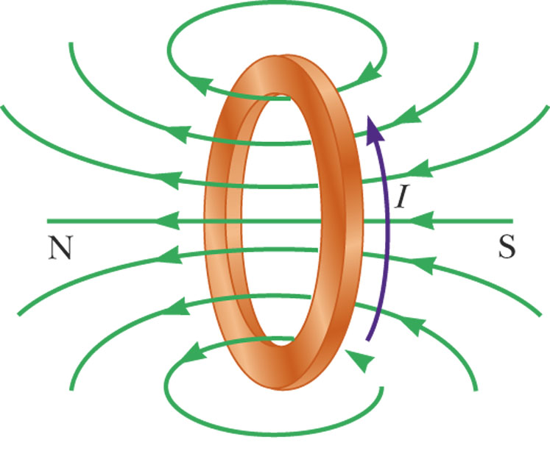
Lenz’ Law – Example 1
When the magnet is moved toward the stationary loop, a current is induced as shown in a
This induced current produces its own magnetic field that is directed as shown in b to counteract the increasing external flux

Slide 14
The Logic
B_{ext}: ➔
B_{ext}: increasing
B_{I}: ⬅ (to oppose the increase)
I: counterclockwise (view from left)

Slide 15
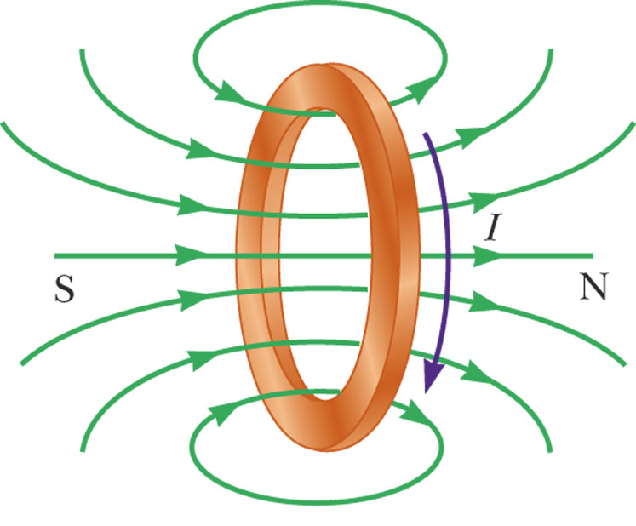
Lenz’ Law – Example 2
When the magnet is moved away the stationary loop, a current is induced as shown in c
This induced current produces its own magnetic field that is directed as shown in d to counteract the decreasing external flux

Slide 16
The Logic
B_{ext}: ➔
B_{ext}: decreasing
B_{I}: ➔ (to slow down the decrease)
I: clockwise (view from left)

Slide 17
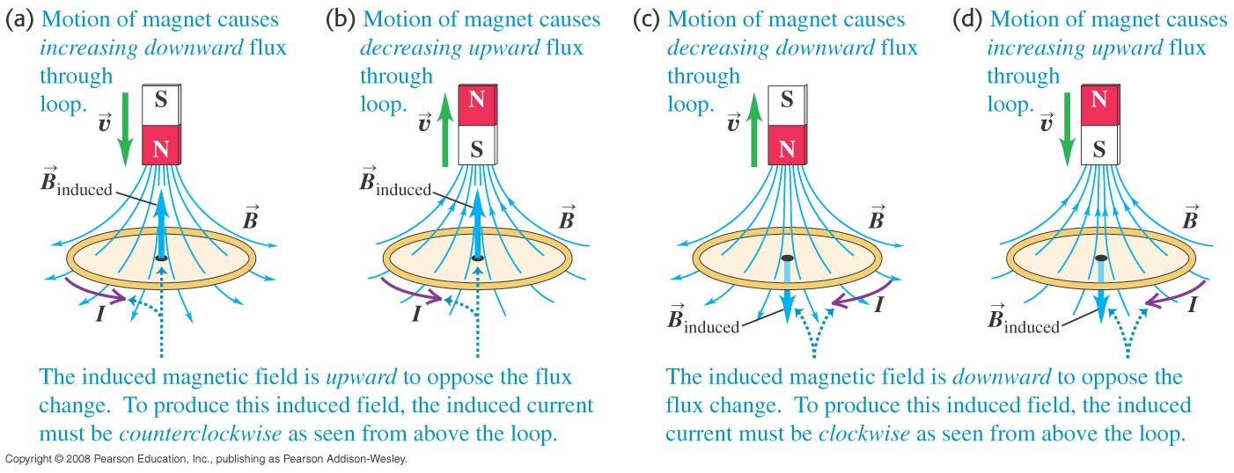
Summary

Slide 18
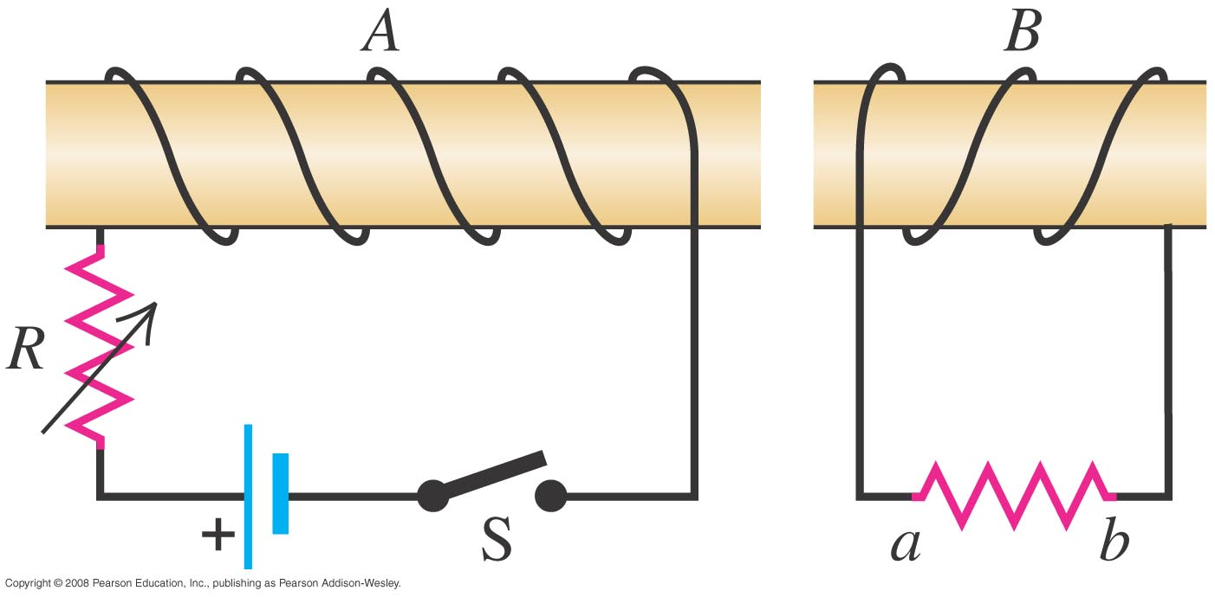
Direction of current
What is the direction of current in B when the switch S is closed?
I

Slide 19
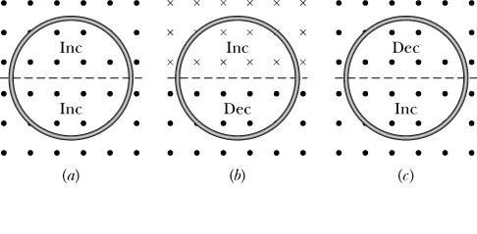
Do it yourself!
Which way do the currents flow?

Slide 20
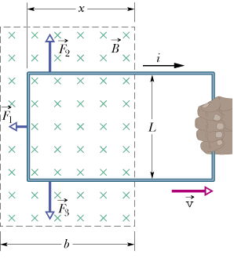
What is the current?
Resistance: R

Slide 21
What is the force?
Resistance: R

Slide 22
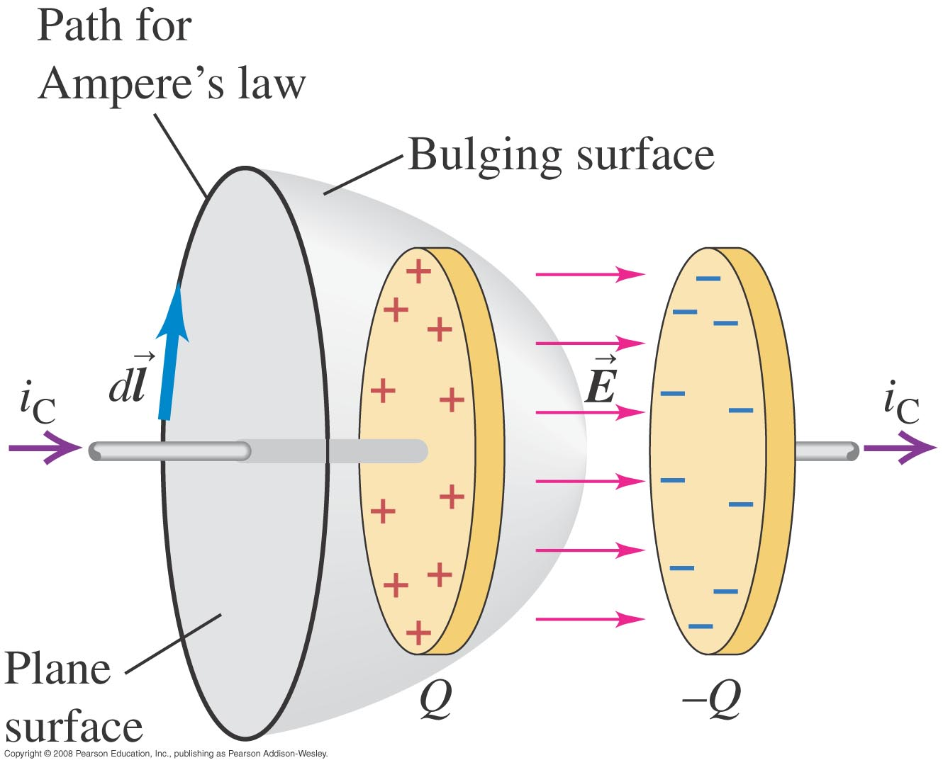
Displacement Current
There is something wrong with Ampere’s Law
Depending on the surface, I_{encl} could be either zero or non-zero. Inside the capacitor there is no conduction current.

Slide 23
Displacement Current
We need to account for the E field in Ampere’s Law.

Slide 24
Does it work?

Slide 25
Displacement current density

Slide 26
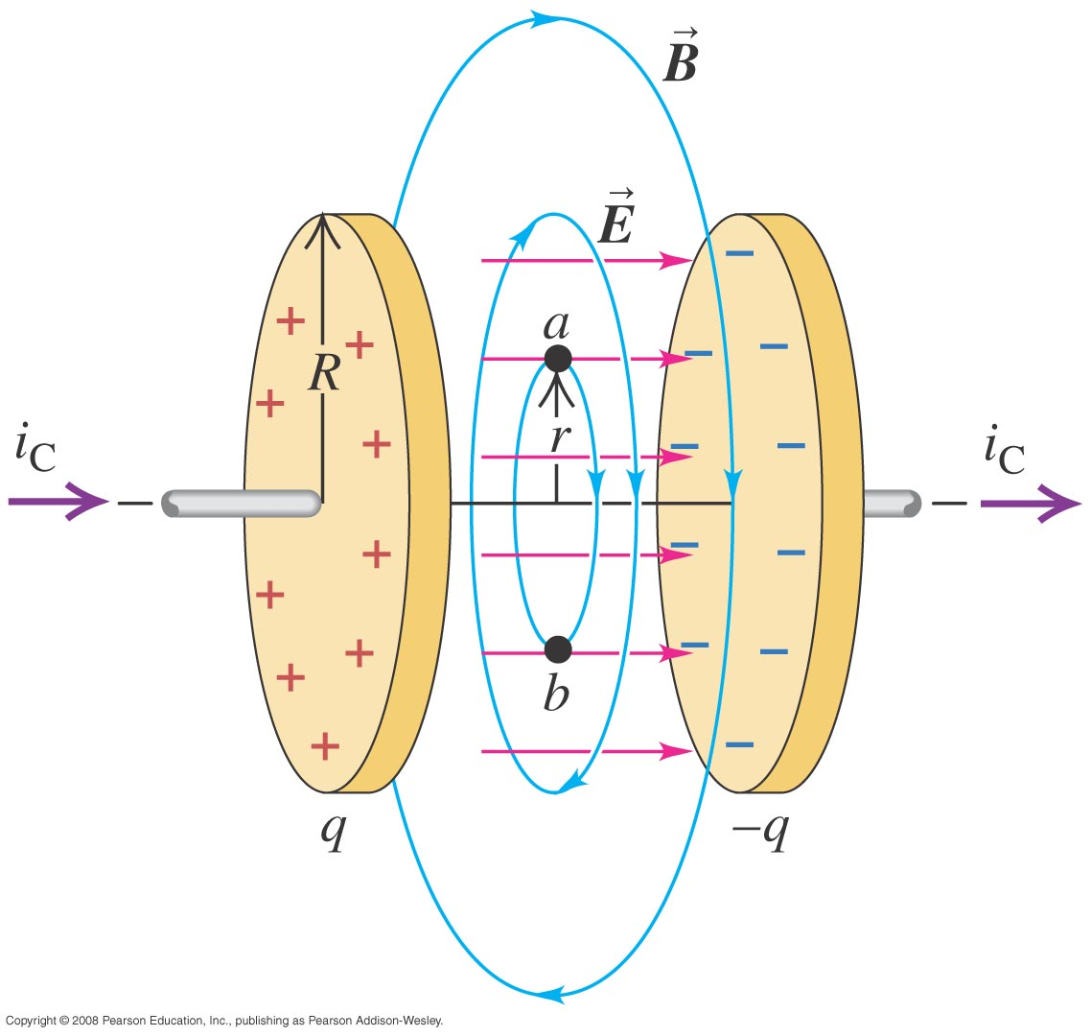
Example
What is the B field at point a given I_{C}?

Slide 27
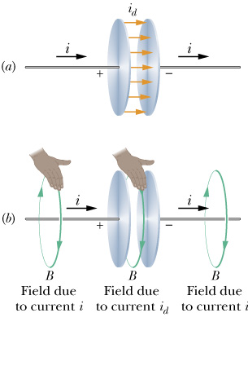
Ampere-Maxwell law

Slide 28
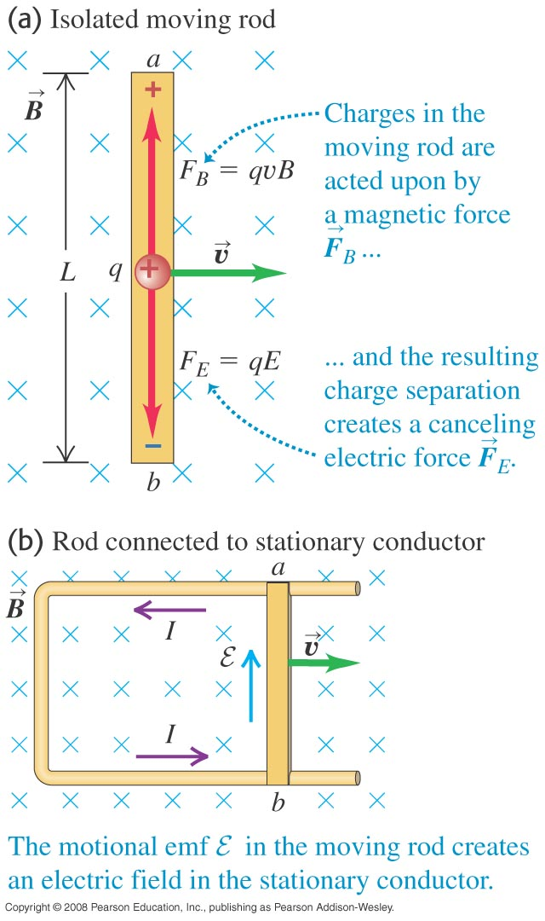
Isolated rod vs closed circuit

Slide 29
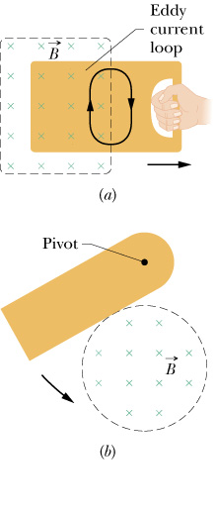
Eddy Currents
Eddy currents want to stop whatever you are doing!

Slide 30
Which one falls faster?

Slide 31
Movie

Slide 32
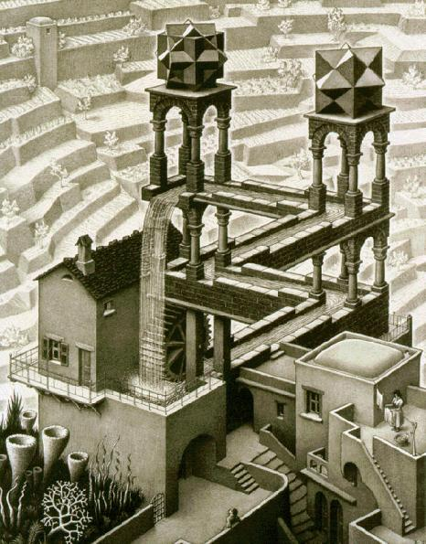
Potential is not well defined

Slide 33
Faraday’s Law (modern form)

Slide 34
Magnetic materials
Diamagnetism
Paramagnetism
Ferromagnetism

Slide 35
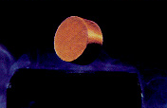
Diamagnetism
No net magnetic dipole for each atom when B=0.
When magnetic field is switched on, an induced magnetic dipole points in the opposite direction to B due to Lenz’s Law, this causes the object to be repelled.
Copper, lead, NaCl, water, superconductor

Slide 36
Paramagnetism
Each atom already has a permanent dipole moment.
This dipole will align with external B field.
Forces points from weak field to strong (attraction).
Oxygen, aluminum, chromium, sodium

Slide 37
Movie
Liquid Oxygen

Slide 38
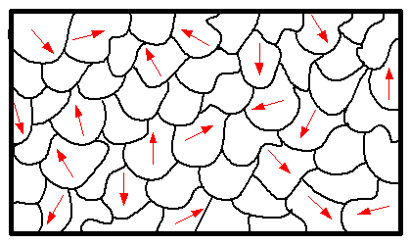
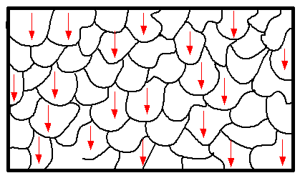
Ferromagnetism
Each atom has a net magnetic dipole.
Atoms arrange themselves into domains.
External fields can affect the alignment of the domains.
Heat can destroy the domains.
Magnets are made this way.
B Field
Insert Picture
Iron, Permalloy

Slide 39
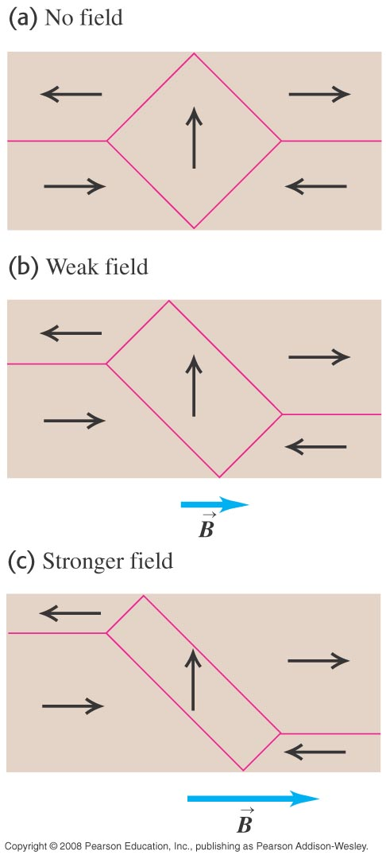
Details

Slide 40
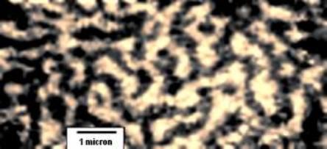
Picture

Slide 41
Applications of Faraday’s Law
Power plants
Flashlight with no battery
Toothbrush?
Transformers (a.c. versus d.c.)
Notes:
Space station, where would such a magnetic field come from?
Faraday’s law is indeed very important to our daily lives.

Slide 42
The wonders of magnetic field
Notes:
Magnetic field disconnects and reconnects

Slide 43
View from afar

Slide 44
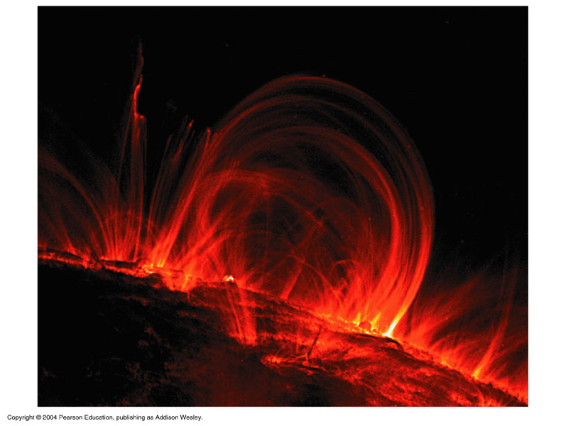
Big magnetic field

Slide 45
