Slide 1
Right Hand Rules
Summary

Slide 2
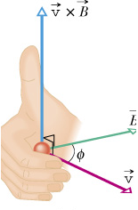
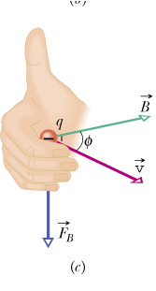
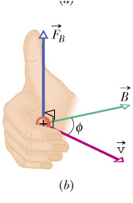
Direction of F_{B}
q > 0
q < 0

Slide 3
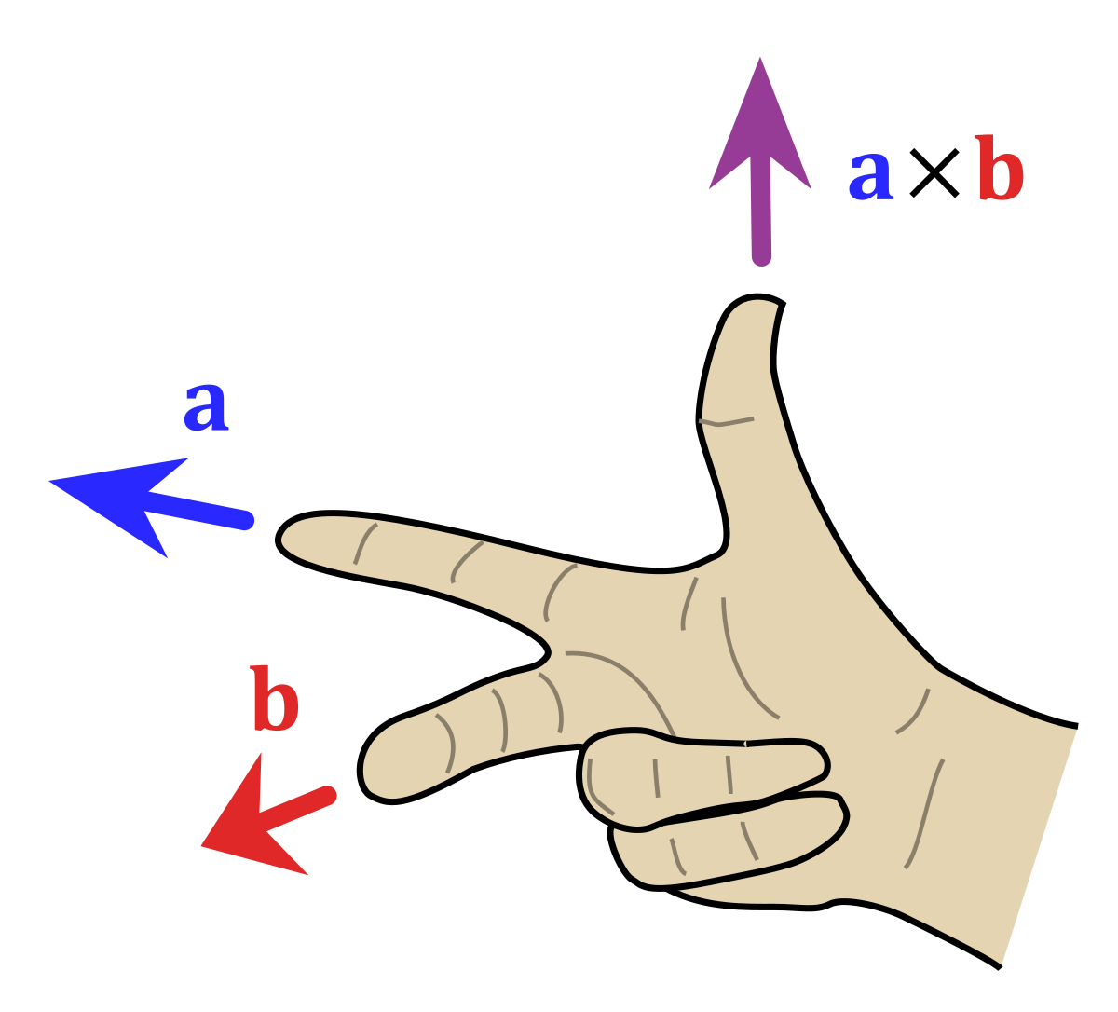
Alternative Right Hand Rule
Reminder to multiply q in the end!

Slide 4
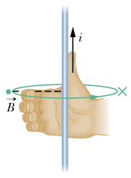
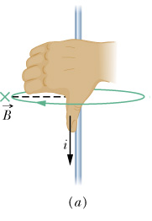
Magnetic field due to currents
Right hand rule

Slide 5
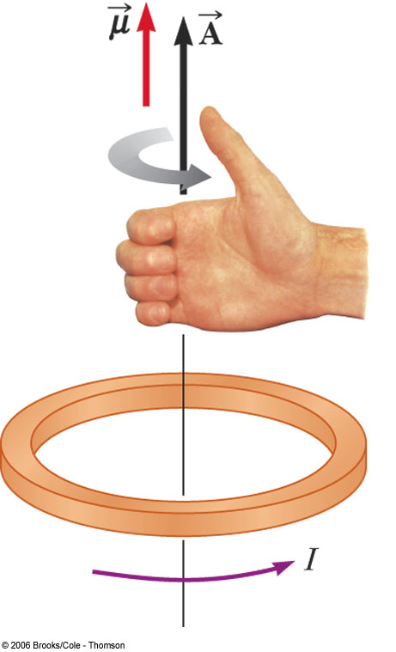
Magnetic field from a coil

Slide 6
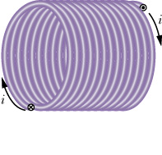
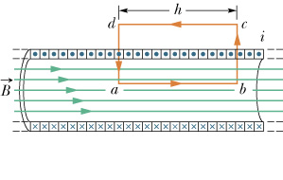
Solenoids

Slide 7
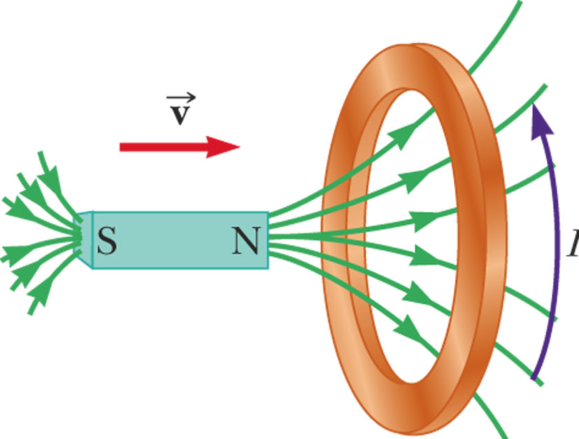
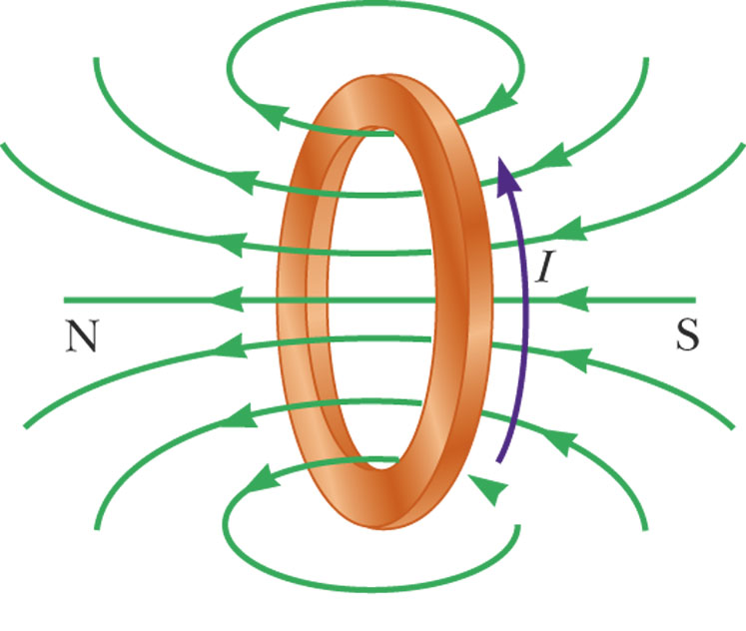
Lenz’ Law – Example 1
When the magnet is moved toward the stationary loop, a current is induced as shown in a
This induced current produces its own magnetic field that is directed as shown in b to counteract the increasing external flux

Slide 8
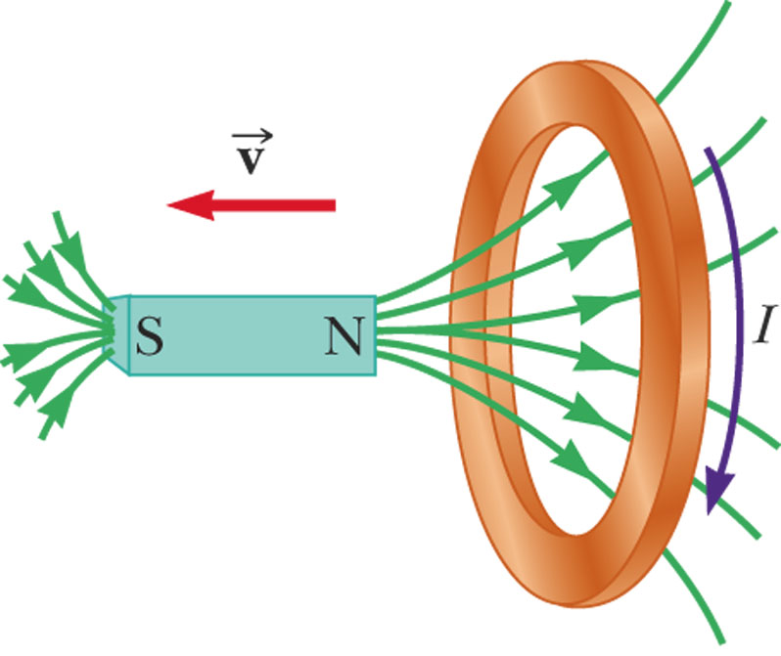
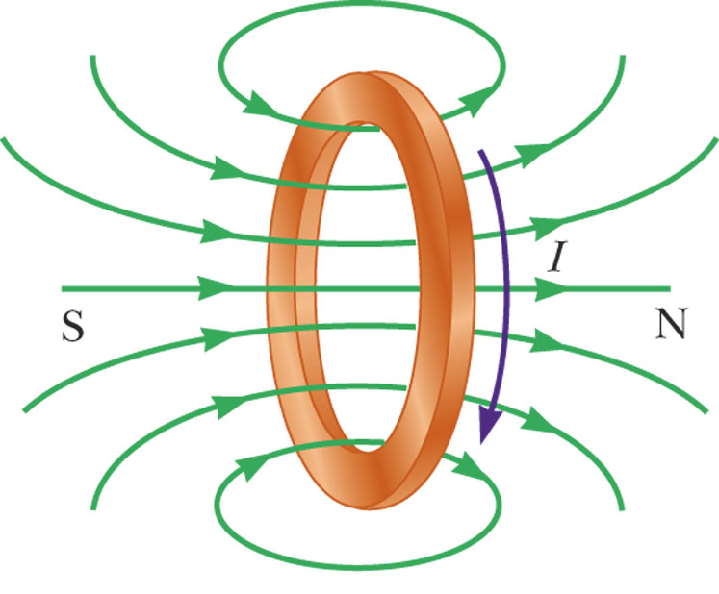
Lenz’ Law – Example 2
When the magnet is moved away the stationary loop, a current is induced as shown in c
This induced current produces its own magnetic field that is directed as shown in d to counteract the decreasing external flux

Slide 9
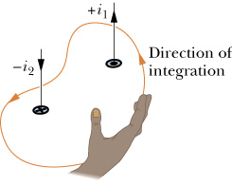
Ampere’s Law (Phys 272)

