Slide 1
CHAPTER 28
Sources of Magnetic Field

Slide 2
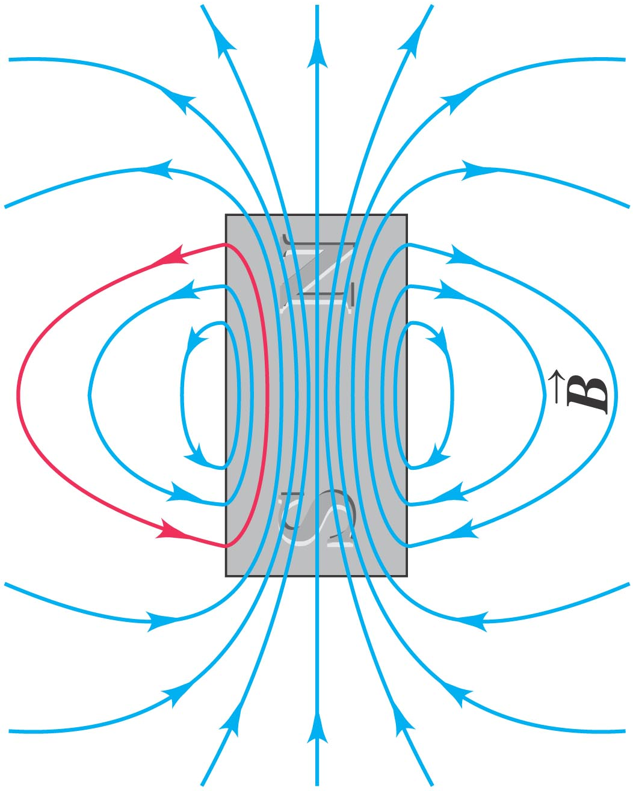
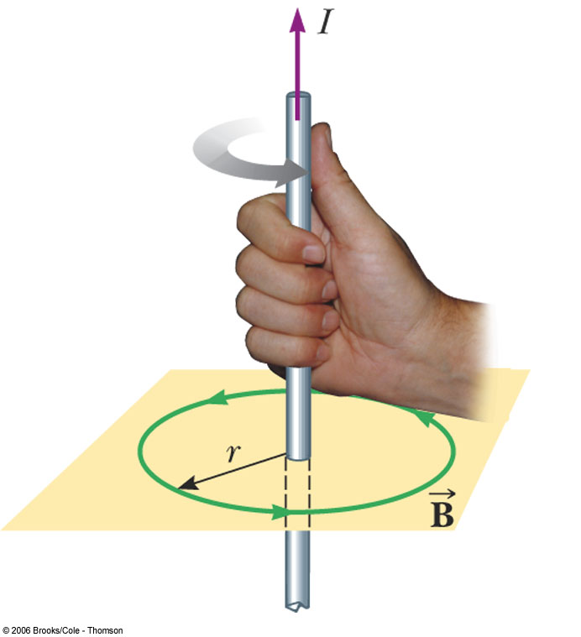
Producing a magnetic field
Permanent Magnet
Current

Slide 3
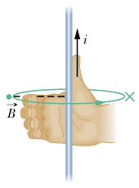
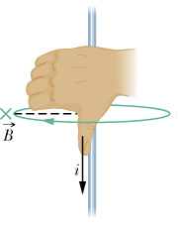
Magnetic field due to currents
Right hand rule

Slide 4
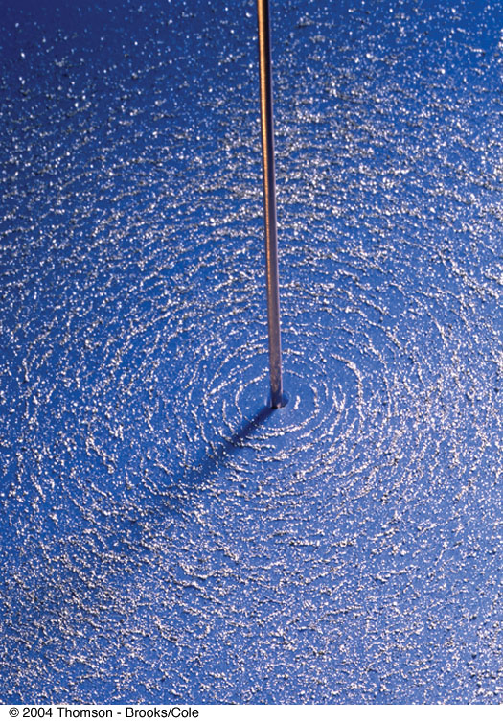
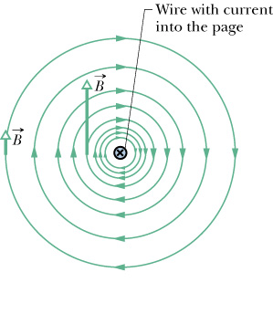
View from the top

Slide 5
VIEW FROM THE SIDE

Slide 6
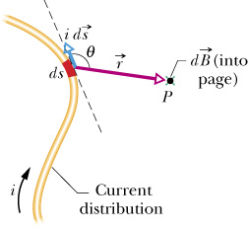
Biot-Savart Law
What if the wire isn’t straight?

Slide 7
Infinite Straight wire
P
I

Slide 8
Infinite Straight wire (Cont.)
Strategy: write everything in terms of θ
P

Slide 9
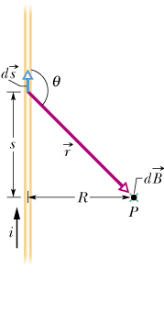
Infinite straight wire

Slide 10
Infinite straight wire (Cont)

Slide 11
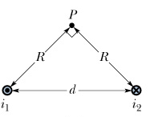
Example: Addition of B Fields
Find the B field at point P

Slide 12
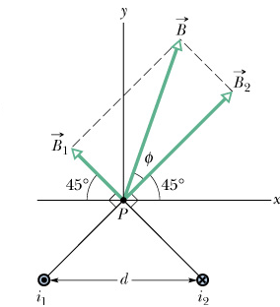
Example: Addition of B Fields

Slide 13
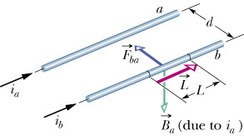
Force between parallel currents
What if the currents are in opposite directions?

Slide 14
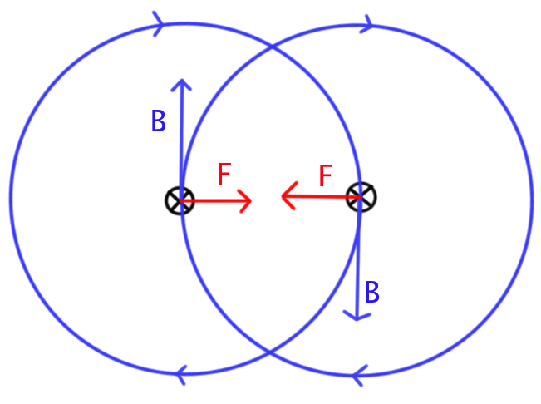
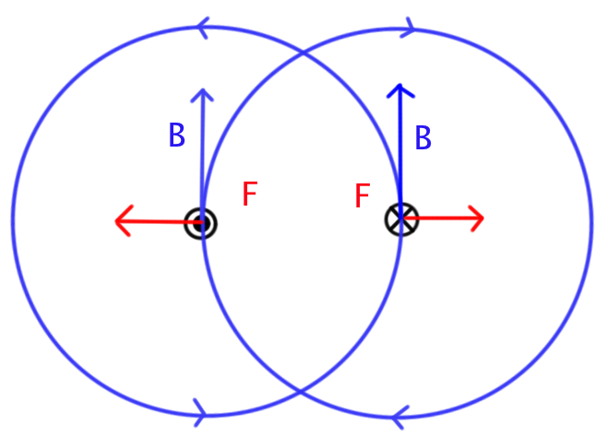
Field and Force

Slide 15
MAGNETIC FIELD OF A LOOP OF CURRENT

Slide 16
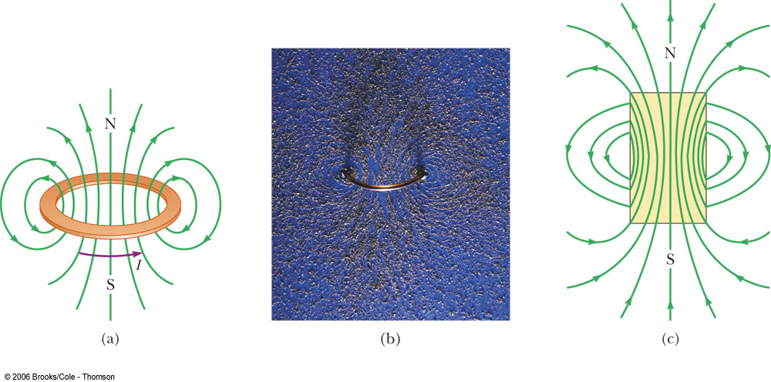
COIL AND BAR MAGNET
The magnetic field produced by a coil is almost identical to that of a bar magnet.

Slide 17
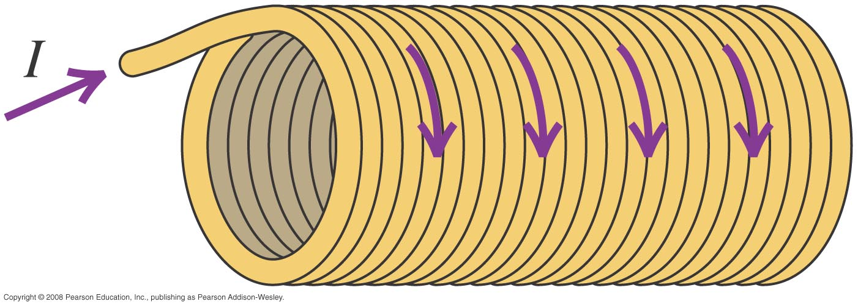
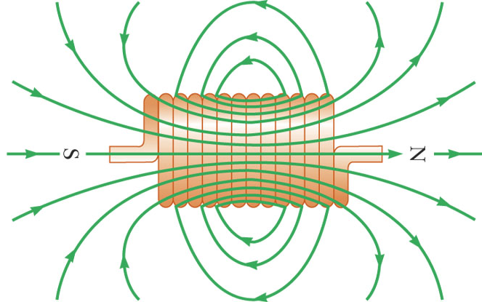
Solenoids

Slide 18
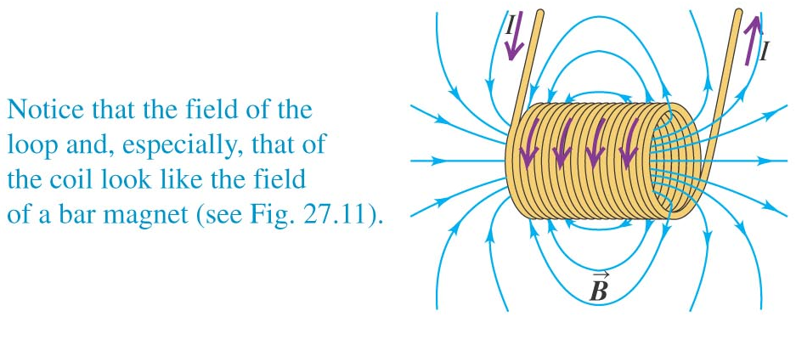
Solenoids
n: Number of turns per unit length
Unit of n: m⁻¹=turns/m

Slide 19
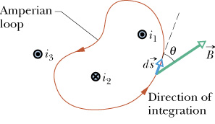
Ampere’s Law

Slide 20
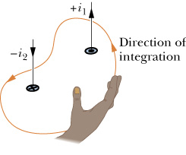
Right hand rule, again

Slide 21
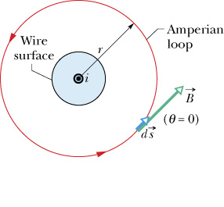
Long Straight Wire, again

Slide 22
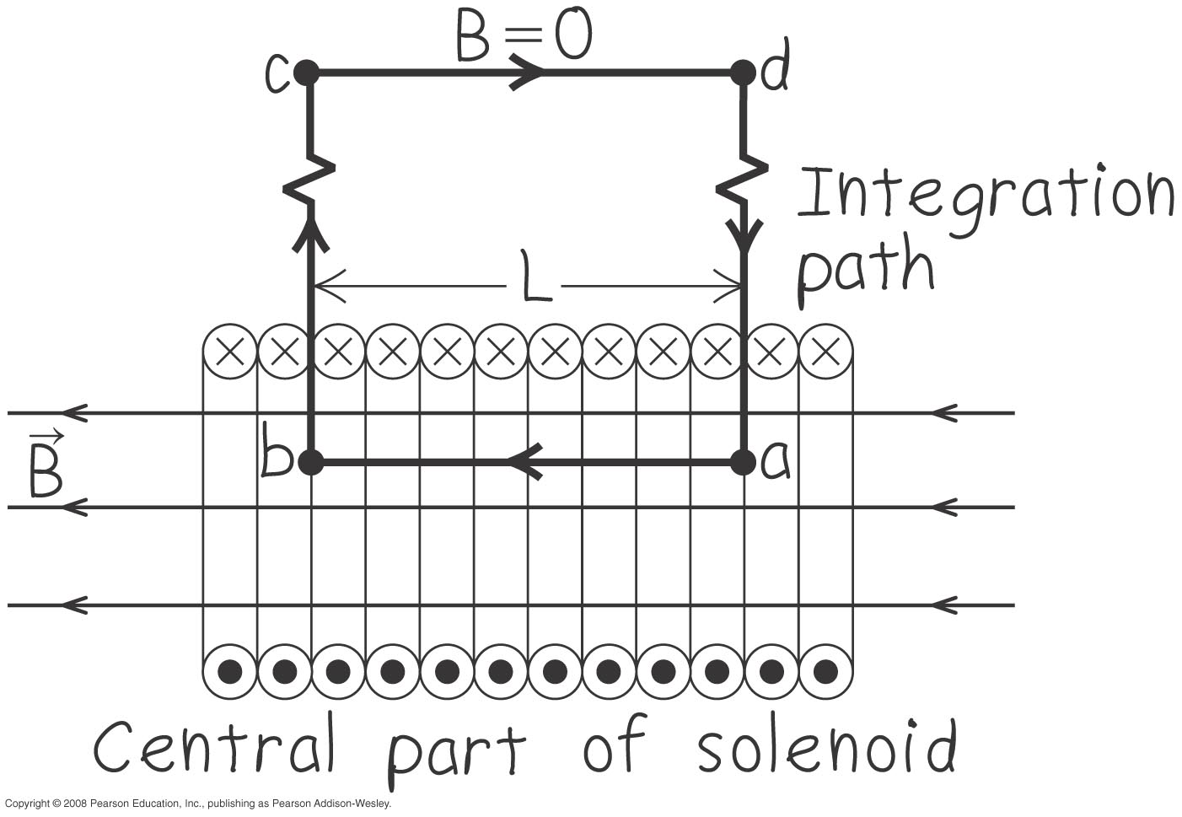
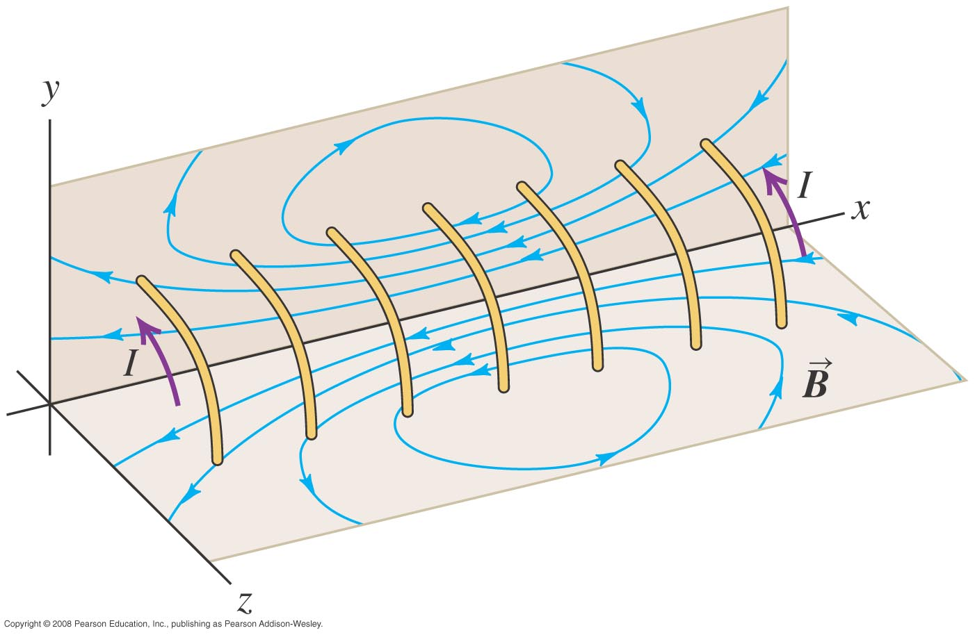
Derivation: B Field inside a Solenoid

Slide 23
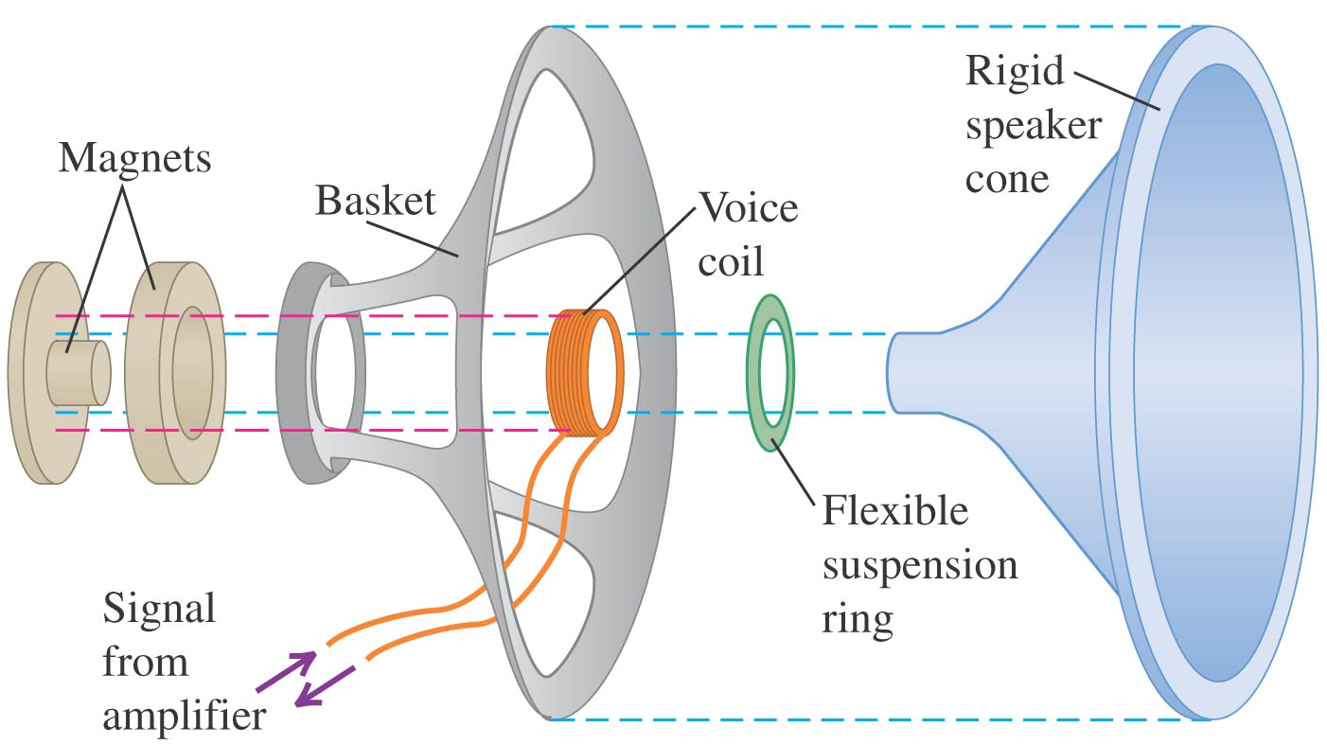
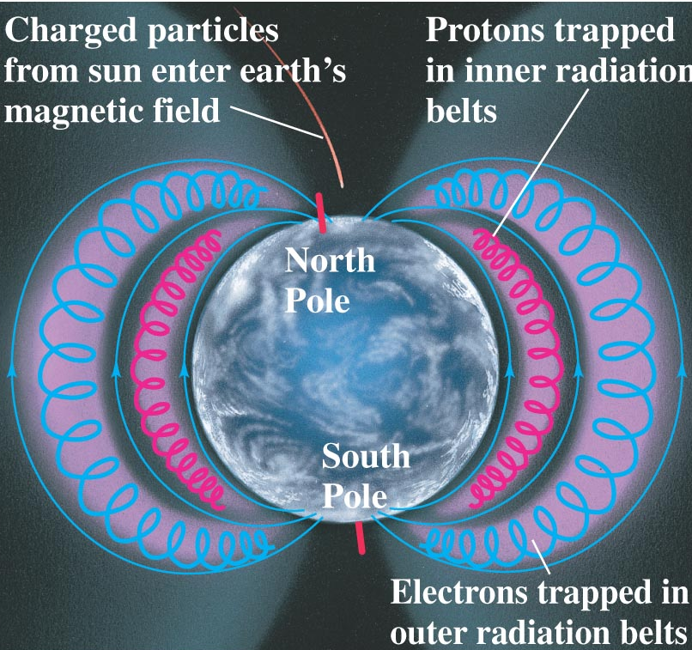
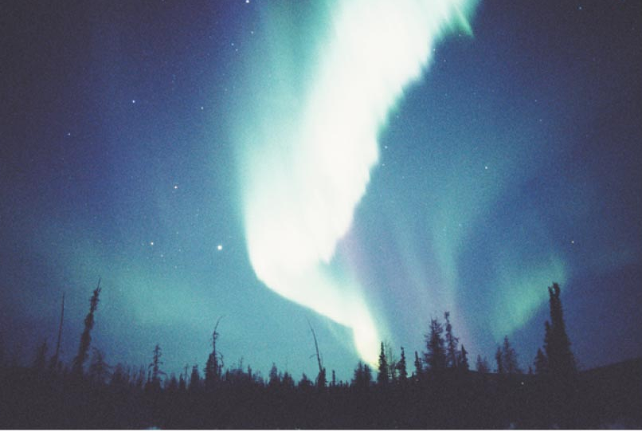
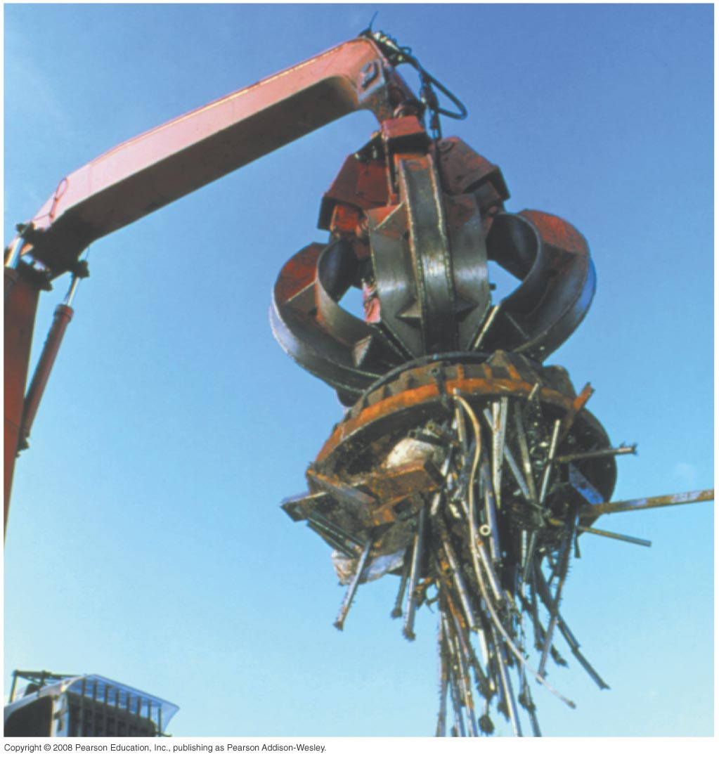
APPLICATIONS
Notes:
Aurora (northern light)

