Slide 1
CHAPTER 27
Magnetic Field and Magnetic Forces

Slide 2
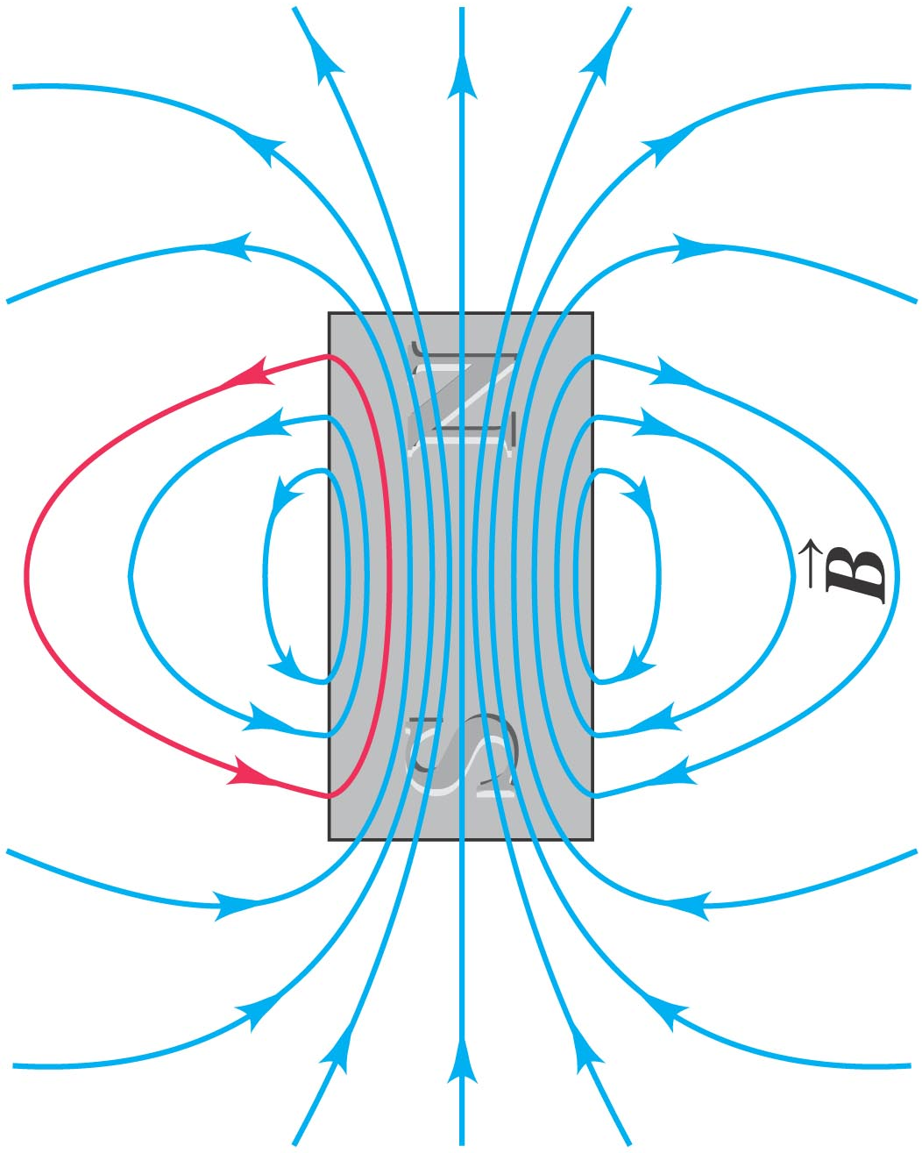
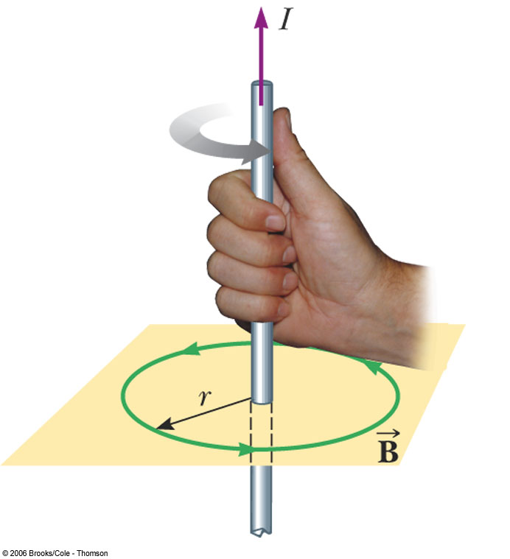
Producing a magnetic field
Permanent Magnet
Current

Slide 3
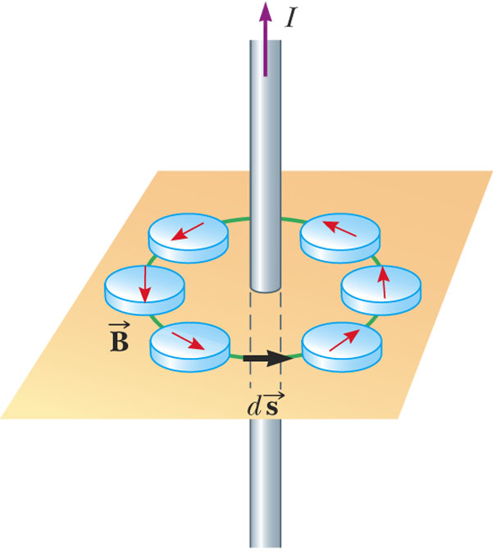
Magnetic Field Lines, Bar Magnet Example
The compass can be used to trace the field lines
The lines outside the magnet point from the North pole to the South pole

Slide 4
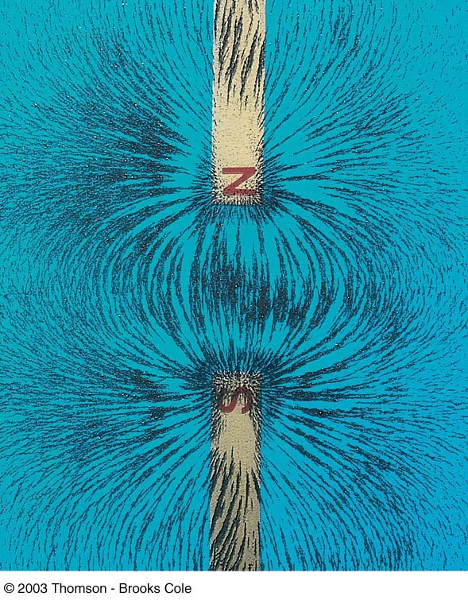
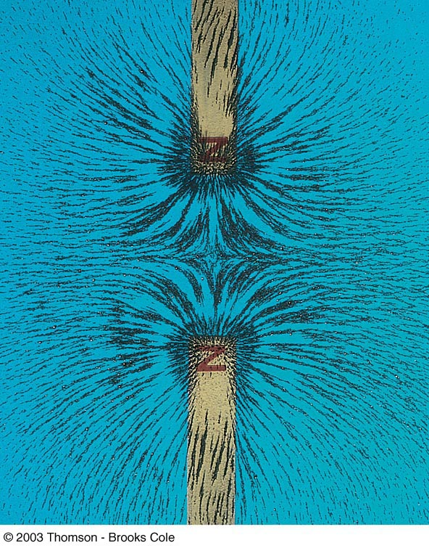
Magnetic Field Lines, Bar Magnet

Slide 5
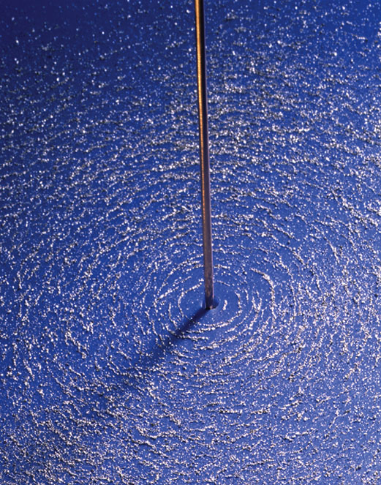
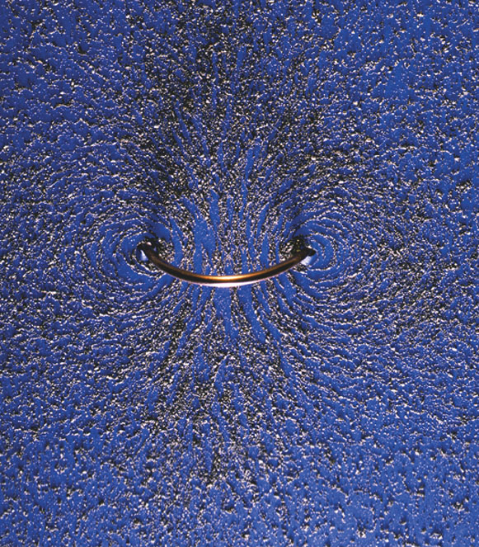
MAGNETIC FIELD LINES OF CURRENT

Slide 6
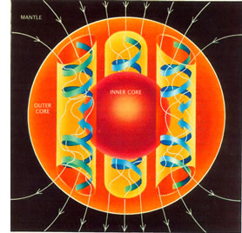
Geographic North Vs Magnetic North

Slide 7
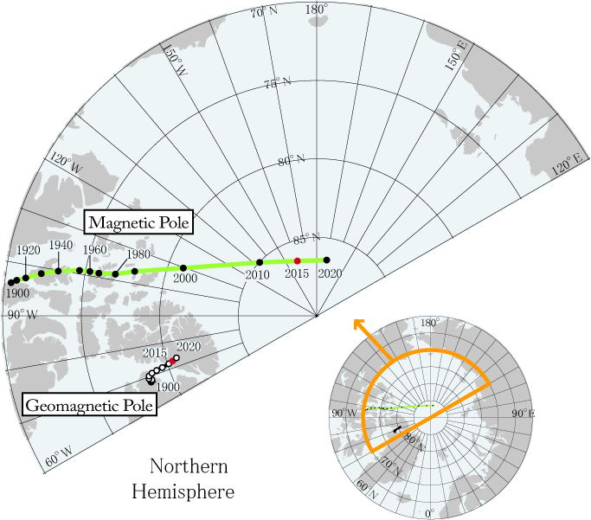
Magnetic Field B
Unit: T (Tesla)
1T=1Ns/(Cm)
Magnetic field of earth: 10⁻⁴T
(Reverses every 250 000 years)
Poles moves 30 miles per year
Non SI unit: Gauss (G)
1 G = 10⁻⁴T

Slide 8
Force on a charge

Slide 9
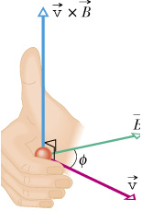
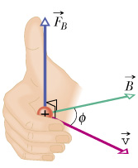
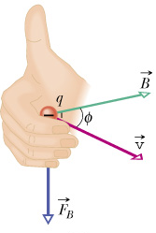
DIRECTION OF MAGNETIC FORCE
q>0
q<0

Slide 10
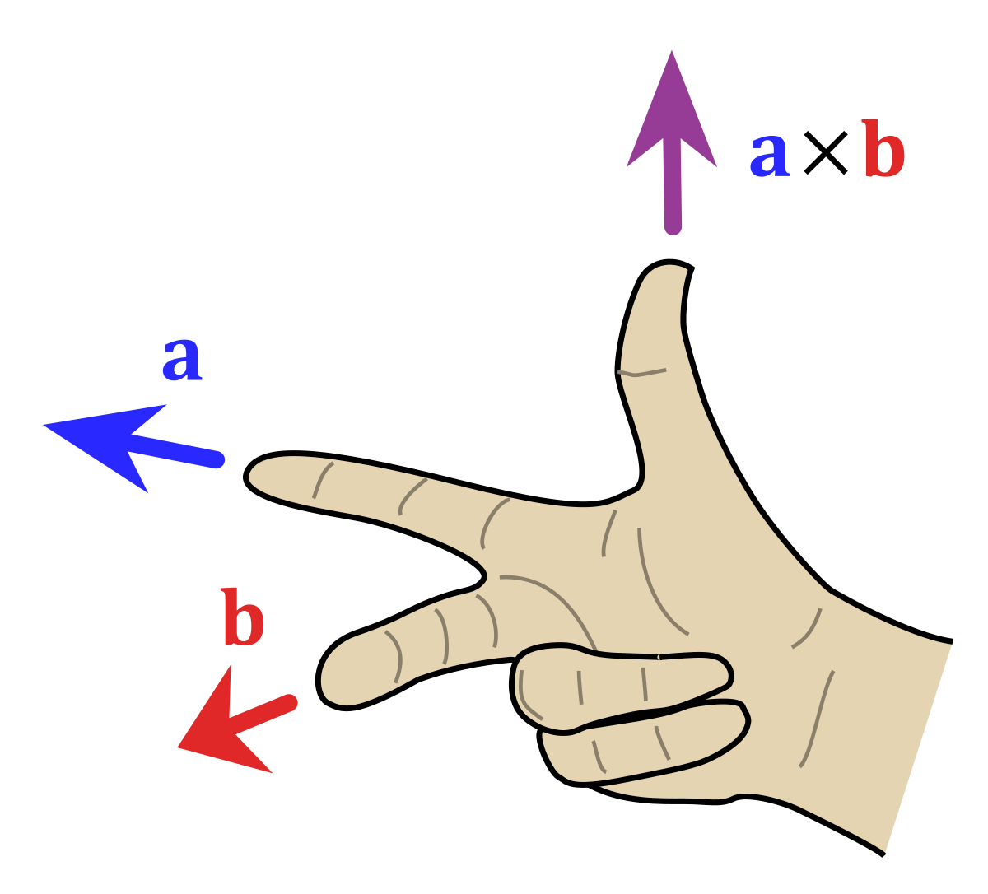
Alternative Right Hand Rule
Reminder to multiply q in the end!

Slide 11
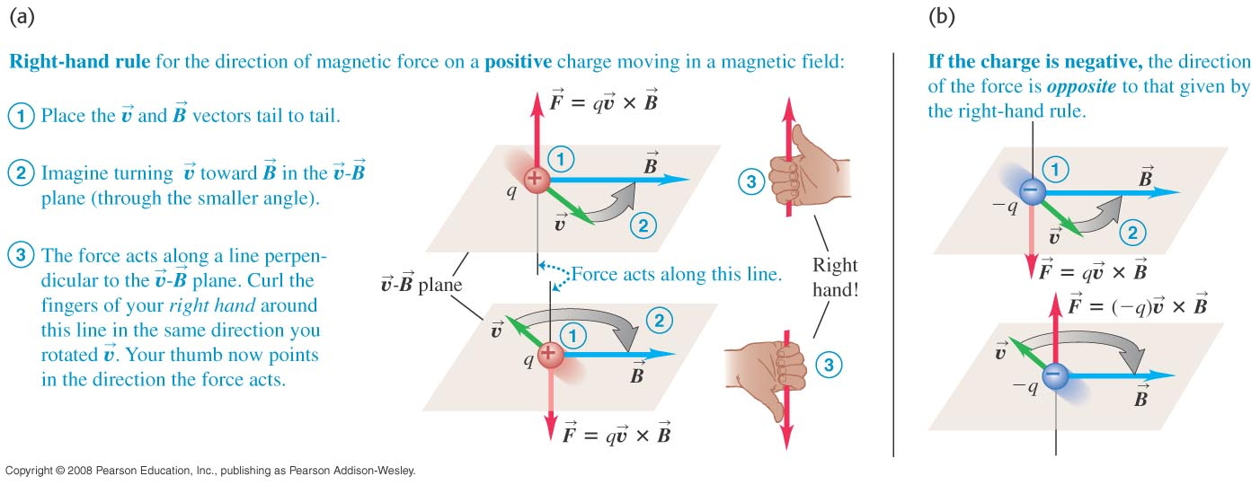
RIGHT HAND RULE

Slide 12
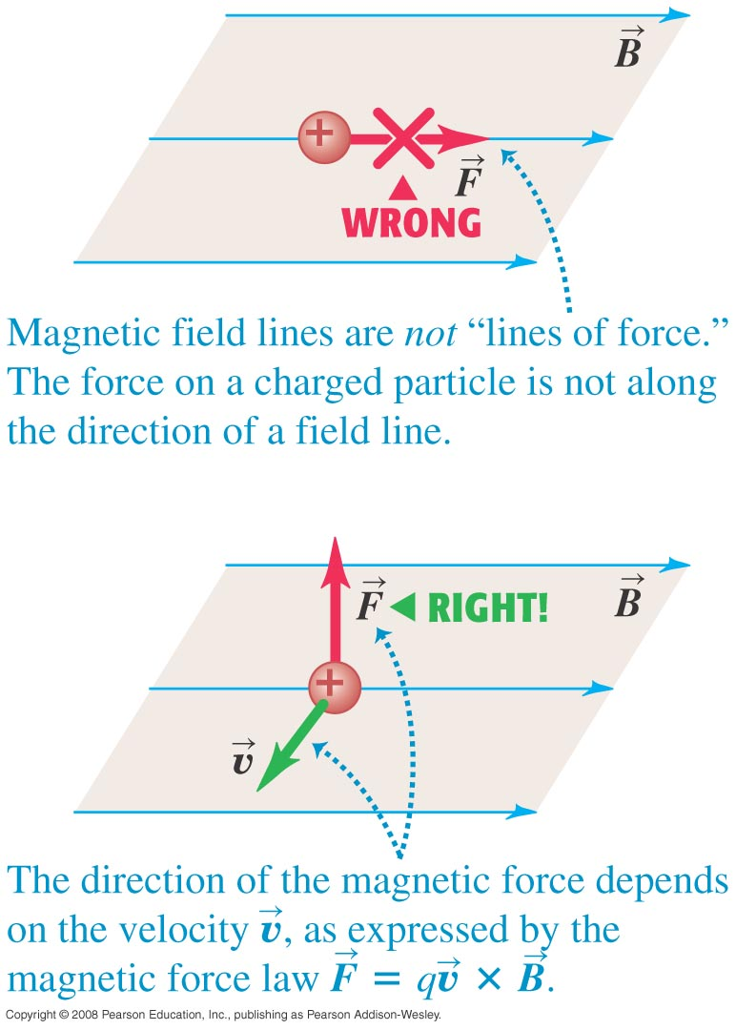
EXAMPLES OF DIRECTION OF MAGNETIC FORCE

Slide 13
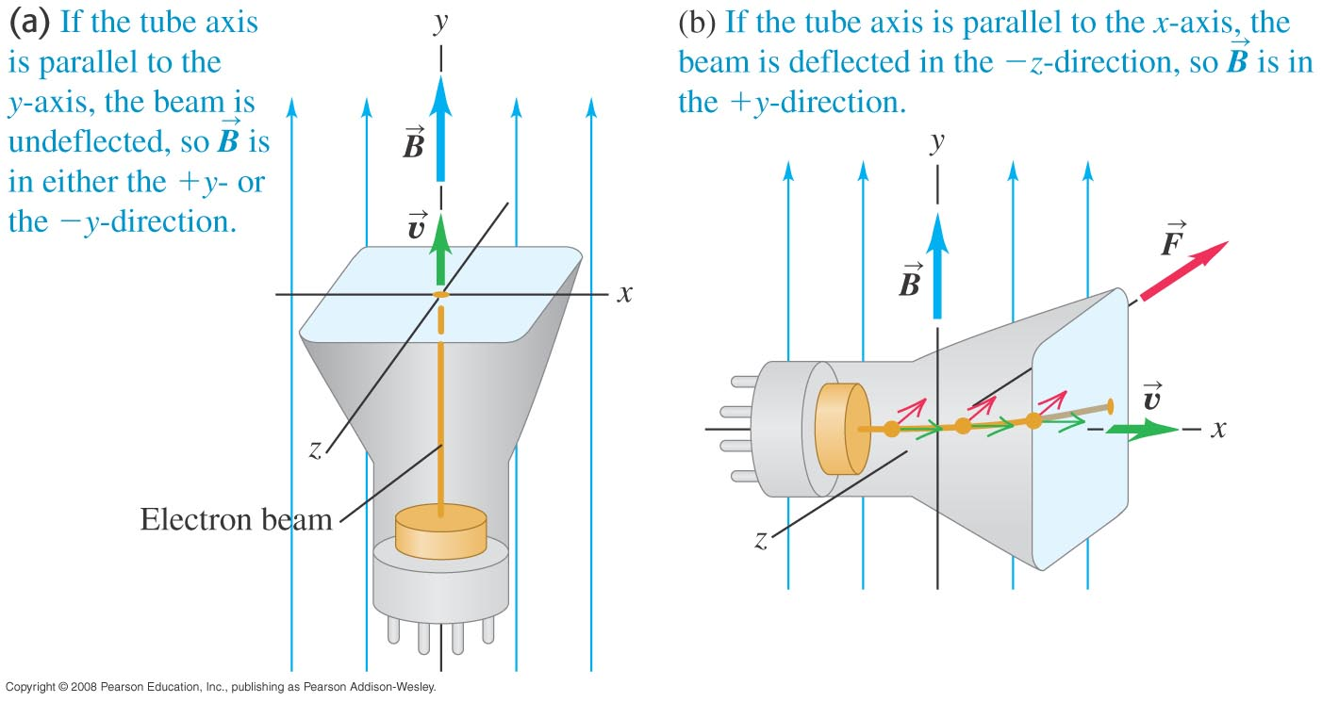
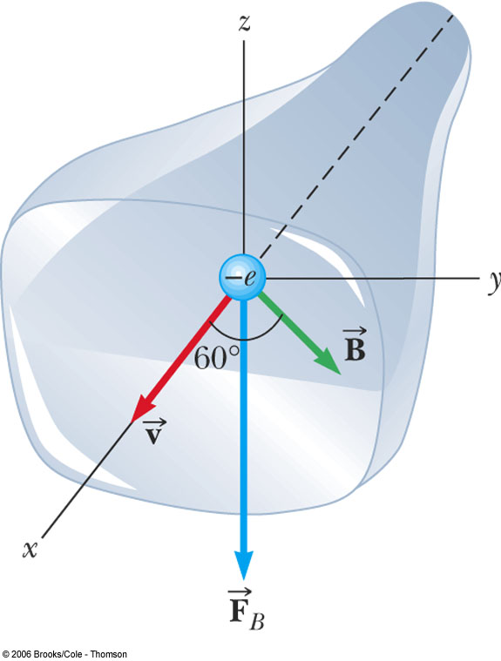
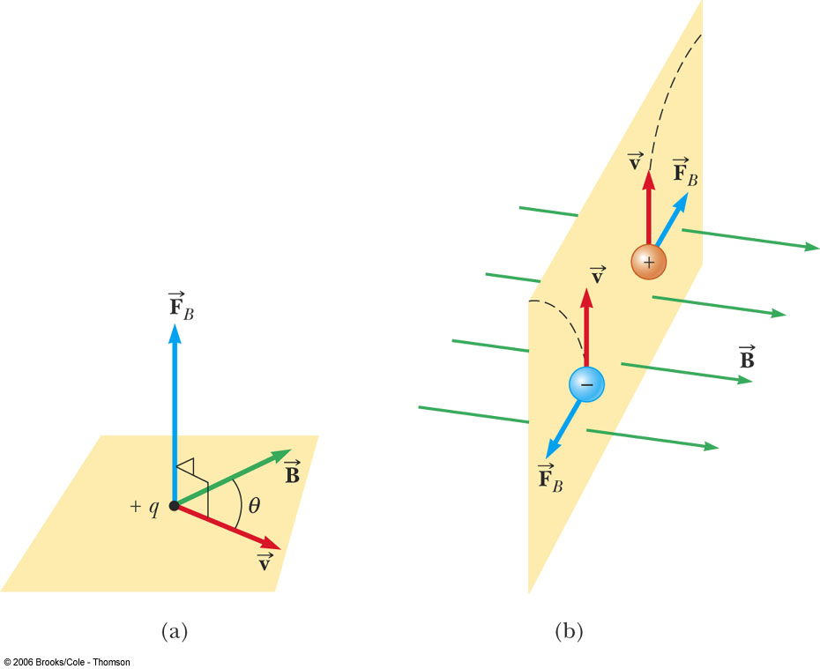
EXAMPLES OF DIRECTION OF MAGNETIC FORCE

Slide 14
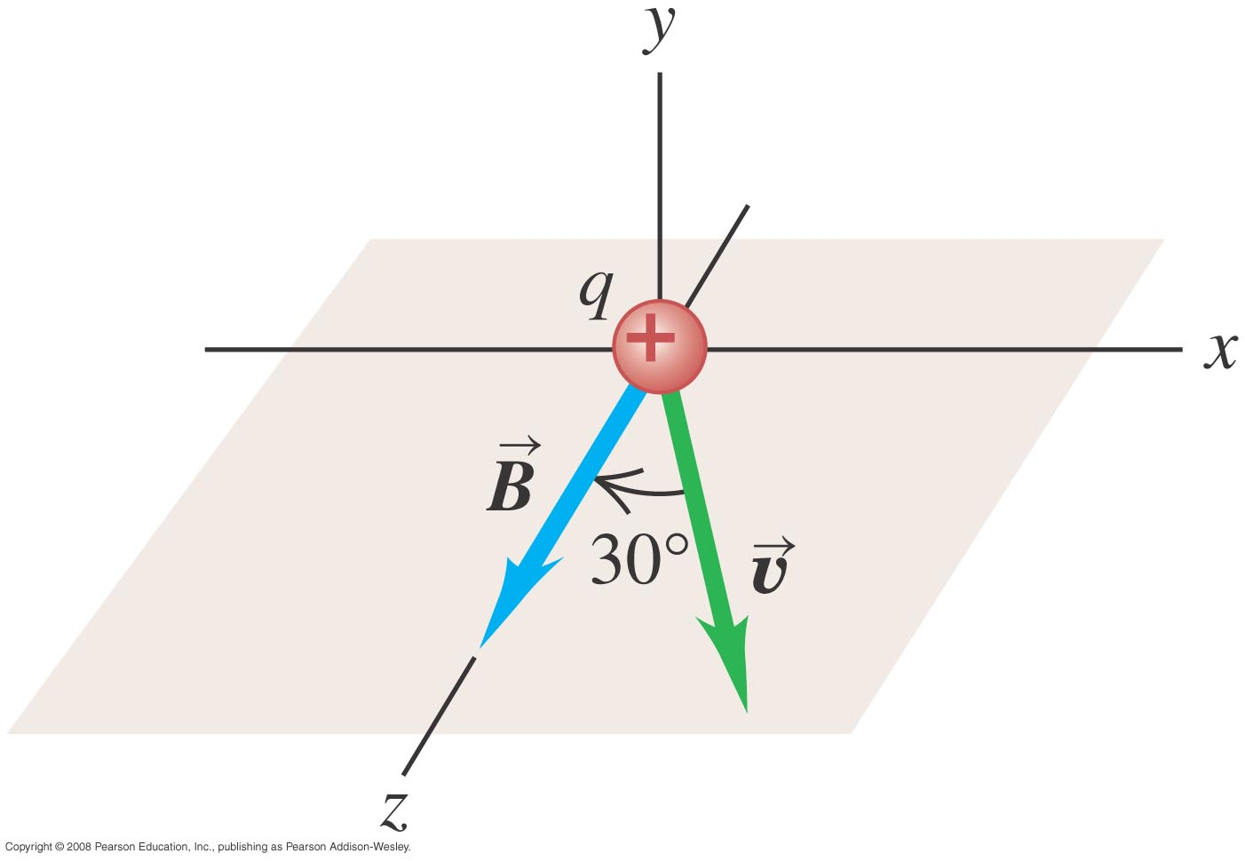
MAGNETIC FORCE ON A PROTON

Slide 15
Vector cross product

Slide 16
Cross product example

Slide 17
Vector Cross Product

Slide 18
Example

Slide 19
Another method

Slide 20
In and out of the plane
Symbols for B field going in/out of paper
Going into the paper
Going out of the paper

Slide 21
Example
v
B

Slide 22
Example
v
What if ϕ is not 90º ?
30º
B

Slide 23
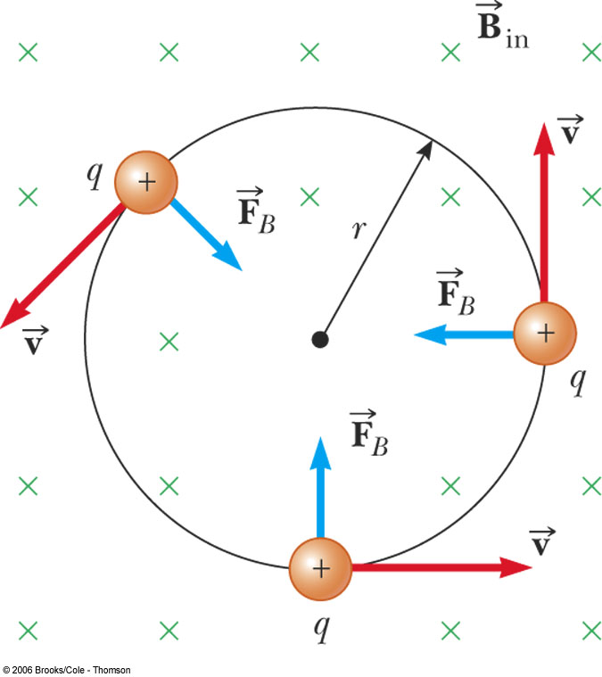
CIRCULAR MOTION IN A MAGNETIC FIELD
What happens when a positively charged particle enters with velocity v into a region with B field pointing down (into the screen).

Slide 24
Bending of an Electron Beam

Slide 25
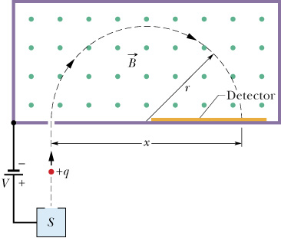
Measuring charge to mass ratio q/m
Measuring r gives you q/m.
What if the charge is negative?

Slide 26
A Better Way to get q/m
The velocity v is often difficult to measure, but we can figure out v using the potential difference V.

Slide 27
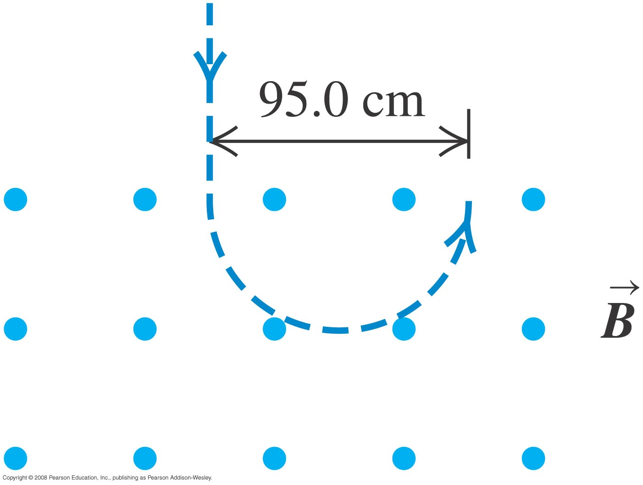
FIND THE PARTICLE VELOCITY

Slide 28
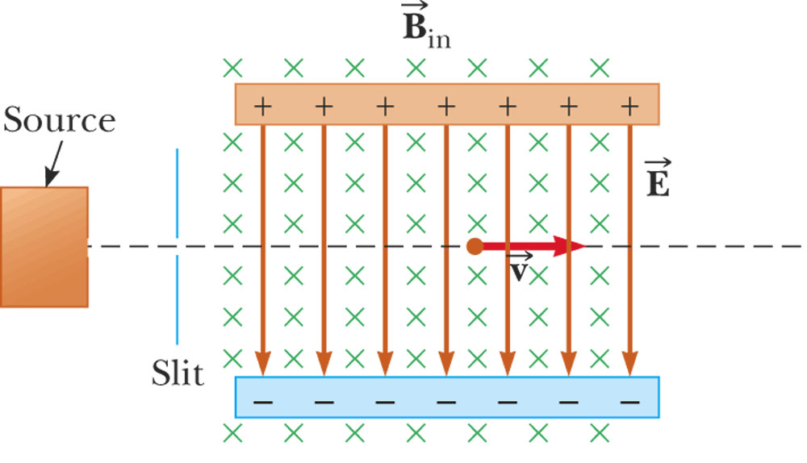
Crossed fields

Slide 29
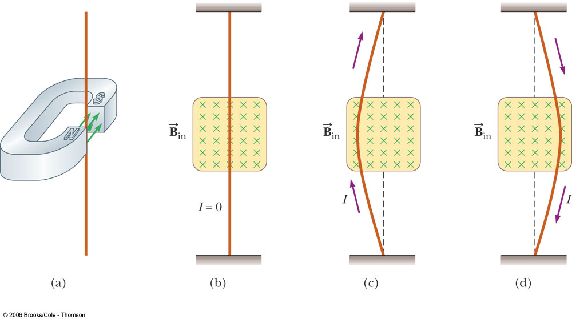
Force on current
Does it matter whether the charge carriers are positive or negative?

Slide 30
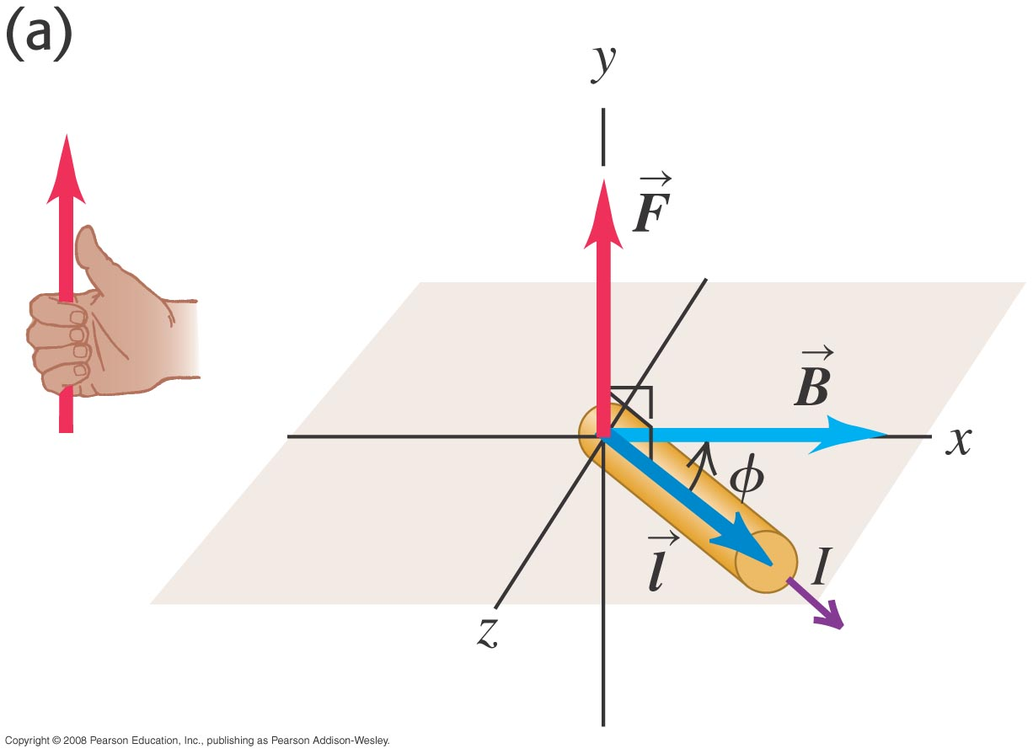
EXAMPLES OF MAGNETIC FORCE ON A WIRE

Slide 31
Derivation: Magnetic Force on a Wire
Notes:
Skip Spring 2016

Slide 32
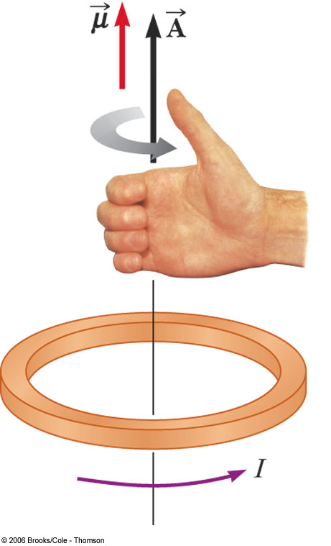
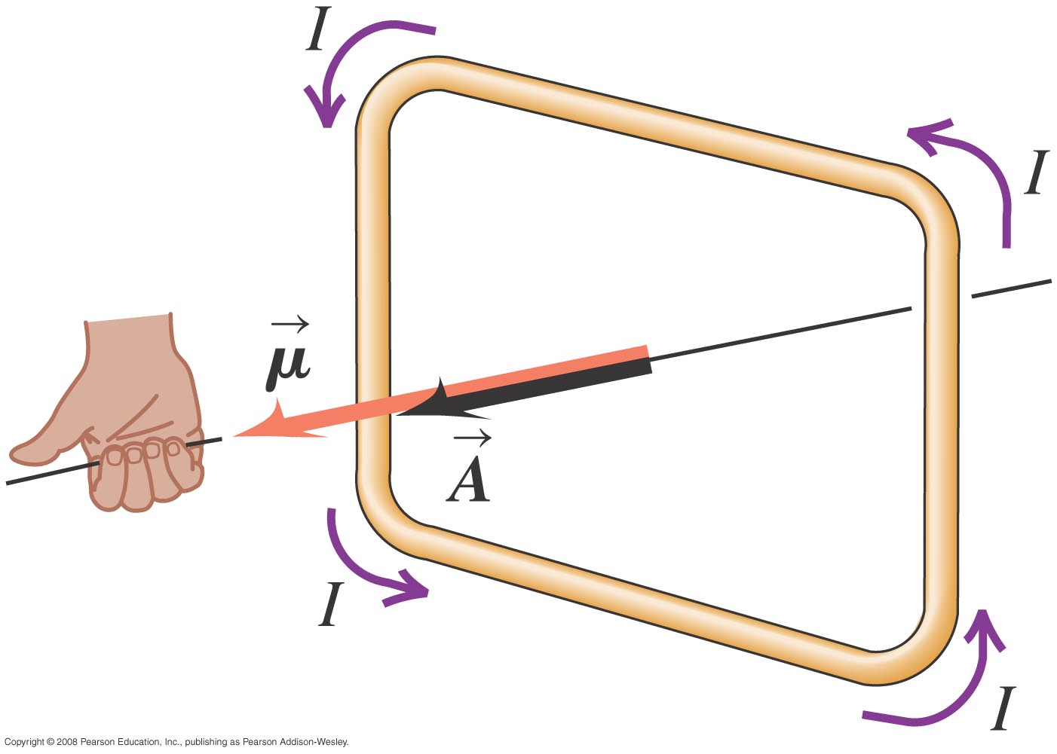
Magnetic Dipole Moment
A loop of current carries magnetic dipole moment (or magnetic moment):
SI unit: Am²
The direction of the area vector is determined by the right hand rule.

Slide 33
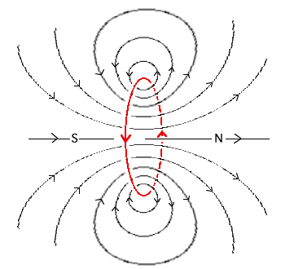
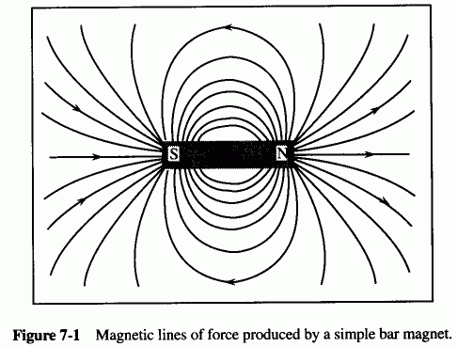
Dipole is a source of B Field
The B field generated by a magnetic dipole is roughly the same as that of a bar magnet.
μ

Slide 34
Example
Find the magnetic dipole of a loop of wire of radius 10cm carrying a current of 3A.
What if the wire has N=30 loops?

Slide 35
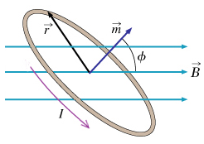
Torque on a dipole
μ and B tends to align

Slide 36
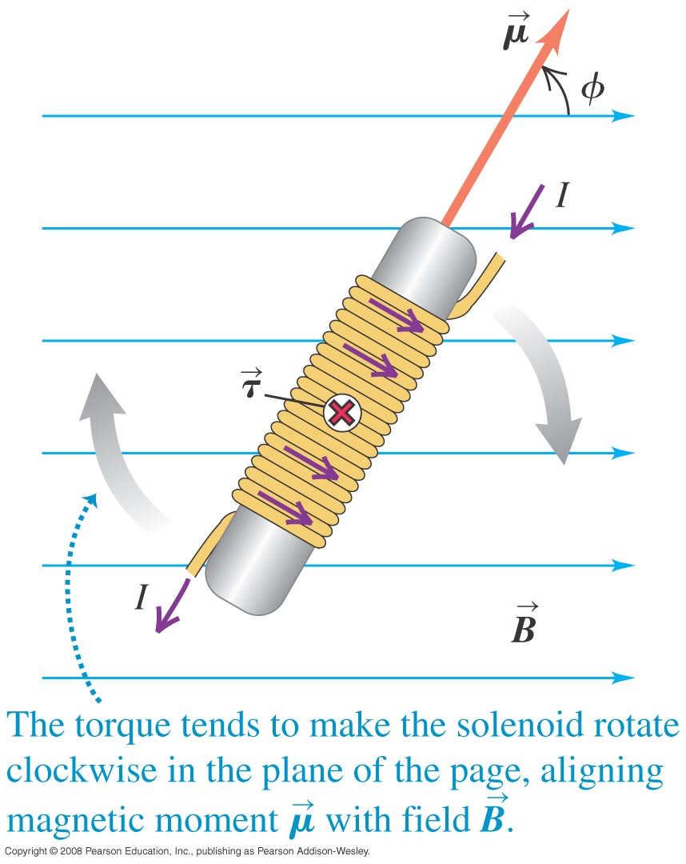
Example: Torque on a Dipole

Slide 37
Potential Energy of a Dipole
μ and B tends to align in order to attain the lowest energy.

