Slide 1
Direct Current Circuits
Chapter 26

Slide 2
Reminder: Ohm’s Law

Slide 3
Pumping Charges

Slide 4
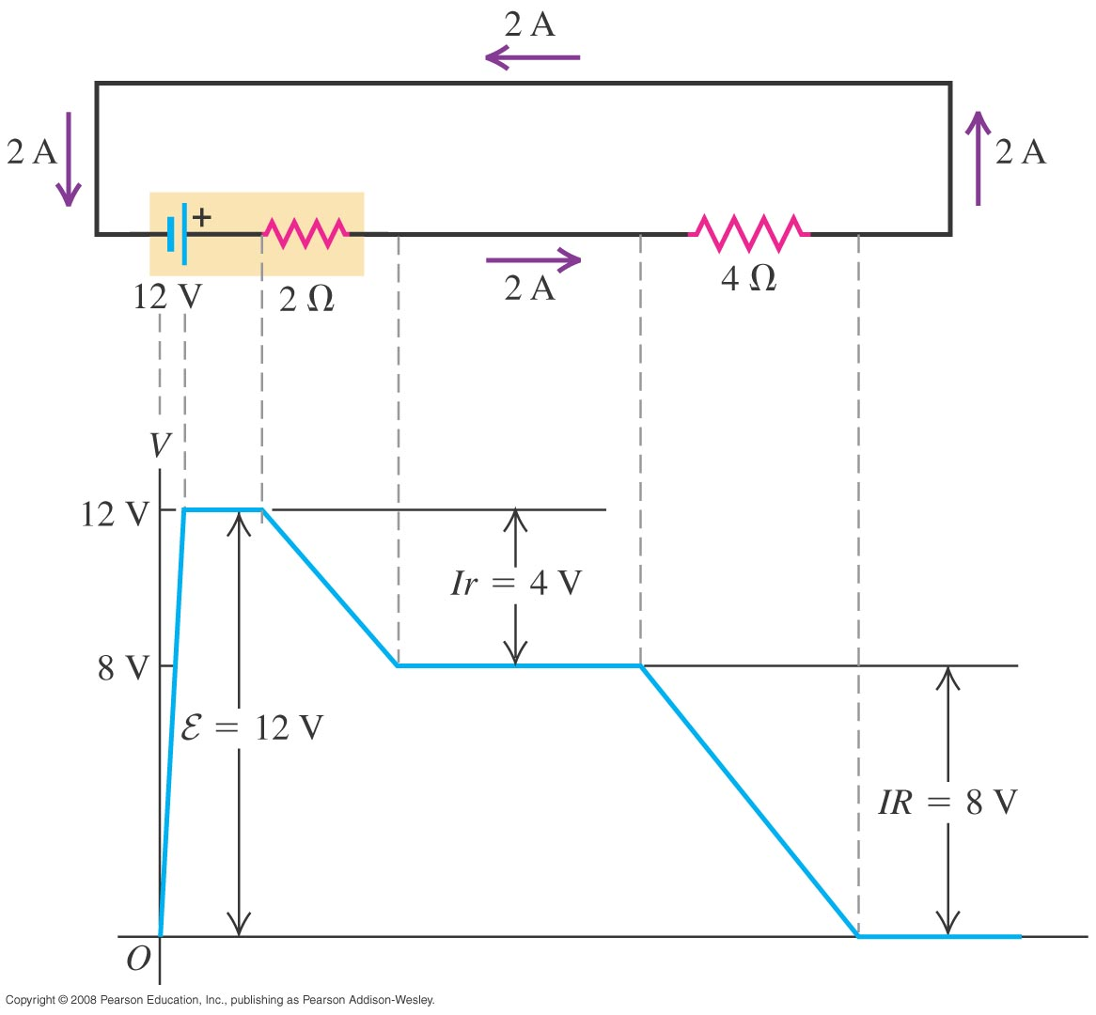
Kirchhoff’s Loop rule

Slide 5
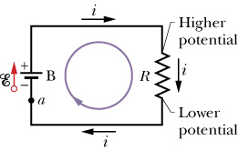
Ideal voltage source
In this class, unless stated otherwise, we often assume voltage source is ideal, i.e., battery with no internal resistance (r =0).

Slide 6
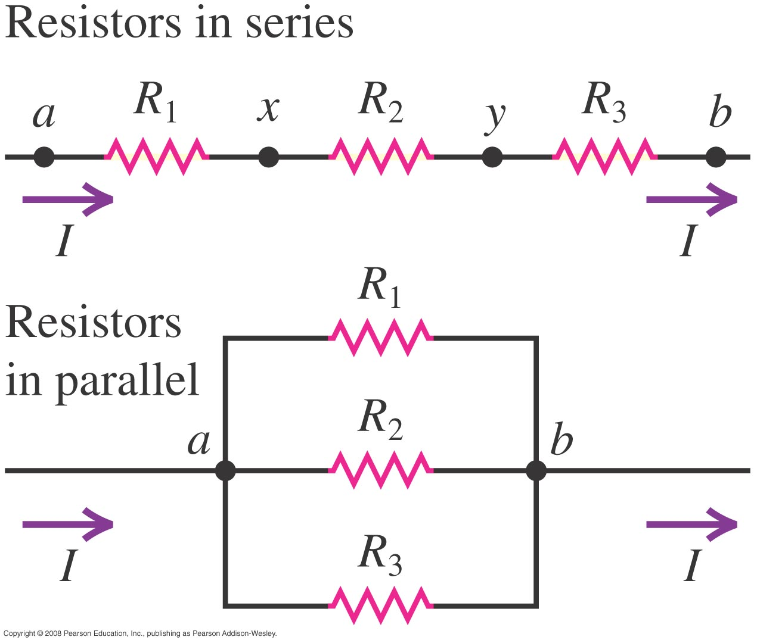
Series and Parallel

Slide 7
Capacitance & Resistance
Series
Parallel

Slide 8
Resistance in series
Resistors in series all have the same current, but not the same voltage.

Slide 9
Resistance in parallel
Each branch in parallel has the same potential difference, but not the same current

Slide 10
Summary

Slide 11
Circuit Reduction – Example 1

Slide 12
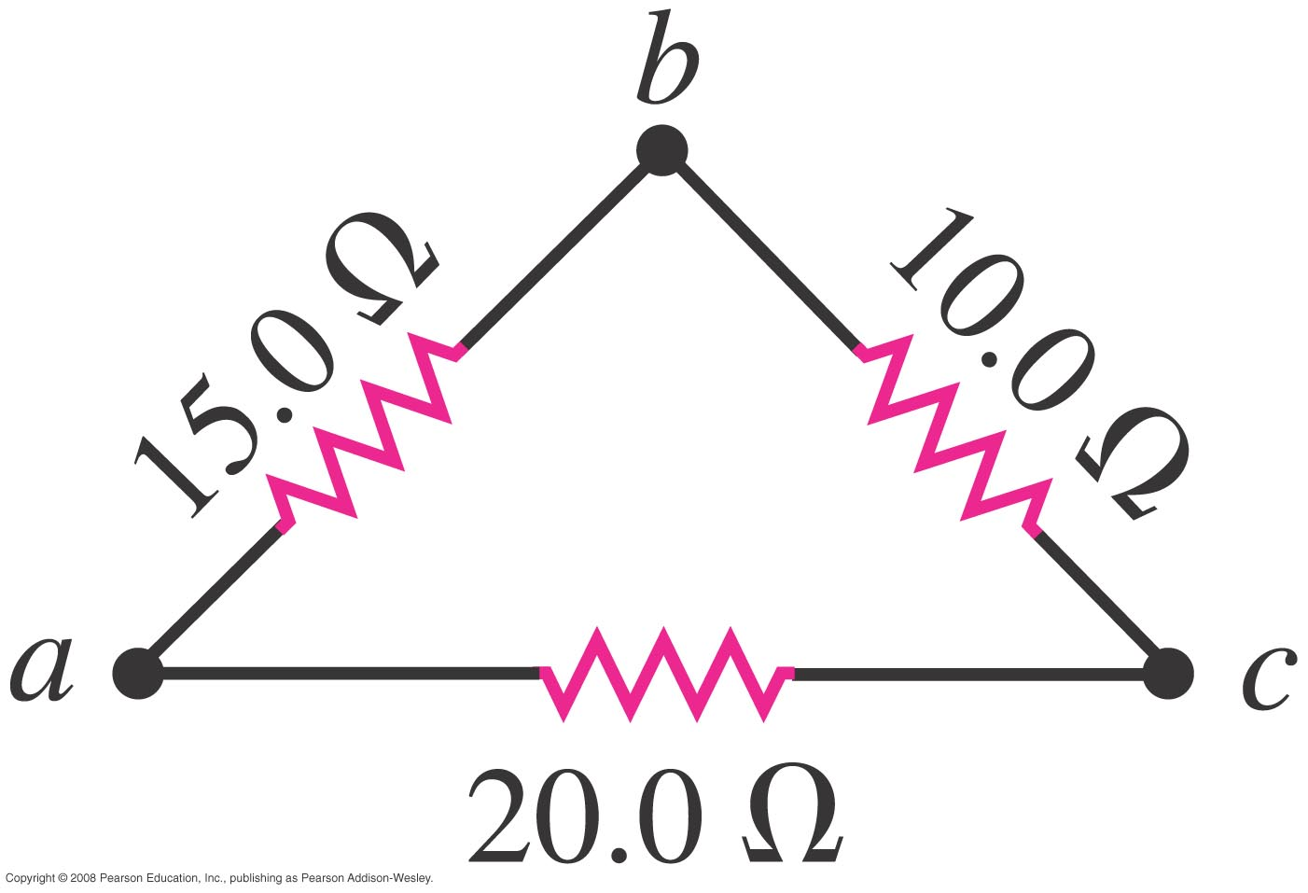
Circuit Reduction – Example 2

Slide 13
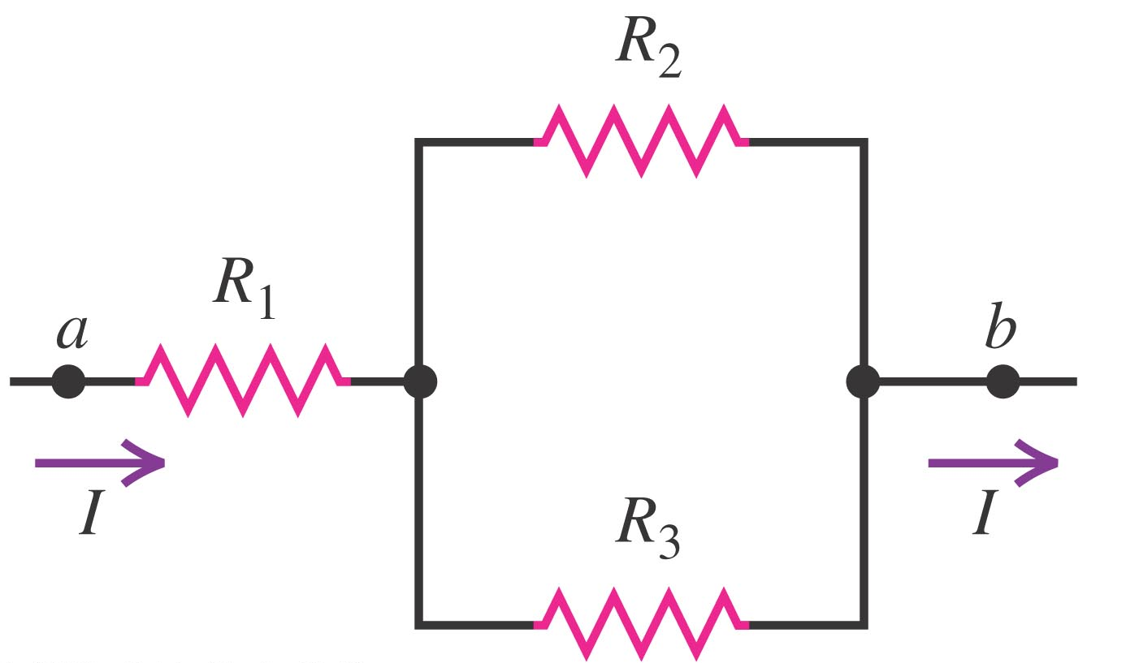
When you apply Ohm’s Law
You need to identify TWO points every time you apply Ohm’s Law!

Slide 14
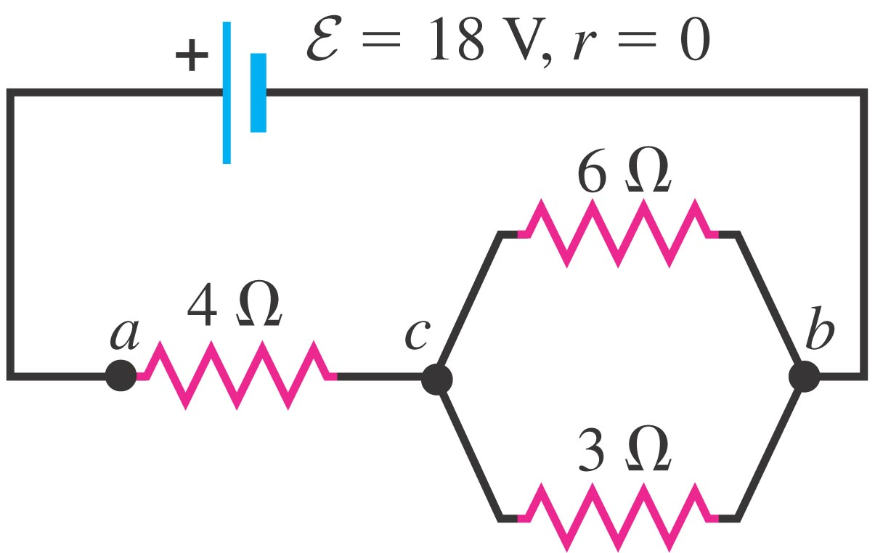
Find the current though each resistor

Slide 15
Find the current though each resistor

Slide 16
Find the current though each resistor

Slide 17
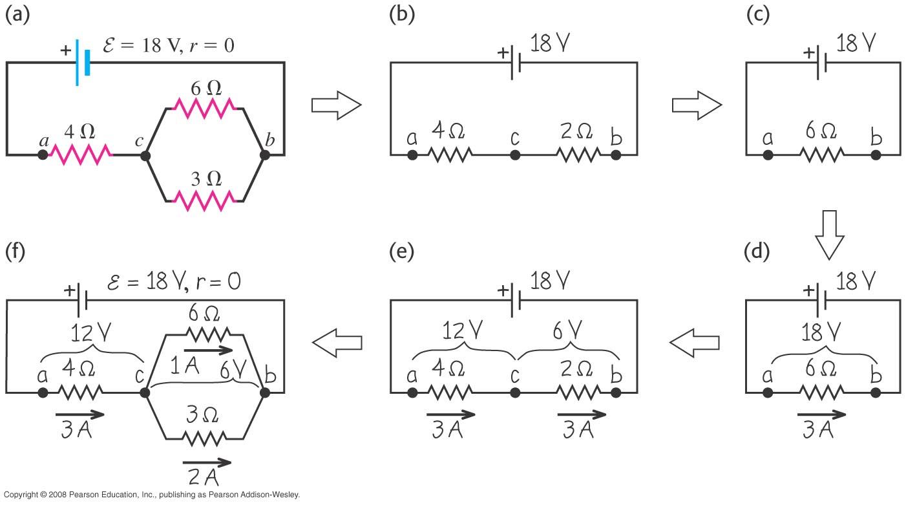
Solution Summary

Slide 18
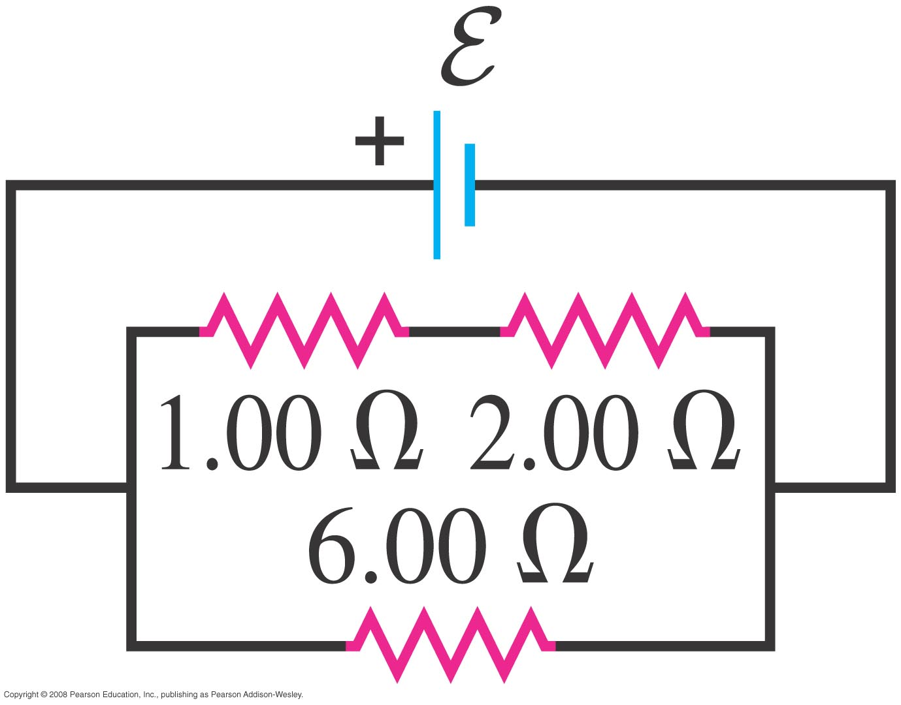
Find the current though each resistor
=12V
c
d
e
b
a
f
g

Slide 19
RC Circuits (Charging)

Slide 20
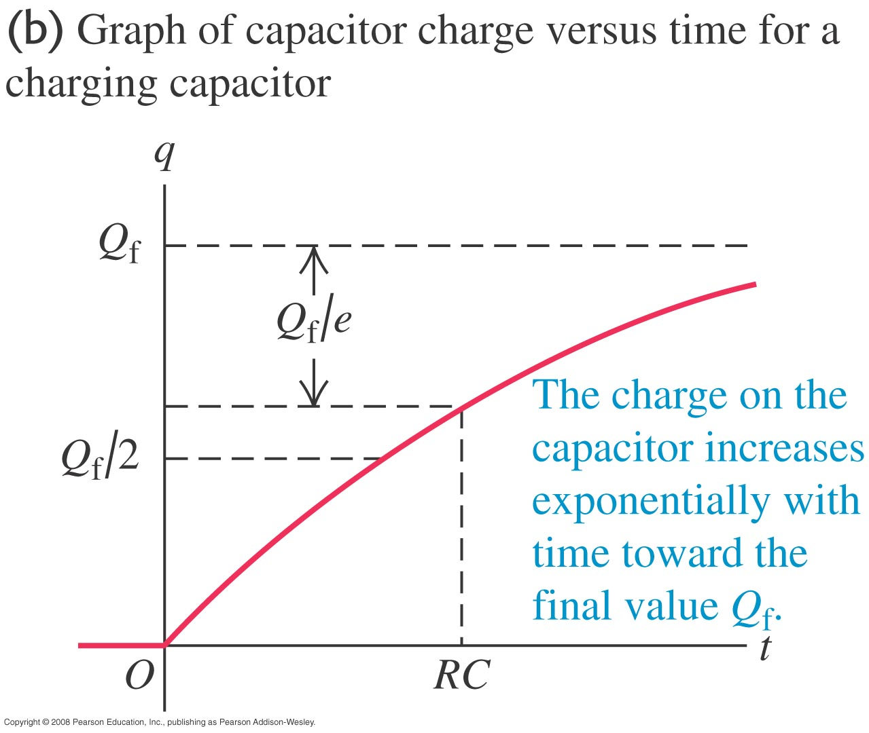
RC Circuits (Charging)
Does it make sense?

Slide 21
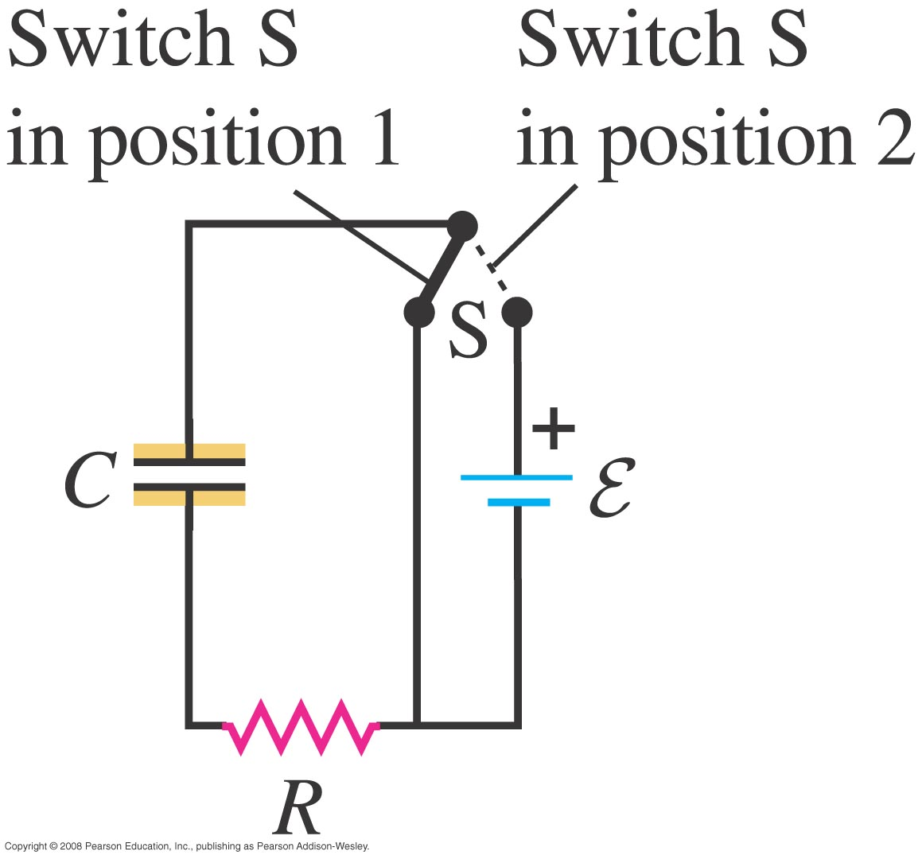
RC Circuits (Discharging)

Slide 22
Summary

Slide 23
Current and Voltage

Slide 24
Example

Slide 25
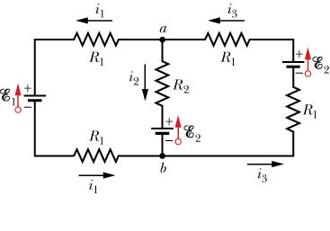
Multi-loop Circuit
Go around each loop (Kirchhoff)

Slide 26
Solving the equations
What’s with the negative sign?
It just means the current i₂ flows in the opposite direction to what was indicated in the diagram.

Slide 27
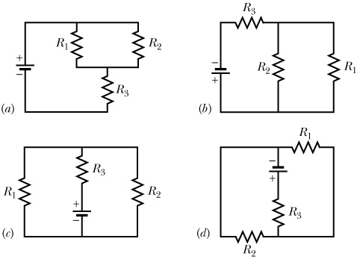
One circuit, many diagrams

