Slide 1
Current, Resistance, and Electromotive Force
Chapter 25

Slide 2
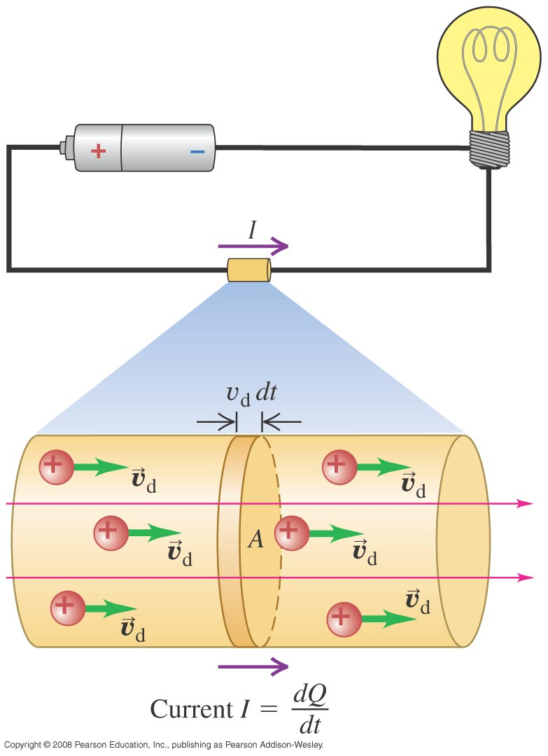
Current
Current = Rate of flow of charge
Unit: A (Ampere)
1 A = 1C/s
Current flows from high potential to low potential

Slide 3
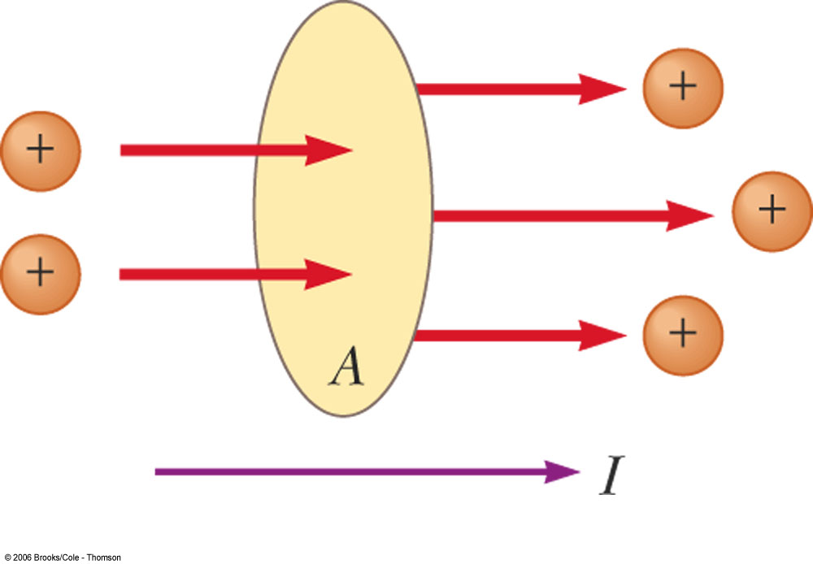
Total Amount of Charge
Suppose a wire carries current I. Find the total charge passing through the wire in time t.

Slide 4
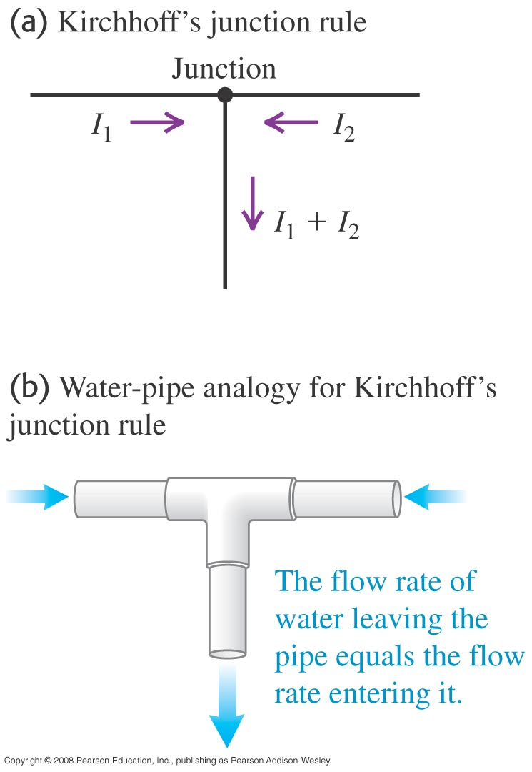
Conservation of charge (Kirchhoff’s junction rule)
Arrows: Directions of POSITIVE charge flow
We now know that current (in metals) is in fact caused by negatively charged electrons flowing in the opposite direction.

Slide 5
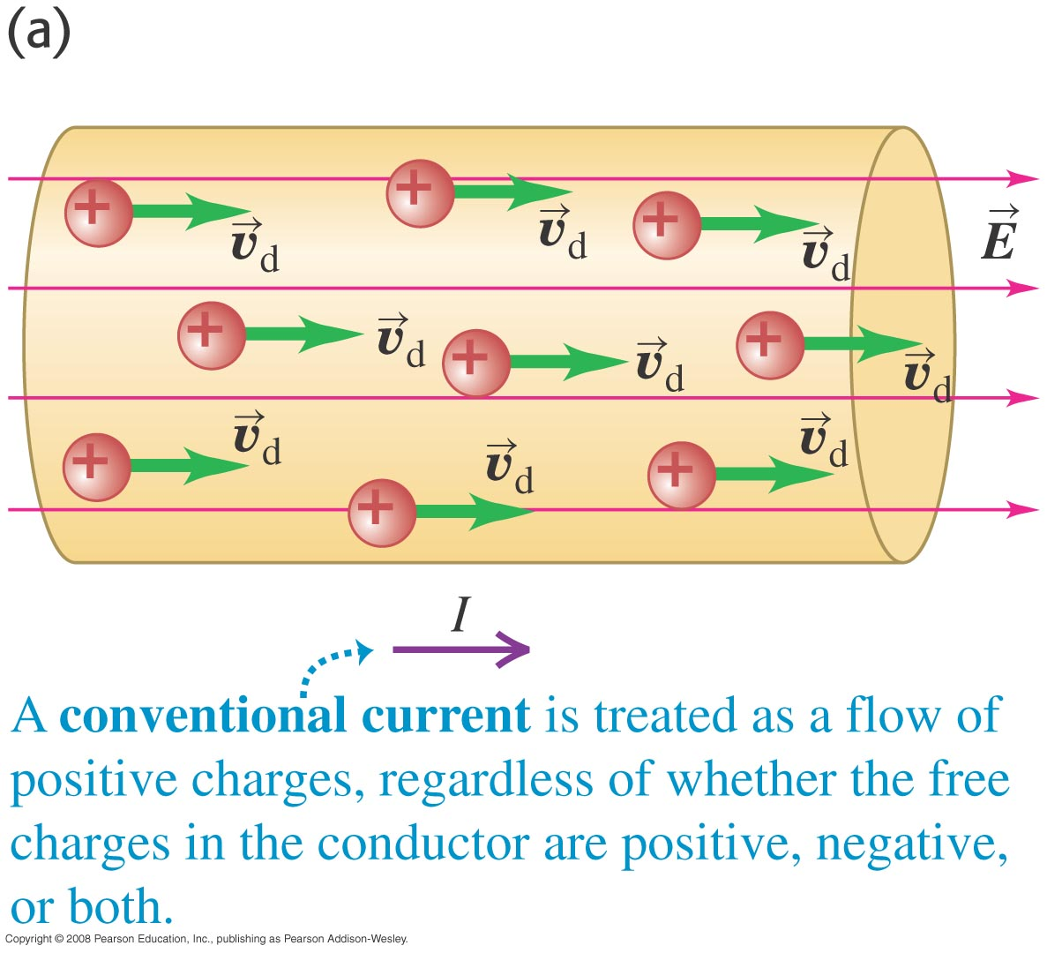
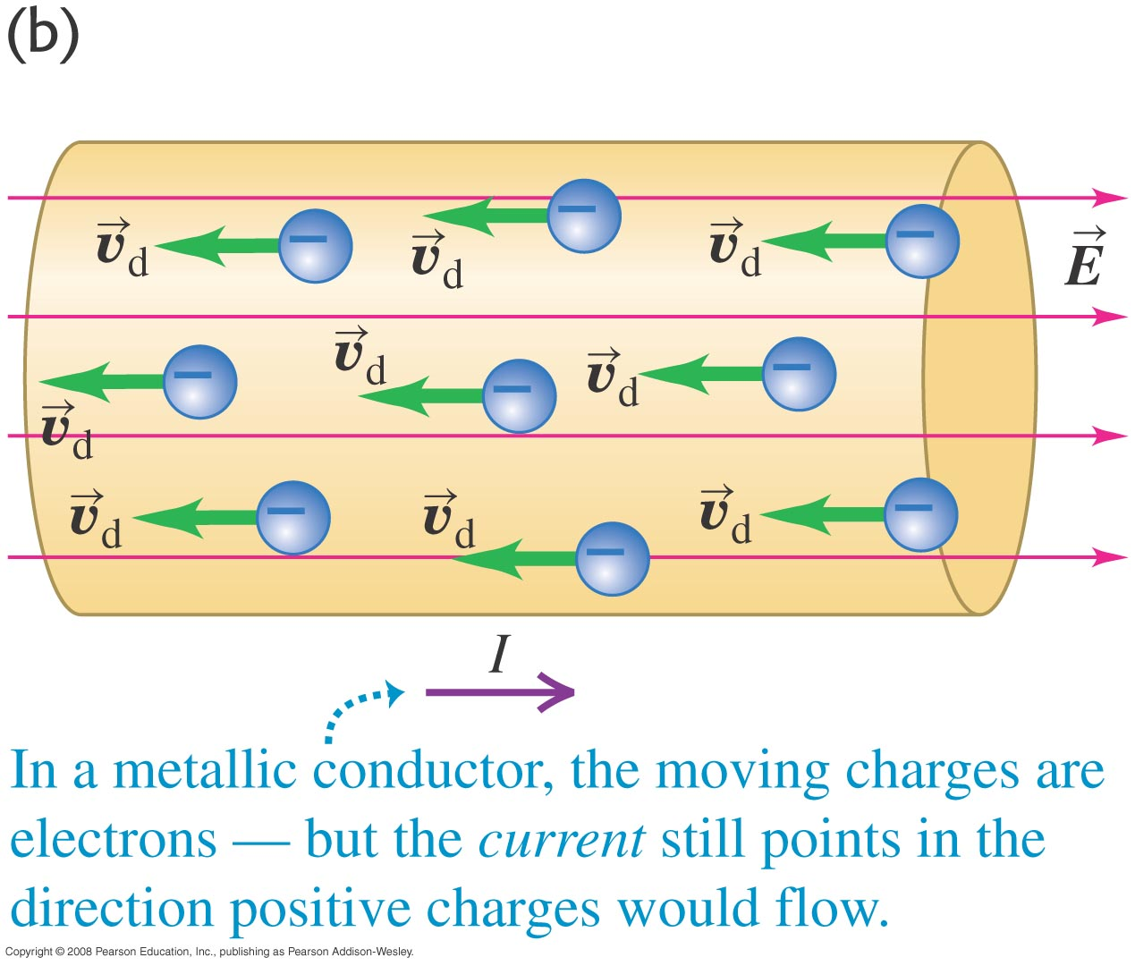
Positive or negative charge carriers

Slide 6
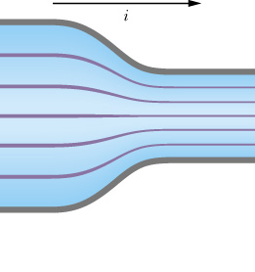
Current Density
Current Density: Current per unit area
Unit: A/m²
a
b

Slide 7
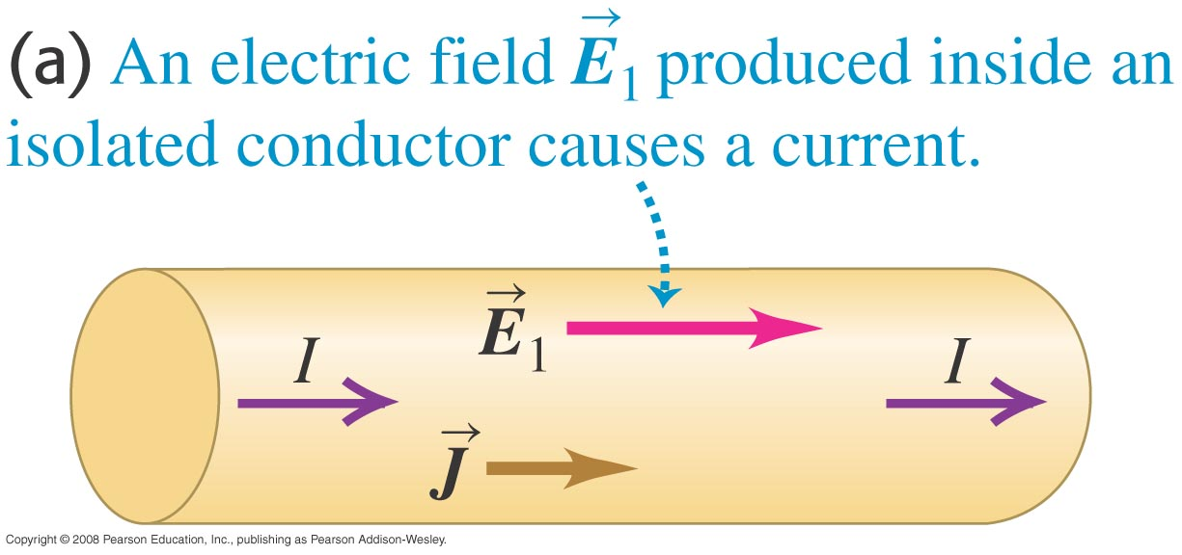
Direction
Left or Right?
I
J
E
Right
Right
Right

Slide 8
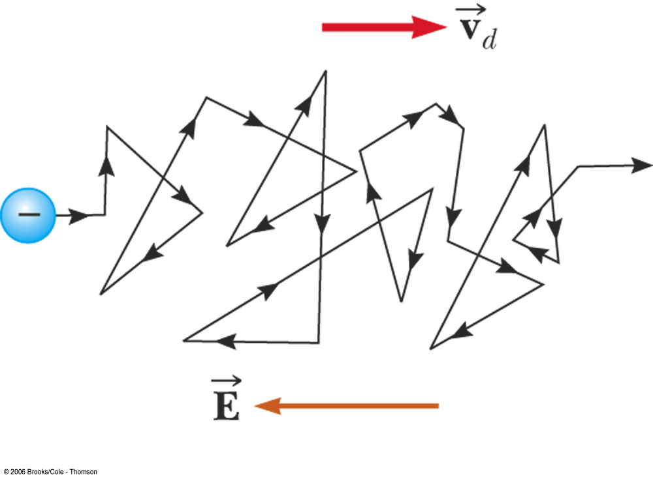
Drift Velocity
Closing time at the bar
Drift velocity: v_{d}

Slide 9
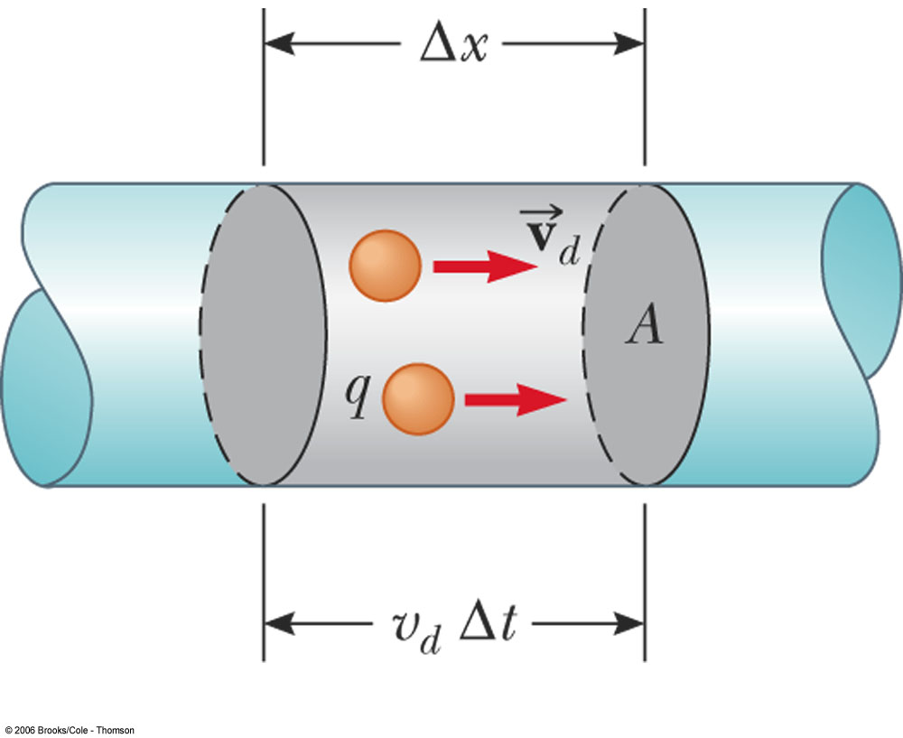
Derivation of Drift Velocity

Slide 10
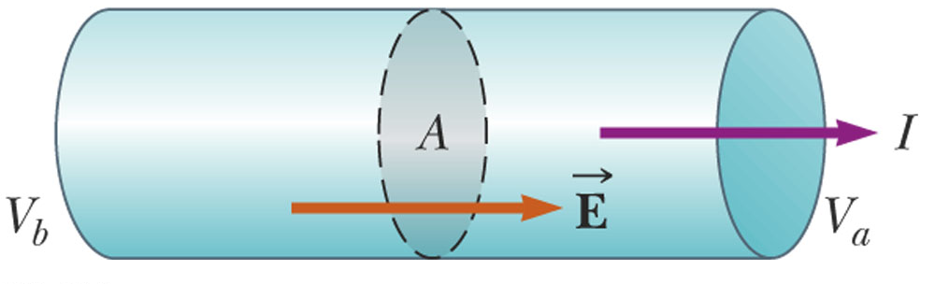
Find the drift velocity
Given n=8.49 × 10²⁸ m⁻³ for copper, what is the drift velocity of electrons in a copper wire with radius r=900μm and I =17 mA?

Slide 11
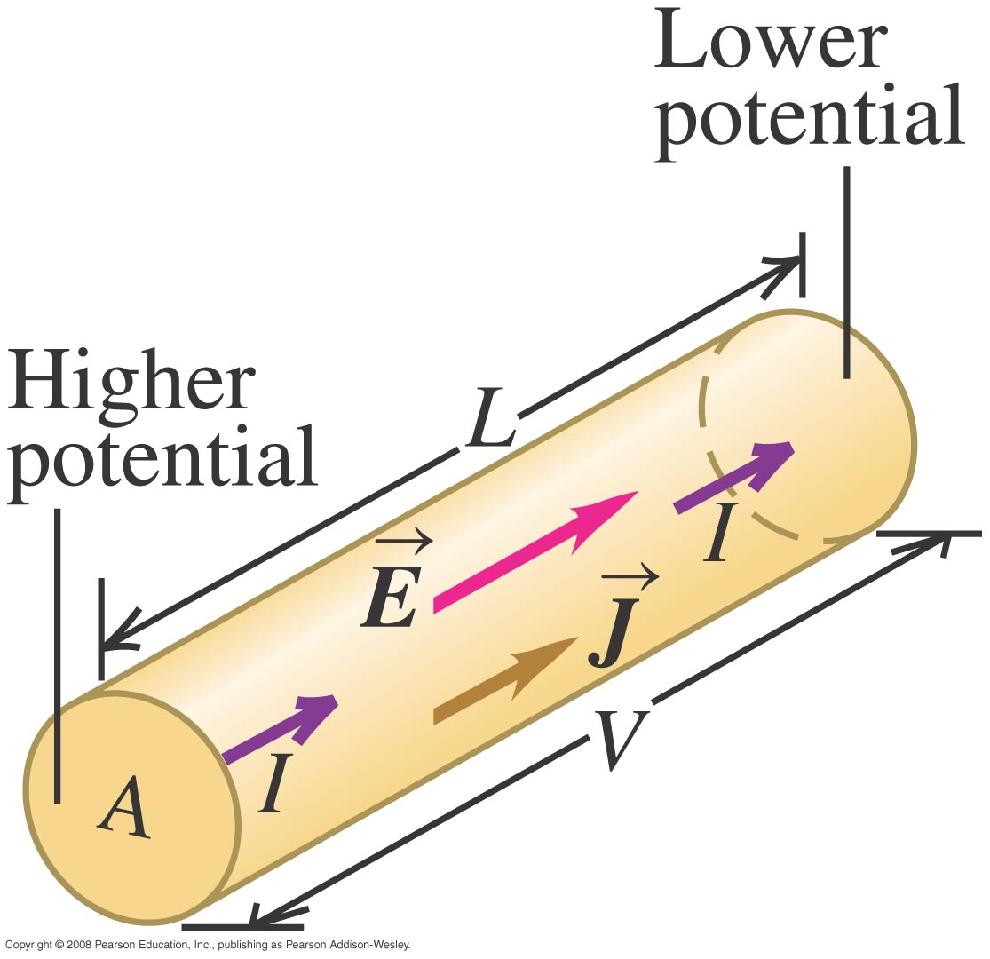
Resistance

Slide 12
Ohm’s Law

Slide 13
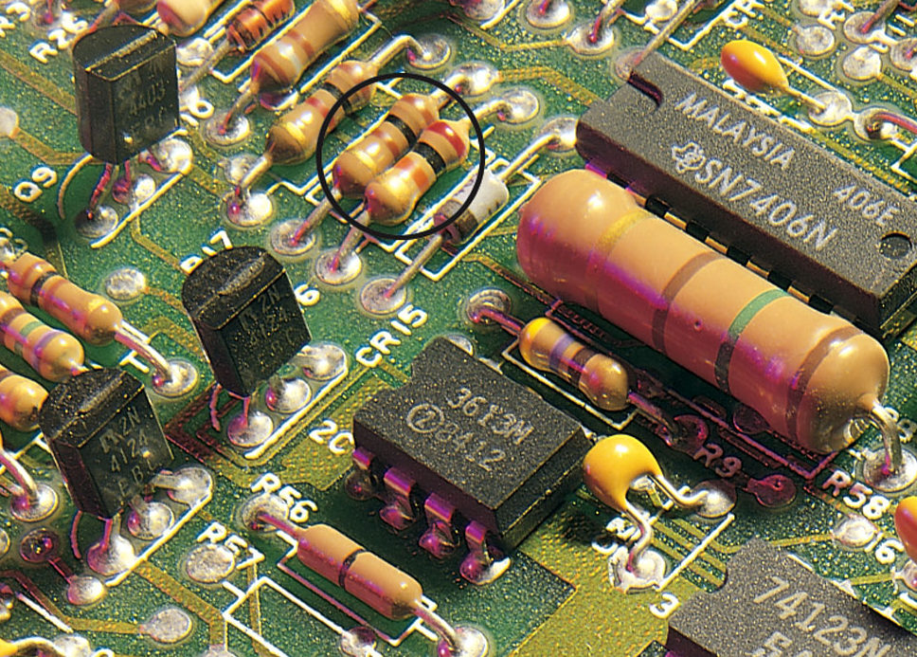
Resistor

Slide 14
Resistivity ρ and Conductivity σ

Slide 15
Resistivity

Slide 16
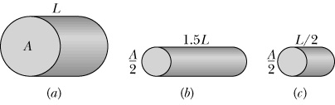
Which has the higher resistance?

Slide 17
Ohmic Material

Slide 18
Nonohmic Material, Graph

Slide 19
Power
Power: Energy per unit time
Unit: W (Watt)
1W=1J/s

Slide 20
Example

Slide 21
Kilowatt-hour and Joules
Both measure energy
1kWh is the amount of energy dissipated by a 1000 Watts light bulb in one hour.
Therefore:
1kWh = (1000J/s) (3600s)=3.6 × 10⁶ J

Slide 22
Pumping Charges

Slide 23
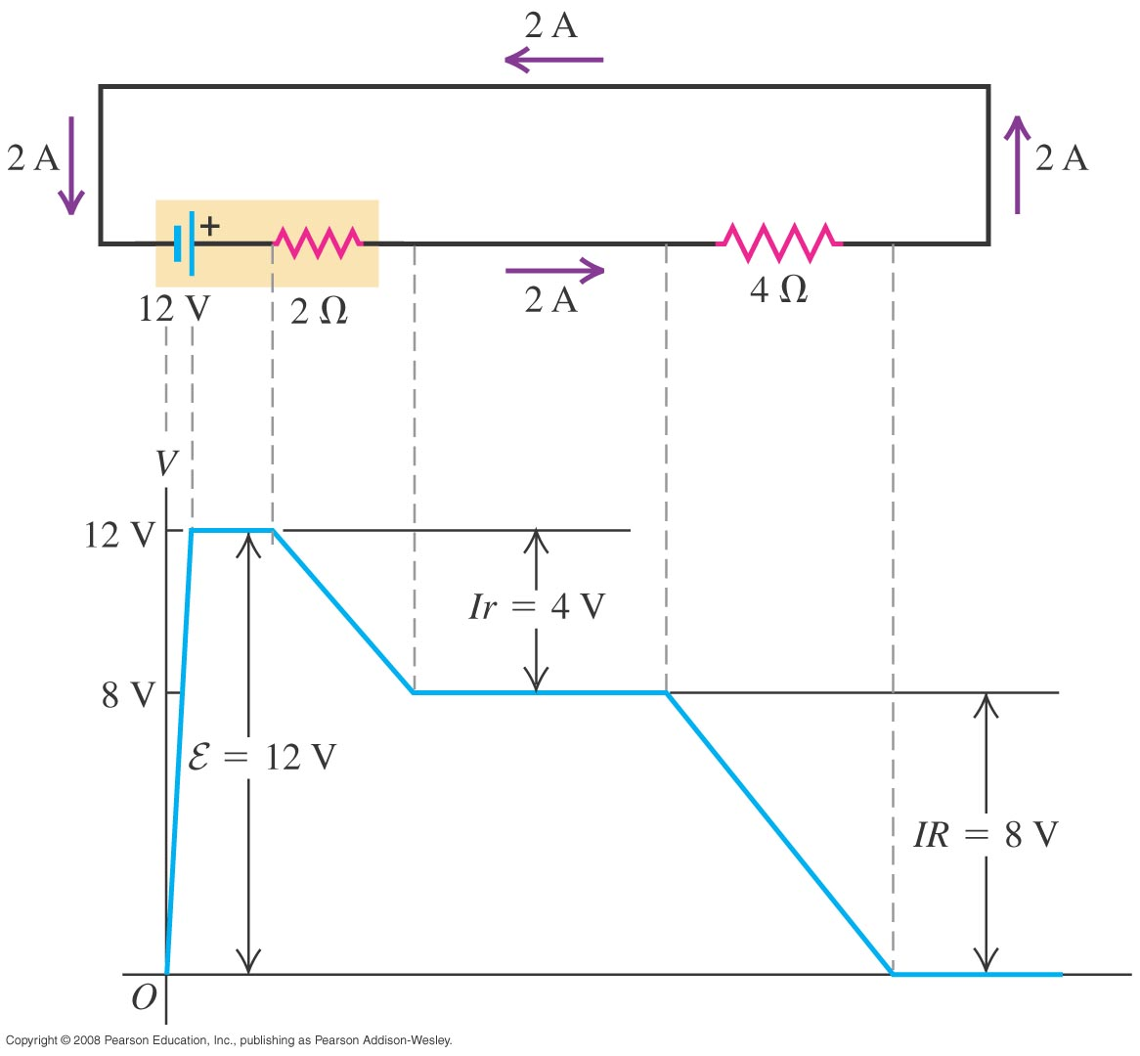
Kirchhoff’s Loop rule

Slide 24
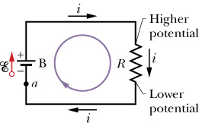
Ideal voltage source
In this class, unless stated otherwise, we often assume voltage source is ideal, i.e., battery with no internal resistance (r =0).

