Slide 1
Chapter 24
Capacitance and Dielectric

Slide 2
Reminder of Potential Energy
q₂
r₁₂
q₁

Slide 3
Moving a charge through a potential ΔV
In this chapter, we will write the potential difference as V instead of ΔV.

Slide 4
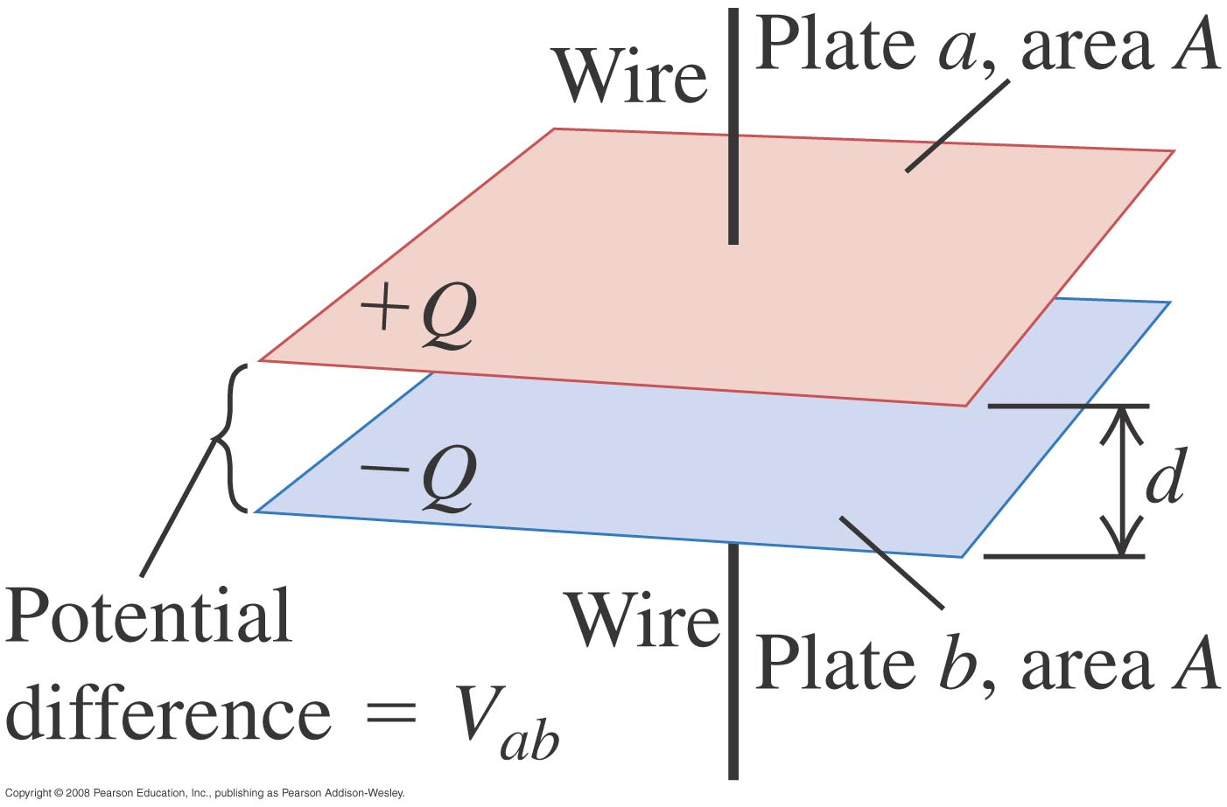
Capacitor
Previously, you learned that a system of charges carries electrostatic potential energy. Can we build a device that can be used to store electrostatic potential energy?
Yes, such devices are called capacitors.

Slide 5
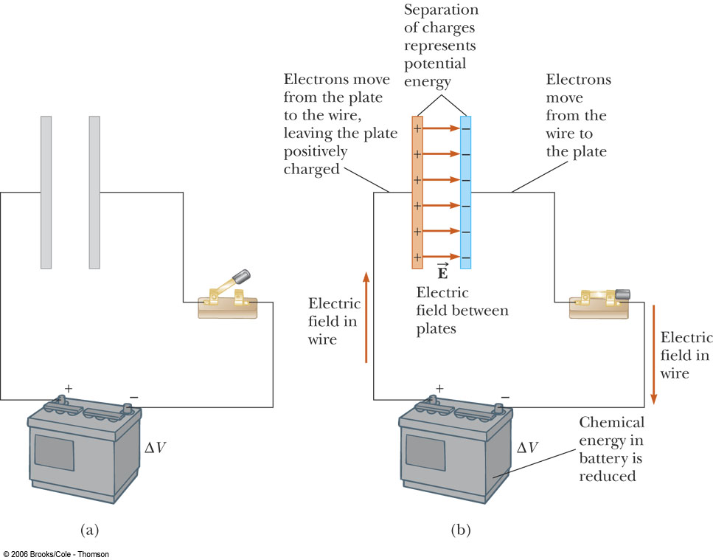
Charging a capacitor

Slide 6
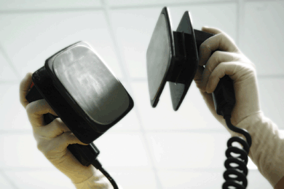
Applications
Flash of a camera
Power energy intensive devices such as big lasers, defibrillators
Tuner inside your radio and TV

Slide 7
Capacitance
Capacitance measures how effective a capacitor is.
Symbol: C (do not confuse this with Coulomb)
Unit: Farad (F = C/V)

Slide 8
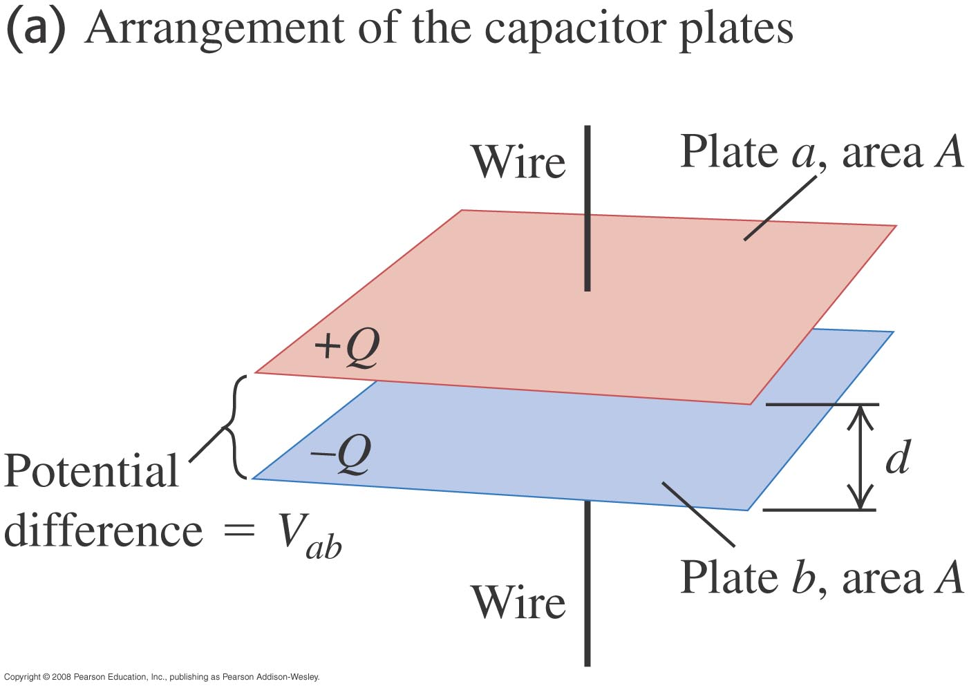
Capacitance
A capacitor consists of 2 spatially separated conductors charged to +Q and -Q .
The absolute value of the charge on one of the conductors only
We write V, but we actually mean |ΔV|

Slide 9
Parallel Plate Capacitor
We will now calculate the capacitance of a parallel-plate capacitor of area A and separation d.

Slide 10
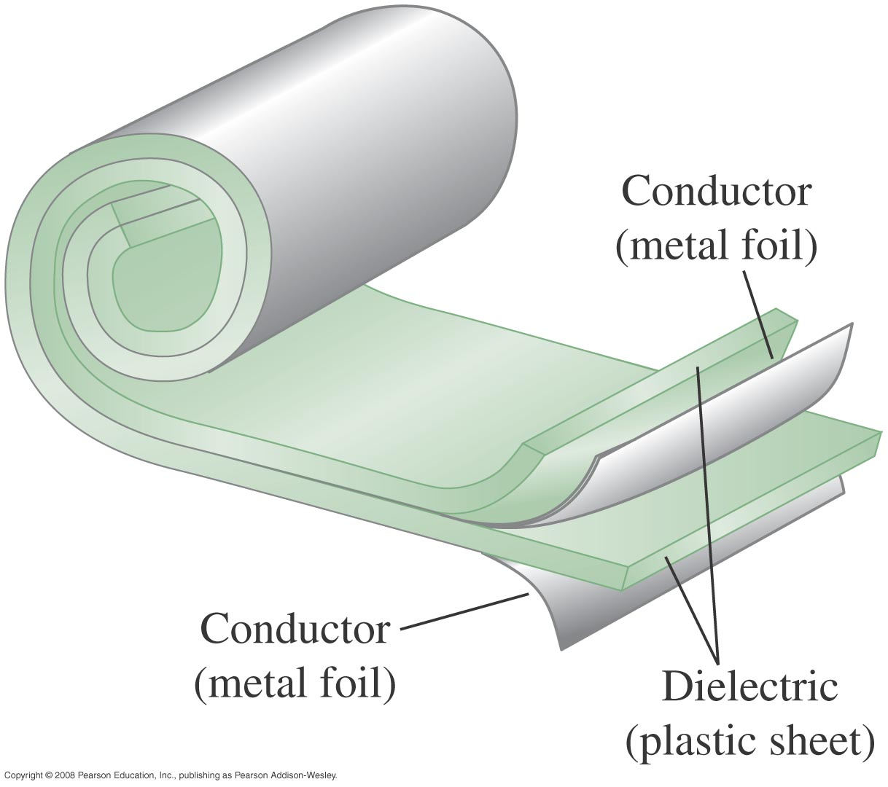

Slide 11
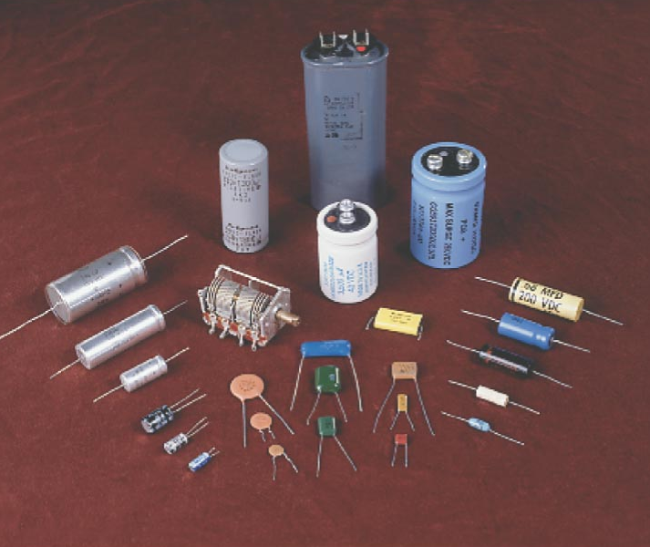
Capacitor

Slide 12
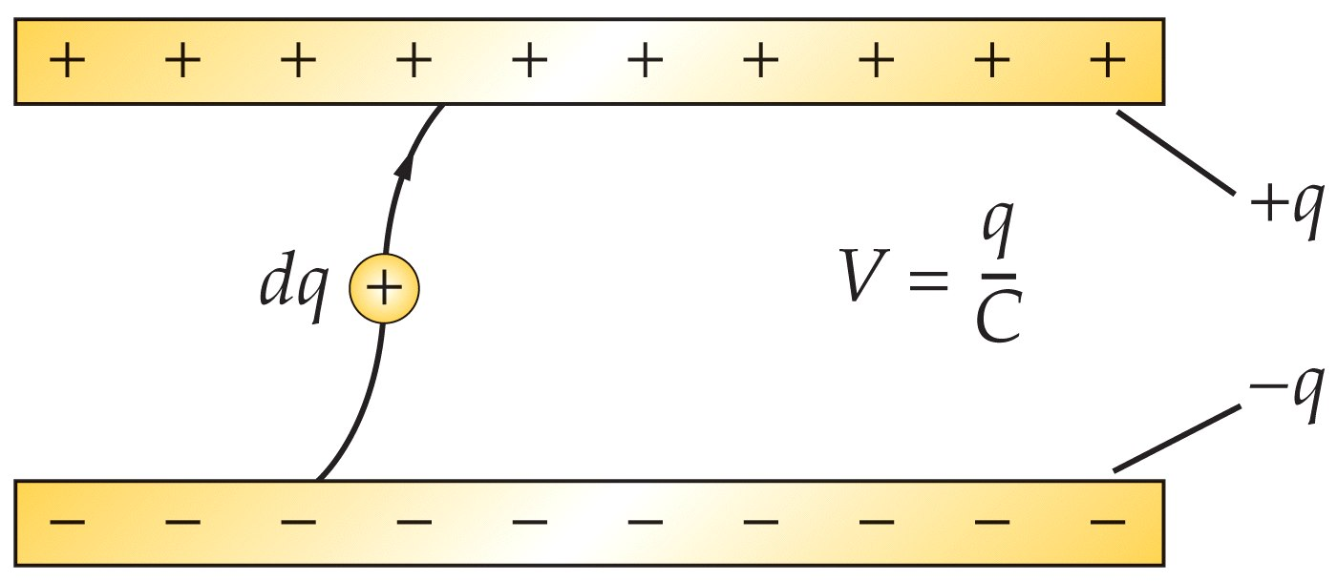
Energy stored in a capacitor
There are three forms for U, each of which involve only two out of the three quantities Q,C,V.

Slide 13
Derivation: Energy stored in a capacitor

Slide 14
Which equation to use?
Suppose the separation d of the plates is doubled, what is the final energy compared with the original energy?

Slide 15
Energy Density
u is the energy density (energy per unit volume), which turns out to depend only on the electric field. Unit: J/m³

Slide 16
Recipe for calculating C
Let’s use the recipe for a cylindrical capacitor shape.

Slide 17
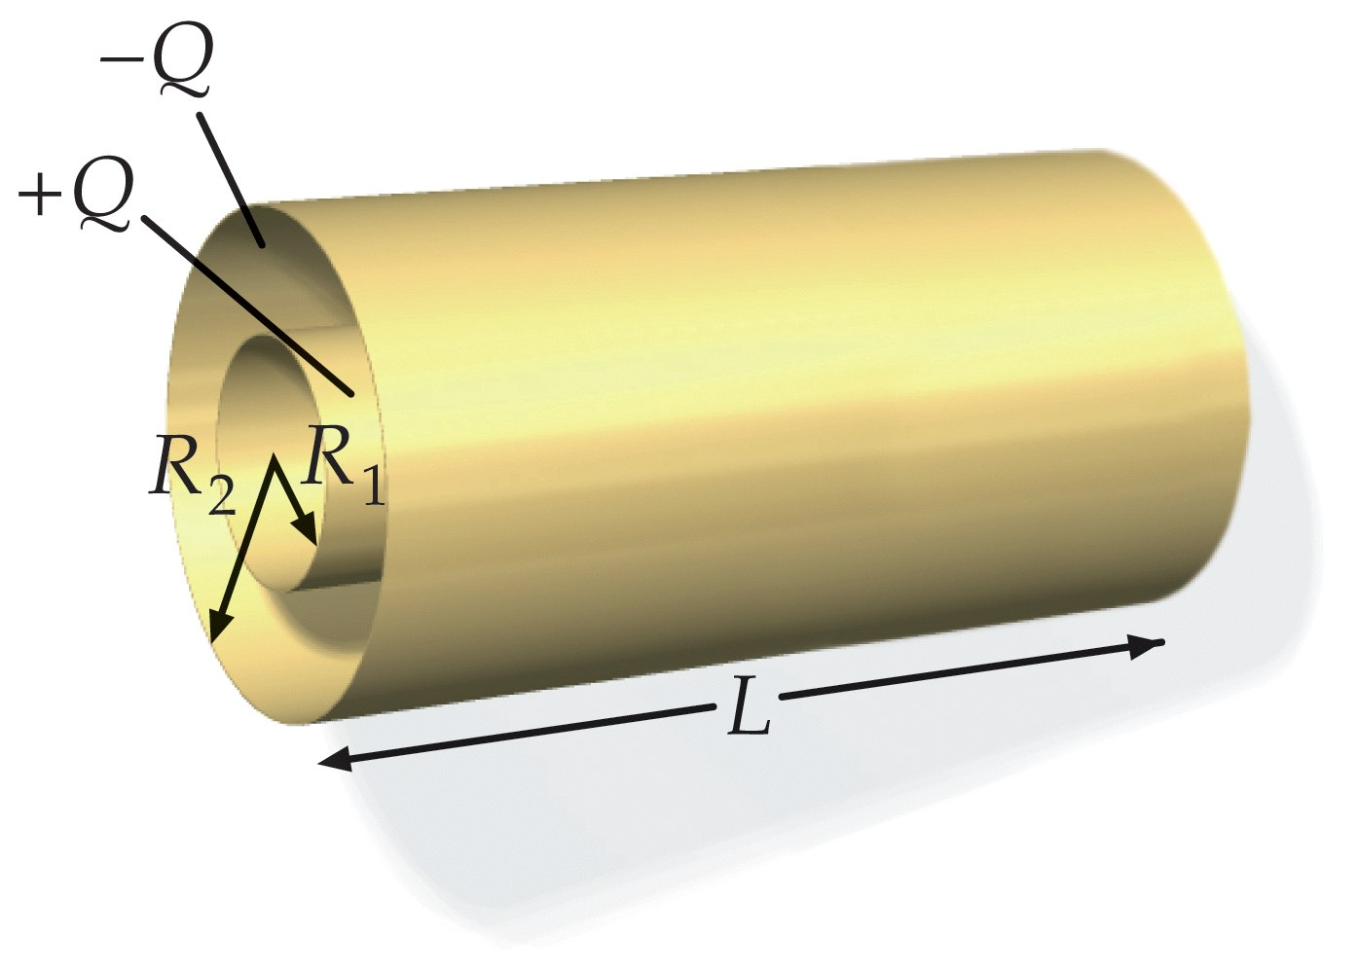
Calculate the capacitance of a Cylindrical Capacitor
We first have to put some charge on each plate ( -Q on the outer shell and +Q on the inner conducting cylinder).
Next we have to find the electric field E between the plates. We know the answer from previous lectures.

Slide 18
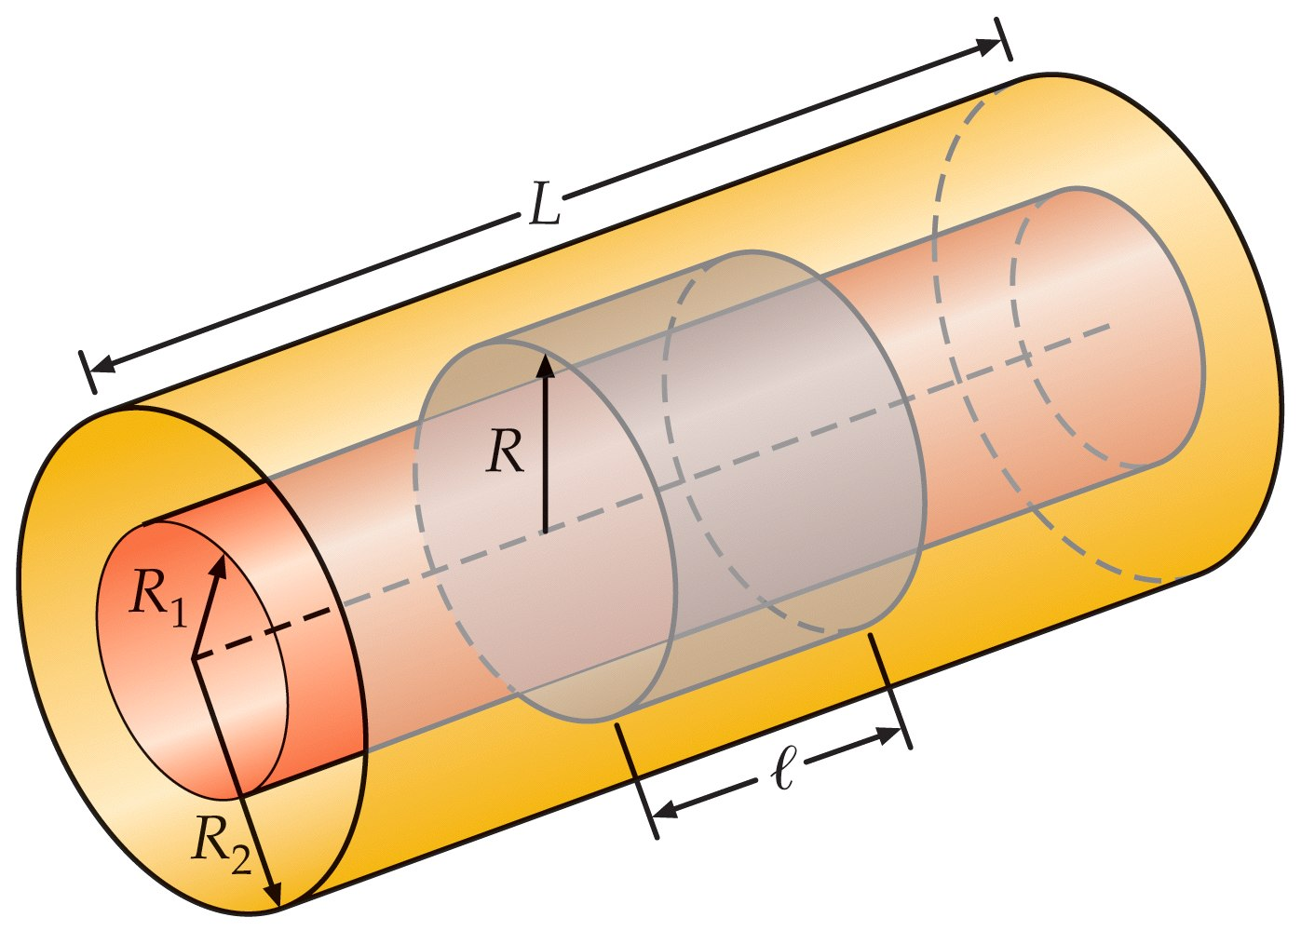
Calculate the capacitance of a Cylindrical Capacitor

Slide 19
Calculate the capacitance of a Cylindrical Capacitor
Now we can calculate the potential difference:

Slide 20
Calculate the capacitance of a Cylindrical Capacitor

Slide 21
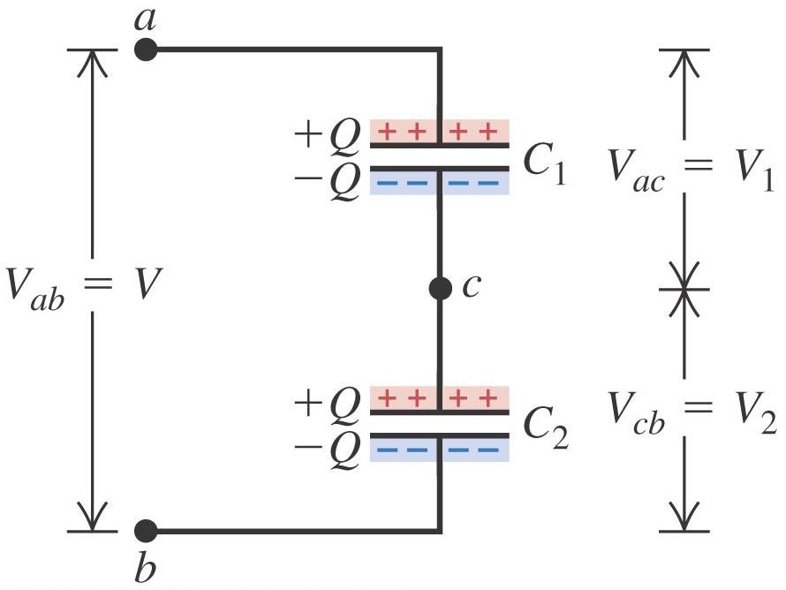
Capacitors in series

Slide 22
Capacitors in parallel

Slide 23
Example
Find the total capacitance of the circuit. Assume each capacitor has a capacitance of 10μF.

Slide 24
Solution

Slide 25
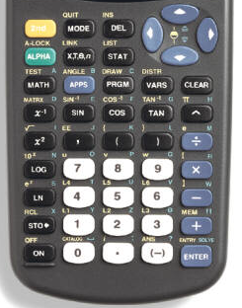
Using Your Calculator
Instead of typing:
“10^(-1)” or “1/10”
Type:
“10⁻¹”

Slide 26
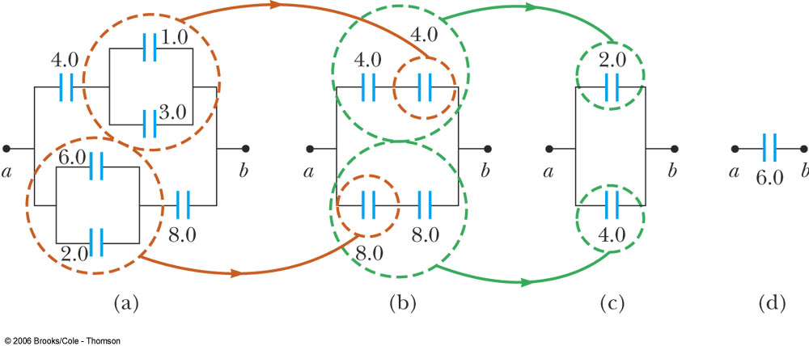
Example 1

Slide 27
Example 2

Slide 28
Dielectrics

Slide 29
Dielectrics
Reorientation of polar molecules
−
+
+
−
+
−
+
−
−
+
−
+
−
+
−
+
+
+
−
−
−
−
+
+
−
+
−
+
−
+
−
+
+
−
+
−
+
−
+
−
−
+
−
+
−
+
−
+
−
+
−
+
−
+
−
+
−
+
−
+
−
+
−
+
Induced polarization of non-polar molecules
−
+
−
+
−
+
−
+
−
+
−
+
−
+
−
+
−
+
−
+
−
+
−
+
−
+
−
+
−
+
−
+

Slide 30
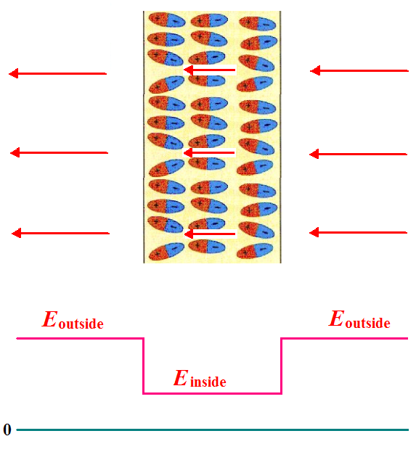
Dielectrics

Slide 31
Which equation to use?
Suppose the an dielectric κ is inserted, what is the final energy compared with the original energy?

