Slide 1
Chapter 23
Electric Potential & Electric Potential Energy

Slide 2
Electric Potential (Voltage)
Electric potential is a scalar (not a vector). It can be positive or negative.

Slide 3
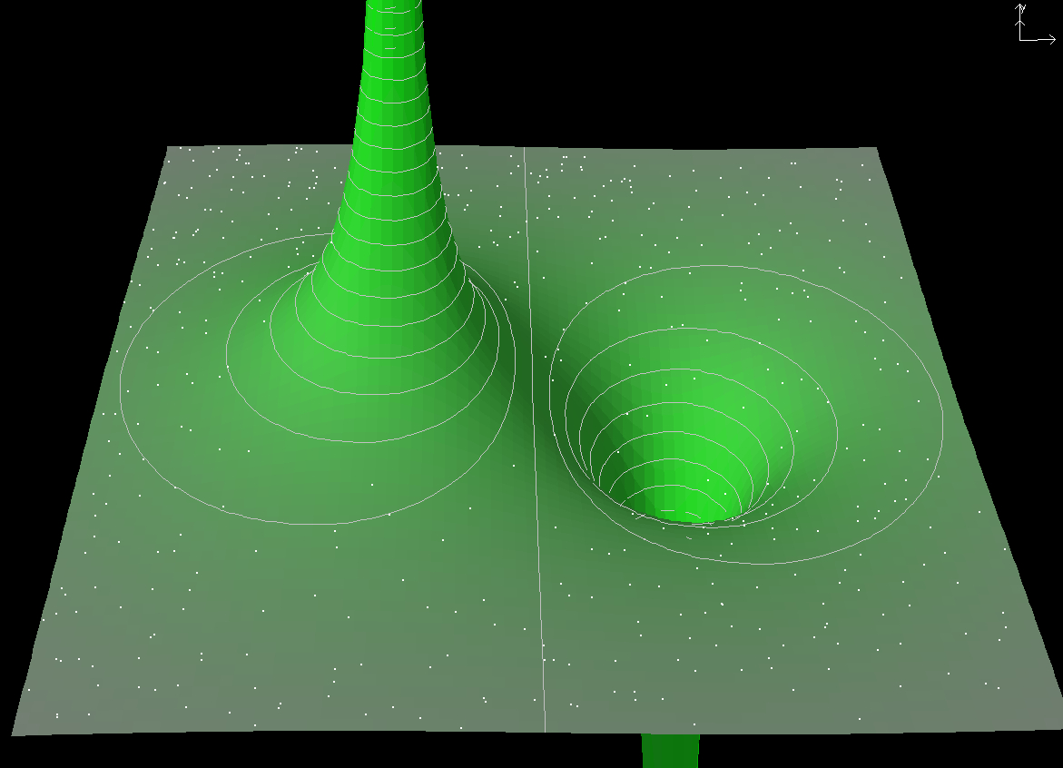
Electric Potential of a Point Charge

Slide 4
Potential of multiple charges
When you have more than one charge and you want to find the total potential, you simply add the potential due to each individual charge.
P
q₃
q₁
q₂

Slide 5
Point charge potential
A 1.00 μC point charge is located at the origin and a second point charge of -4.00 μC is located on the x-axis. Find the total electric potential at P due to these charges.
y
P
3.00 m
q₂
x
q₁
4.00 m

Slide 6
Point charge potential (The Faster Way)
A 1.00 μC point charge is located at the origin and a second point charge of -4.00 μC is located on the x-axis. Find the total electric potential at P due to these charges.
y
P
3.00 m
q₂
x
q₁
4.00 m

Slide 7
Find V_{s}
Point S is mid way between q₁ and q₂. Find the potential at S.
y
P
3.00 m
S
q₂
x
q₁
4.00 m

Slide 8
Potential Difference ΔV
y
P
Find ΔV_{SP.}
3.00 m
S
q₂
x
q₁
4.00 m
ΔV_{SP} tells you the change in potential if you walk from P to S.
Δv_{fi} = V_{f} – V_{i}: Remember to put the initial point on the right.

Slide 9
Why is potential useful?
q
A
B
Suppose a charge q is moving from A to B inside an electric field. It turns out knowing ΔV is sufficient in calculating the work involved in this process:
Work means energy transfer.
W_{E} means energy transferred from the electric field to the charge.

Slide 10
The meaning of work
Work means energy transfer.
W_{E} means energy transferred from the electric field to the charge.
For example, if W_{E}=100J, it means the electric field has transferred 100J of energy to the charge. If the charge is moving in free space (with no forces other than the electric force), then the energy gained by the charge becomes its KE. In real life applications, this energy from the electric field is extracted to power your appliances.

Slide 11
Work done by other forces: W_{you}
q
A
B

Slide 12
Summary

Slide 13
Final velocity
Find the final velocity of a charge of 2μC and m = 1g released at rest from P to S.
y
P
3.00 m
S
q₂
x
q₁
4.00 m

Slide 14
Energy released by a field
This is the energy released by the field, which could be used to power electrical appliances.
In other words, energy can be extracted from a field when a charge moves from high potential to low potential.

Slide 15
Potential at Infinity
By convention, the electric potential at infinity is set to zero:
Therefore, the change in KE for a charge released from infinity is given by:

Slide 16
Point charge potential
What is the change in KE of a 3.00μC point charge movig from infinity to point P?
y
P
3.00 m
S
q₂
x
q₁
4.00 m

Slide 17
PE for a pair of charges
q₂
r₁₂
q₁
Like charges: U₁₂ > 0
Opposite charges: U₁₂ < 0
Do not confuse potential energy with potential!
Units:
Potential Energy: J (1J=1V C) Potential: V

Slide 18
Multiple Charges
Total potential energy obtained by calculating U for every pair of charges and add them up.
In this case there are total of three pairs:
q₁
r₁₂
q₂
r₁₃
r₂₃
q₃

Slide 19
How many pairs do you see?
q₁
q₂
q₃
q₄

Slide 20
POTENTIAL ENERGY 1
y
q₃
P
3.00 m
S
q₂
x
q₁
4.00 m

Slide 21
POTENTIAL ENERGY 2
y
P
3.00 m
S
q₃
q₂
x
q₁
4.00 m

Slide 22
In greater details

Slide 23
The flow of charge
If unrestrained:
Positive charge flow from high V to low V
Negative charge flow from low V to high V
High V
E field
Low V
+
−

Slide 24
Potential and Electric Field

Slide 25
POTENTIAL AND ELECTRIC FIELD (3D & 1D)

Slide 26
Obtaining E from V
The component of the electric field in a particular direction is the negative of the gradient of the potential in that direction.
E field always point from high potential to low potential.

Slide 27
Example
If V = A(3xy² - 2yz²) where A=5 volts/m³, find the components of E.

Slide 28
Spherical coordinates

Slide 29
Example: electric Dipole
P
+
-

Slide 30
Electric field of a dipole

Slide 31
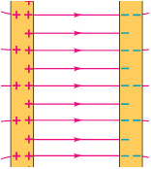
V and uniform E field in 1D
V decreases along the direction of the E field.
E field points in the direction of decreasing V.

Slide 32
V from E
A
B

Slide 33
V from E (Alternative Method)
A
B

Slide 34
Special case
A
B

Slide 35
E from V
A
B

Slide 36
E from V (Alternative Method)
A
B

Slide 37
Spherically symmetric case
For spherically symmetric charge distributions, the electric fields are radial and we have:
The above equations are often combined with the convention of V∞=0 to give the potential:

Slide 38
Potential of a point charge
Integrate from infinity to P
P
q

Slide 39
Tricks to get V from E
A
B
Sometimes the electric field changes from one region to the next. In this case, the integral for ΔV breaks into several terms.

Slide 40
Potential of a uniform spherical charge distribution
Suppose the sphere has a uniform volume charge density ρ, find potential inside and outside the sphere.
R

Slide 41
Case 1: Outside the sphere (r > R)
Integrate from infinity to P
P
R

Slide 42
Case 2: Inside the sphere (r < R)
Integrate from infinity to P
P
R

Slide 43
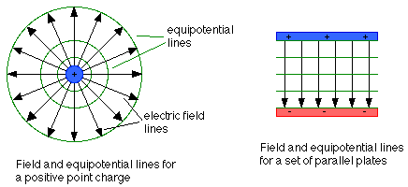
Equipotential surfaces
They are defined as a surface in space on which the potential is the same for every point (surfaces of constant voltage)
The electric field at every point of an equipotential surface is perpendicular to the surface

Slide 44
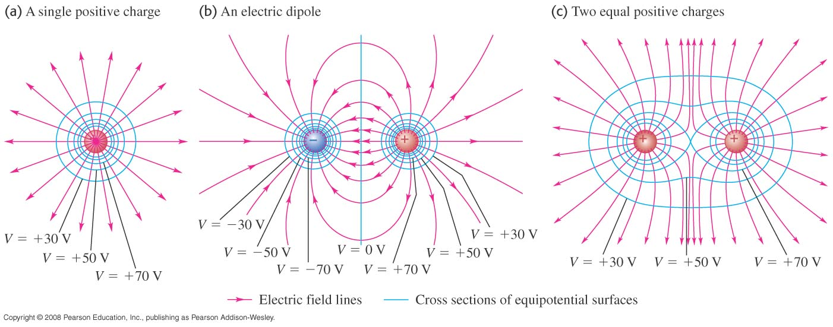
More examples of Equipotentials

Slide 45
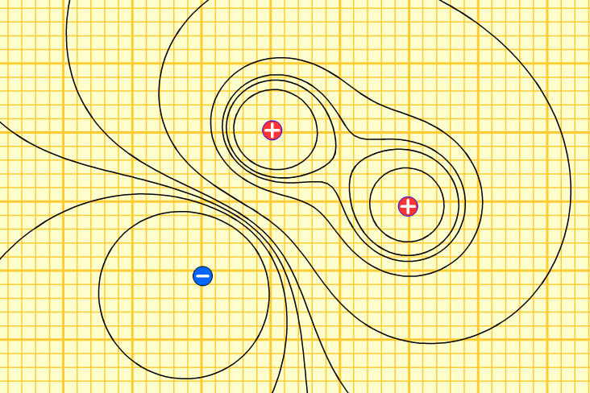
Don’t call them “circles”

Slide 46
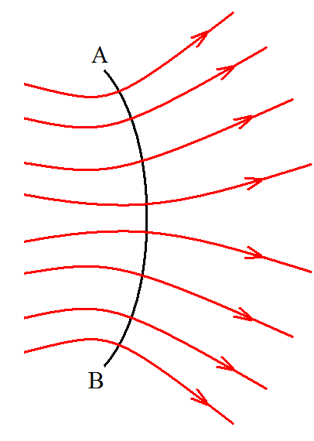
Equipotential lines perpendicular to E field
Consider the equation:
To get zero, all line elements ds along the trace must be perpendicular to E.

Slide 47
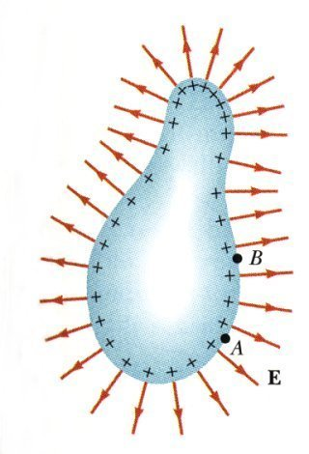
Electric Potential of a Charged Conductor
E =0 inside conductor in equilibrium.
Any net charge resides on the surface of the conductor.
Electric field immediately outside the conductor is perpendicular to the surface of the conductor.

Slide 48
Continuous charge distribution
Find the electric potential at a point P located on the axis of a uniformly charged ring of radius a and a total charge Q. The plane of the ring is perpendicular to the x-axis.
dq
r
a
x
P
x
Each charge element on the ring is the same distance from P, so r is a constant in the integration:

