Slide 1
Chapter 22
Gauss’ Law

Slide 2
Mathematics Reminder

Slide 3
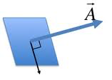
Math: Area Vector

Slide 4
Gauss’ Law

Slide 5
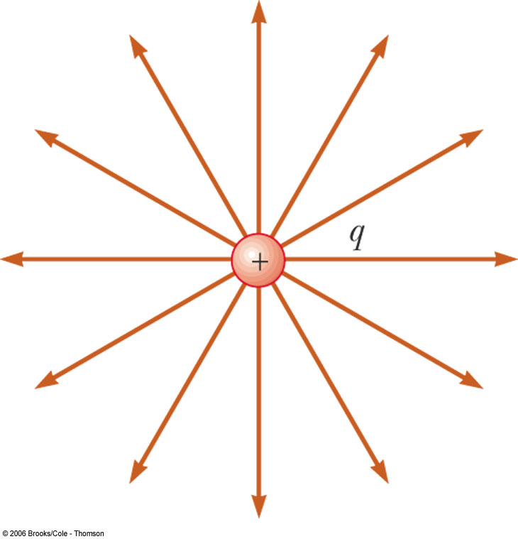
Why it makes sense
All capture the same number of field lines.

Slide 6
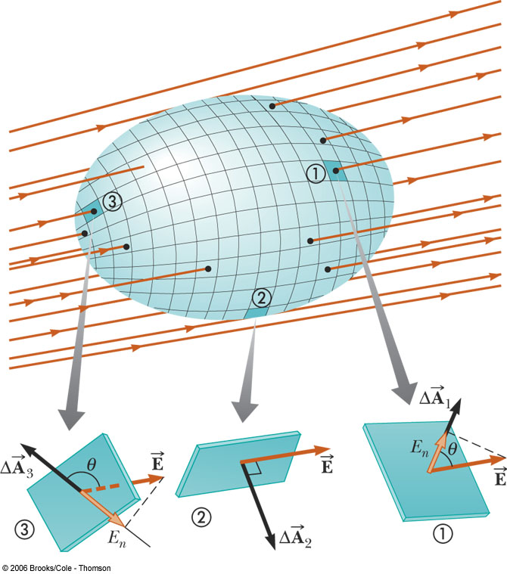
Flux by Integration

Slide 7
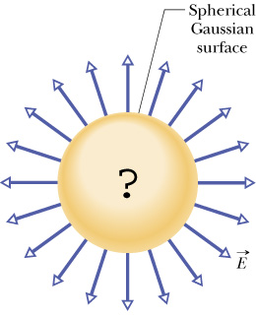
Relates the outside to the inside
Flux through the area of the Gaussian surface
Charge inside the Gaussian surface

Slide 8
A spherical Gaussian surface (#1) encloses and is centered on a point charge +q. A second spherical Gaussian surface (#2) of the same size also encloses the charge but is not centered on it.
Compared to the electric flux through surface #1, the flux through surface #2 is
+q
Gaussian surface #1
Gaussian surface #2
A. greater. B. the same.
C. less, but not zero. D. zero.
E. not enough information given to decide

Slide 9
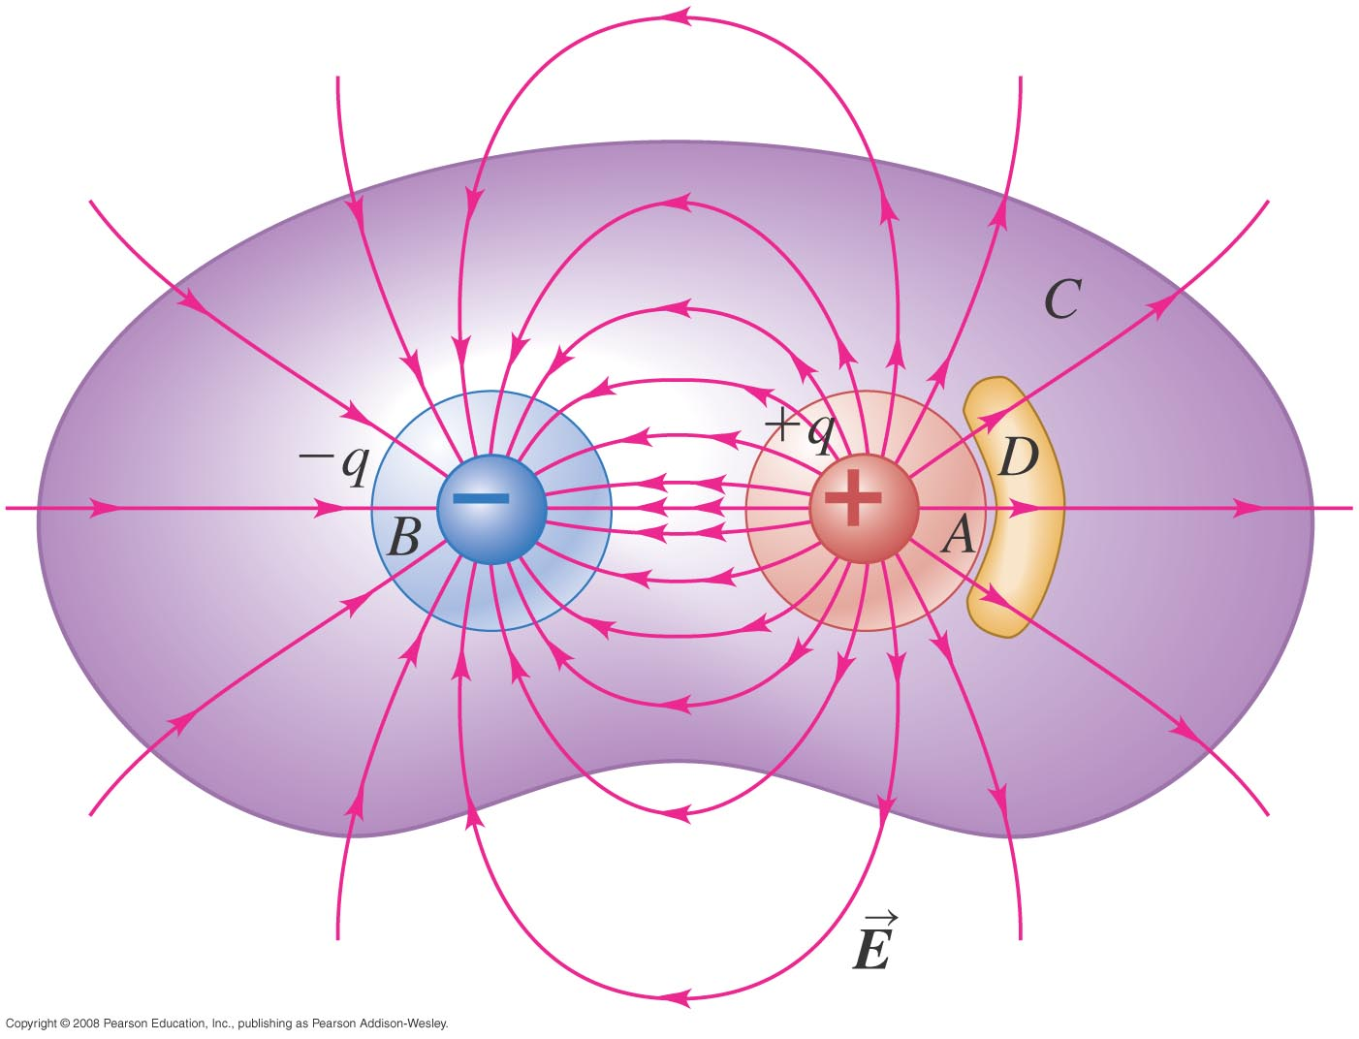
Two point charges, +q (in red) and –q (in blue), are arranged as shown.
Through which closed surface(s) is the net electric flux equal to zero?
A. surface A B. surface B
C. surface C D. surface D
E. both surface C and surface D

Slide 10
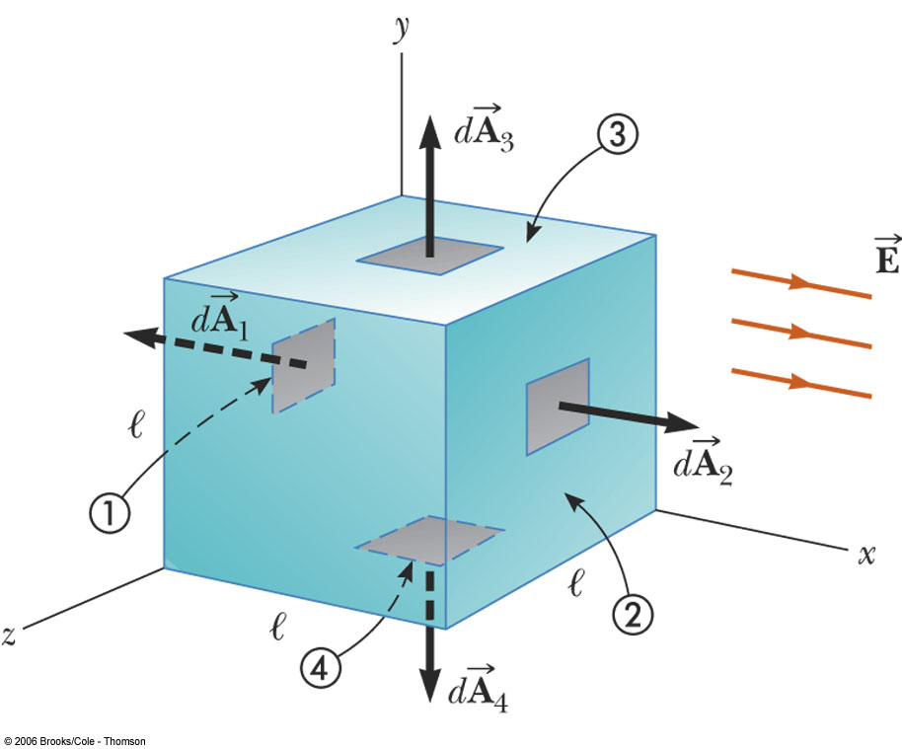
Area vector of a cube
Convention: Area vector of a close surface points outward.

Slide 11
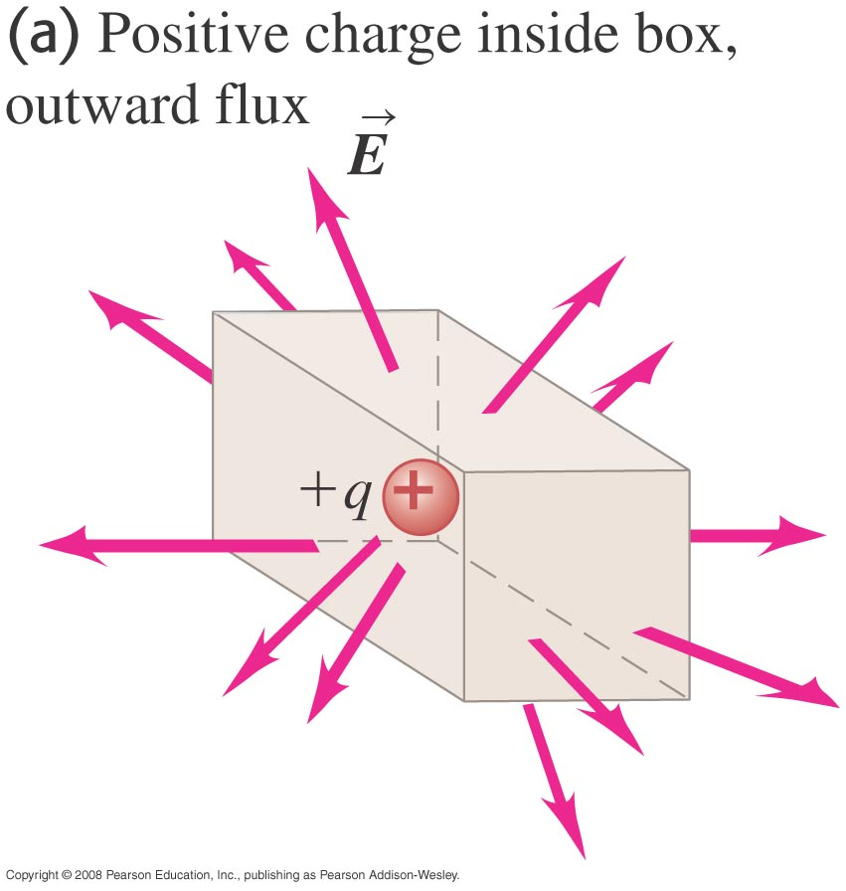
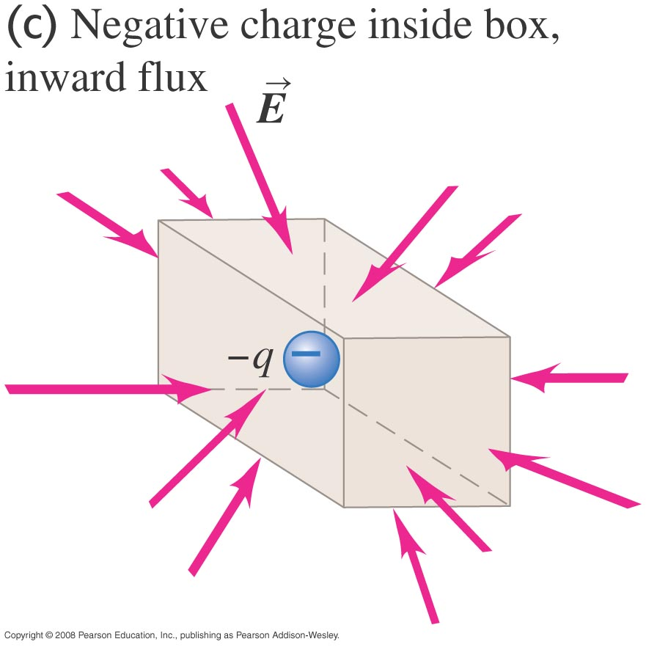
Sign of Flux
Positive when E field is going out
Negative when E field is going in

Slide 12
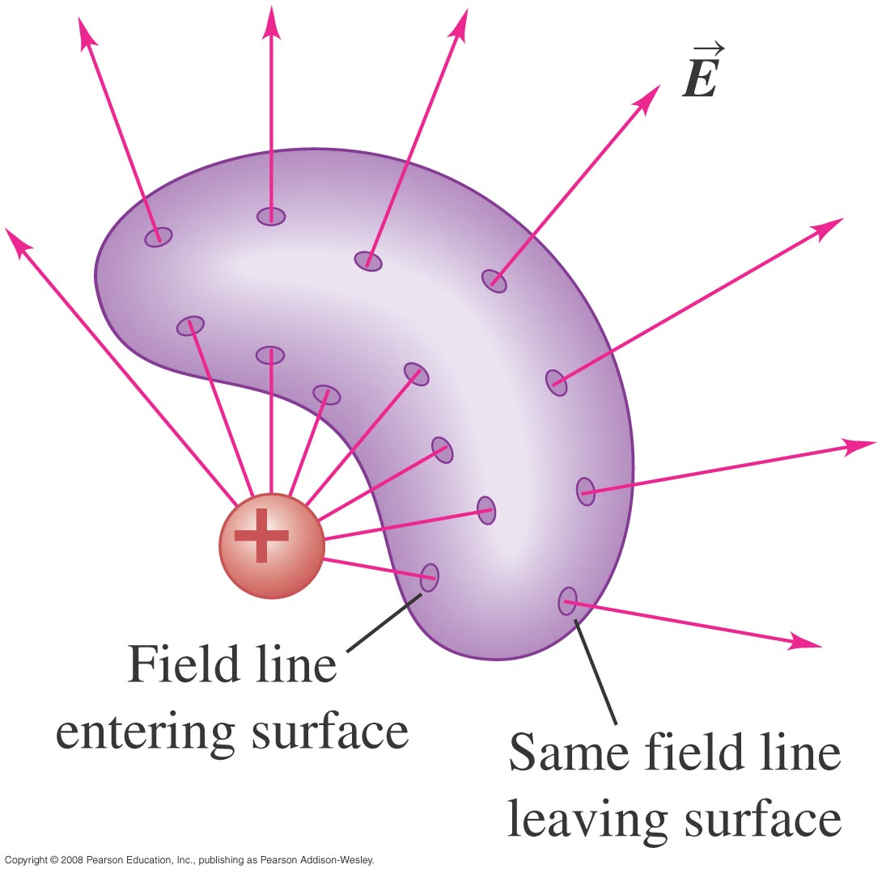
Sign of Flux (Example)

Slide 13
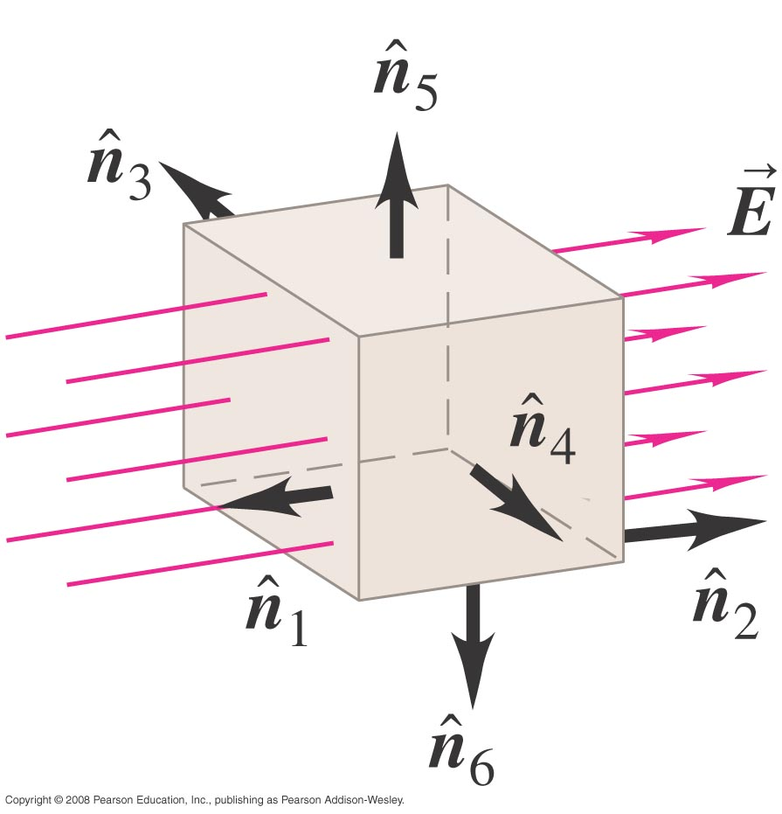
Example (constant E)

Slide 14
Φ is difficult to find in general
… so we need to be smart.
E here is different than E there.
+
You are allowed to change the shape of the Gaussian surface to make the surface integral easy.

Slide 15
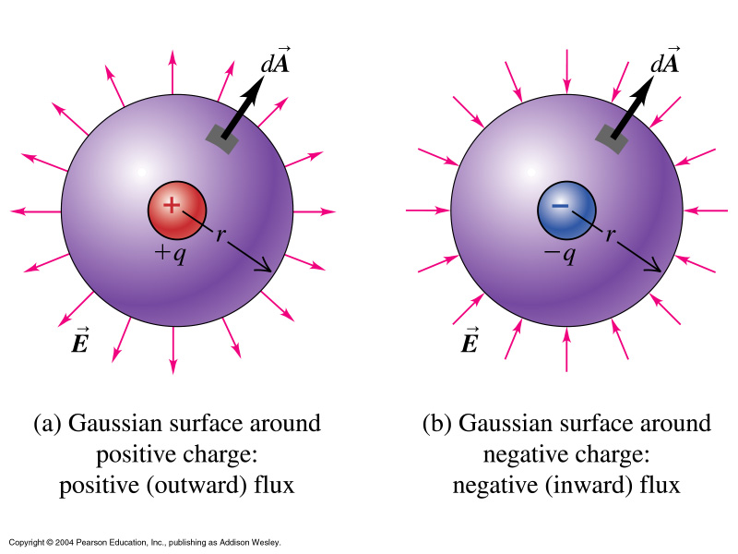
Spherical Gaussian Surface

Slide 16
Simplify the integral

Slide 17

Outside Uniform Sphere of Charge
q
r
x
Gaussian
surface

Slide 18
What to write in the exam
In the exam, just a few words of explanation is enough in simplifying the flux integral:

Slide 19
Must include diagrams
When answering questions on Gauss’ law, you MUST include a diagram to indicate the Gaussian surface you picked.
Without defining the Gaussian surface with the diagram, the flux cannot be defined, and your integral will have no meaning.
You will lose half your points without a diagram.

Slide 20

Linear fly density
L=4m

Slide 21
Linear charge density, λ
+++++++++++++++++++++++++++++++++++++
L=4m

Slide 22
Surface charge density σ
++++++
++++++++++++++++++
++++++

Slide 23
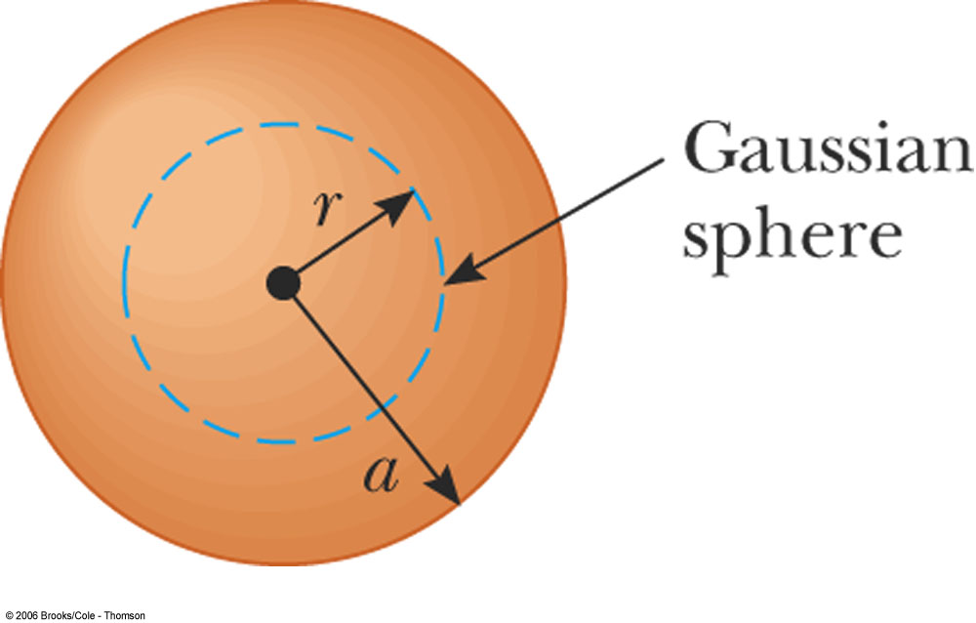
Volume charge density ρ
R

Slide 24
Charge Density Summary

Slide 25
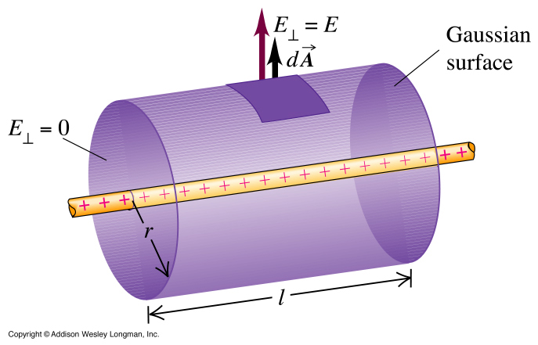
A Line of Charge

Slide 26
Simplify the integral
S₃
S₁
S₂

Slide 27
Simplify the integral
S₃
S₁
S₂

Slide 29
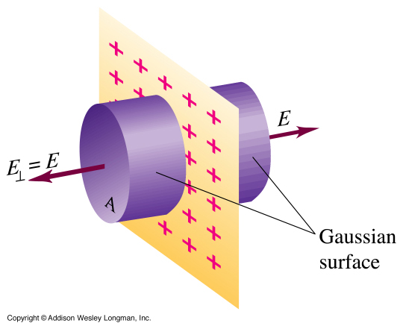
An Plane Sheet of Charge

Slide 30
Simplify the integral
S₃
S₁
S₂

Slide 31
A Plane Sheet of Charge
σ is the charge per area
area A
r
x
Gaussian surface
(cylinder, pillbox)

Slide 32
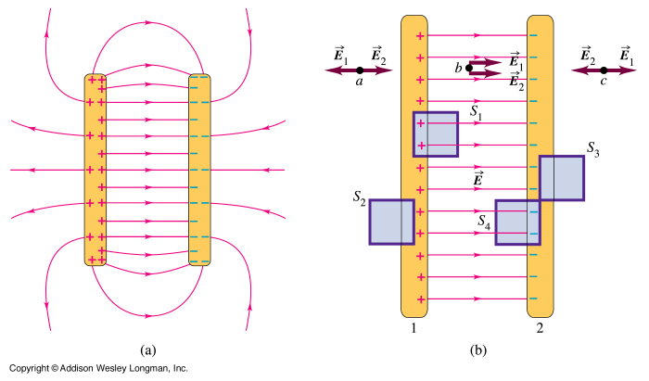
Two Parallel Plates

Slide 33
Derivation with Gauss Law
+
+
+
+
+
+
+
+
+
+
+
+
+
+
+
+
E
No E inside a conductor

Slide 34
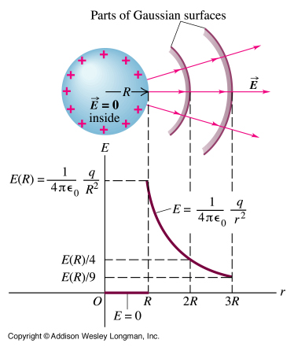
A Solid Conducting Sphere

Slide 35
Useful fact
E field is always zero inside a conductor at equilibrium (no movement of charges).
Since F=qE, if E is non-zero, the electric force will push the charges around. Therefore the only way equilibrium can be established is if F=0, which implies E=0.

Slide 36
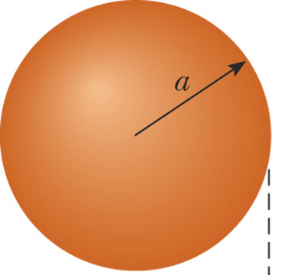
An Uniformly Charged Sphere
R

Slide 37
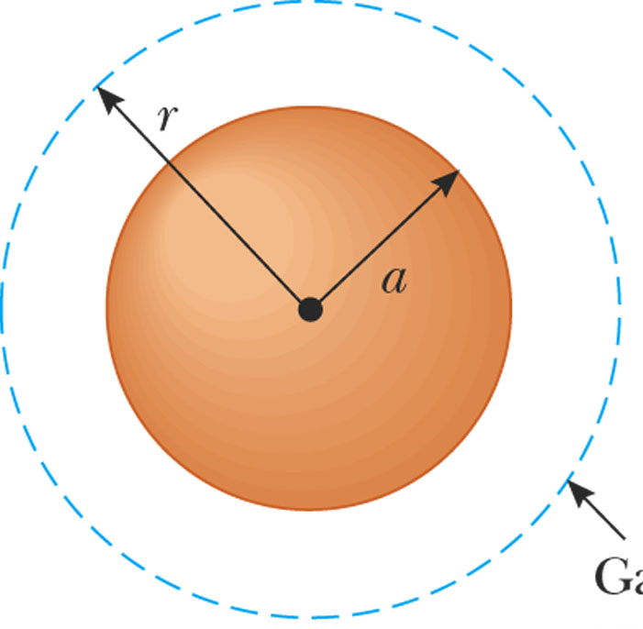
Outside (r > R)
R

Slide 38
Inside (r < R)
R

Slide 39
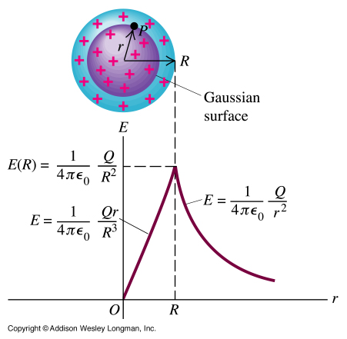
R

Slide 40
Skip everything below

Slide 41
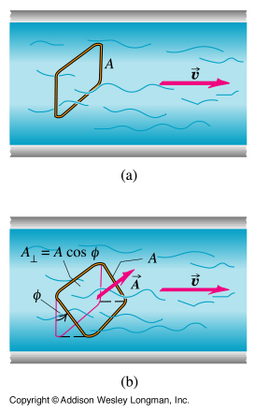
Another Example
How much water passes through the wire?

