Slide 1
Chapter 21
Electric Charge and Electric Field

Slide 2
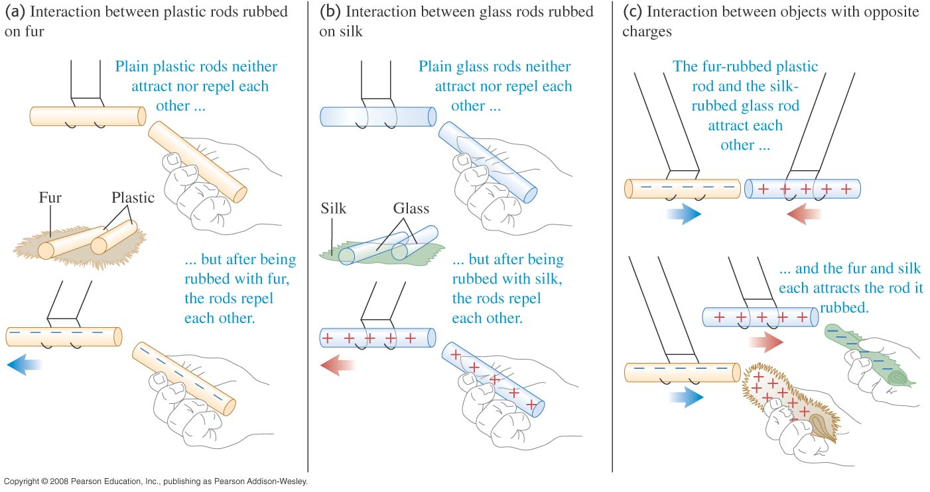
Interaction of Electric Charge

Slide 3
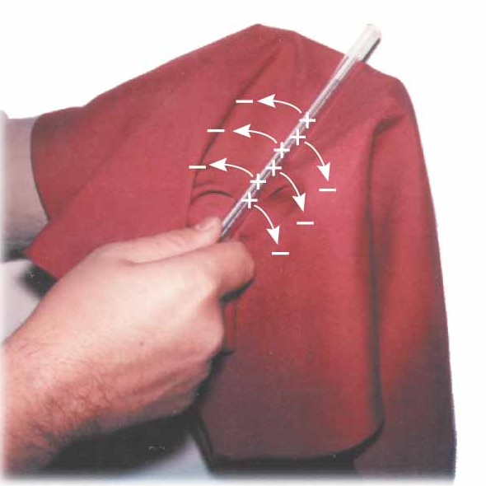
Charging an object
A glass rod is rubbed with silk
Electrons are transferred from the glass to the silk
Each electron adds a negative charge to the silk
An equal positive charge is left on the rod

Slide 4
Charge
+
−
Unit:
C, Coulomb

Slide 5
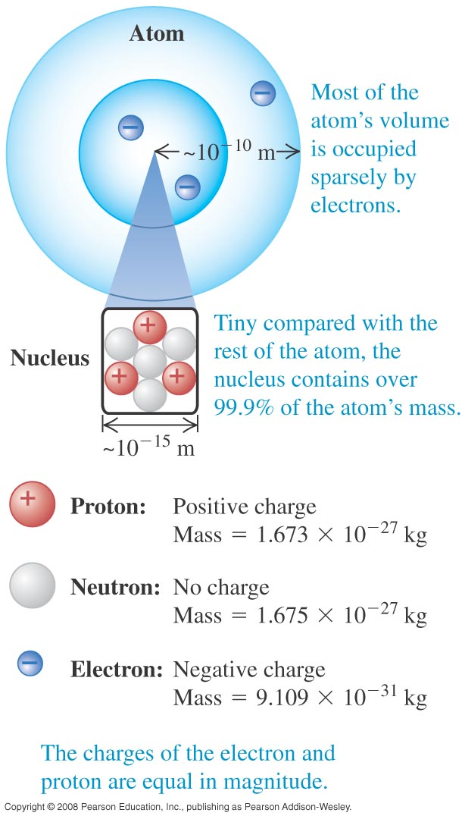
Electric Charge
Electric charge is one of the fundamental attributes of the particles of which matter is made.

Slide 6
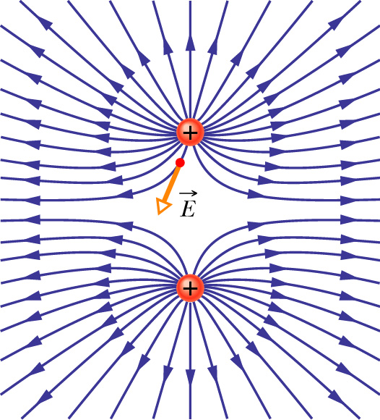
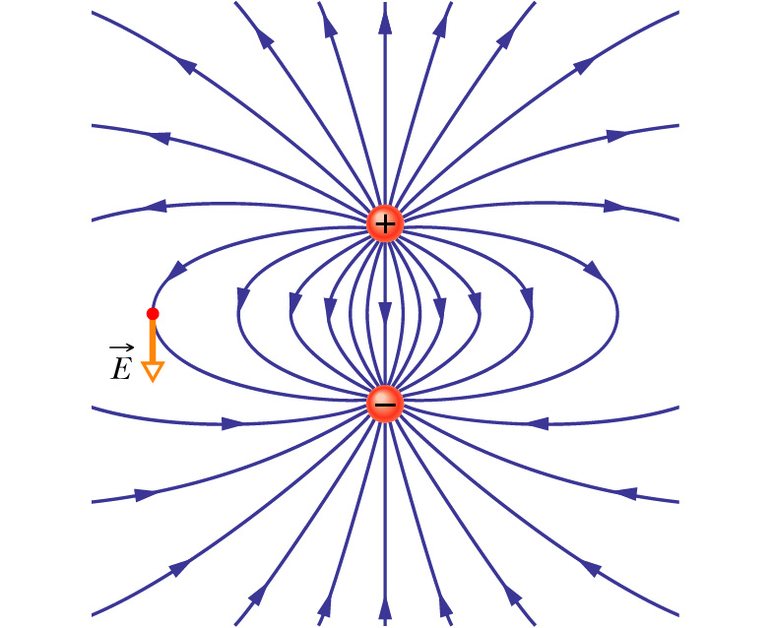
Electric Field
Electric dipole:
Opposite charges (+−)
Like charges (++)

Slide 7
Vectors are arrows

Slide 8
What are these vectors?

Slide 9
Magnitude of a vector = Length of the arrow
3
4

Slide 10
What are the magnitudes?

Slide 11
Magnitudes (solution)

Slide 12
Adding and subtracting vectors

Slide 13
Add and subtract

Slide 14
Solution

Slide 15
Notations

Slide 16
Vector Components
4
-3
5

Slide 17
Terminology

Slide 18
Decomposing a vector
Hint: Once you know one side of a right-angle triangle and one other angle, you can find all the lengths using cos, sin or tan.

Slide 19
A quick reminder

Slide 20
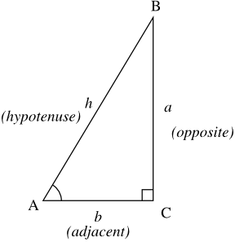
Trigonometry

Slide 21
Solution

Slide 22
Check

Slide 23
Angles of a vector
Find the angles the four vectors make with the positive x-axis.
y
30°
x

Slide 24
Calculating the angles

Slide 25
Use tan to find the angle
First draw a picture!!!

Slide 26
You must draw a diagram…
First draw a picture!!!

Slide 27
Write down the following three vectors in i j notation. Find the sum of these vectors also.
10º
4.5
5
4
50º
60º

Slide 28
(-1) times a vector?
5
3
4

Slide 29
4
5
3
3
5
4

Slide 30
In General

Slide 31
Adding Vectors Diagrammatically
You are allowed to move an arrow around as long as you do not change its direction and length.
Method for adding vectors:
Move the arrows until the tail of one arrow is at the tip of the other arrow.
Trace out the resultant arrow.

Slide 32
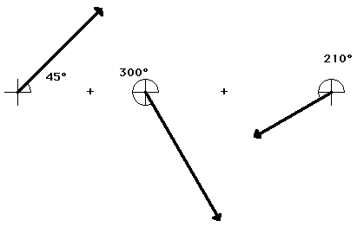
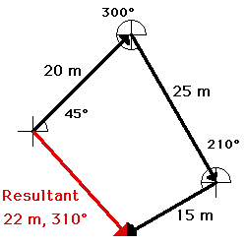
Addition of vectors
You are allowed to move an arrow around as long as you do not change its direction.

Slide 33
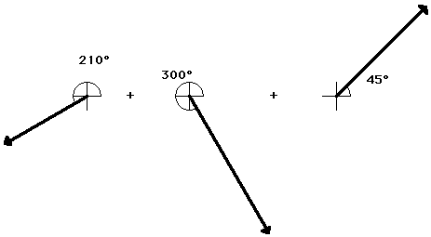
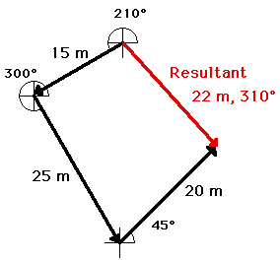
Adding in a different order

Slide 34
Order does not matter

Slide 35
Subtracting Vectors Diagrammatically

Slide 36
Example

Slide 37
Example

Slide 38
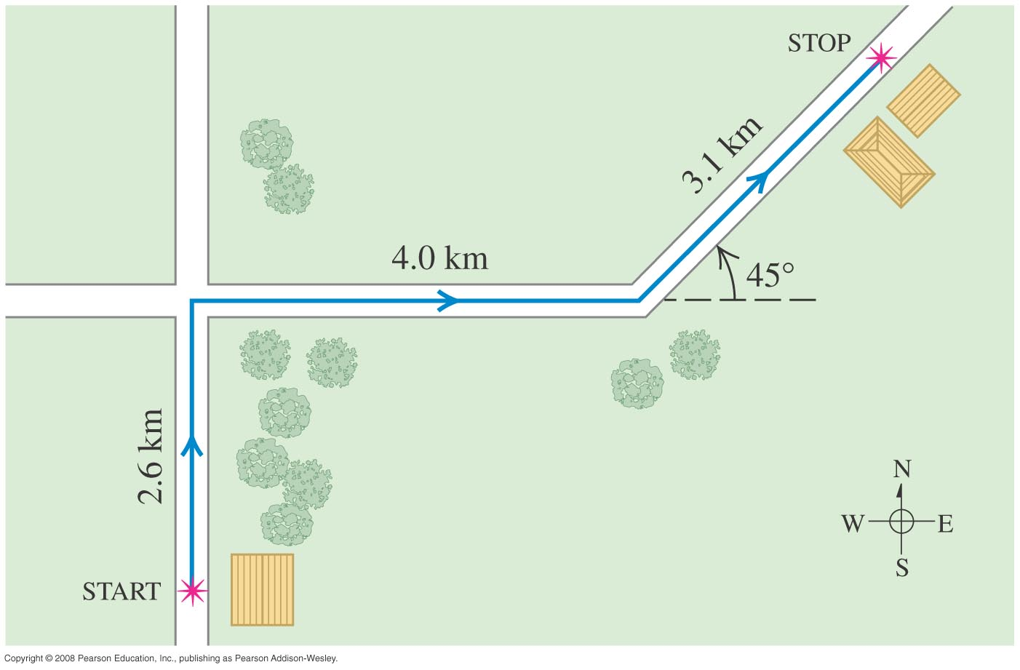
Adding vectors 1
Add the three vectors to find the total displacement.

Slide 39
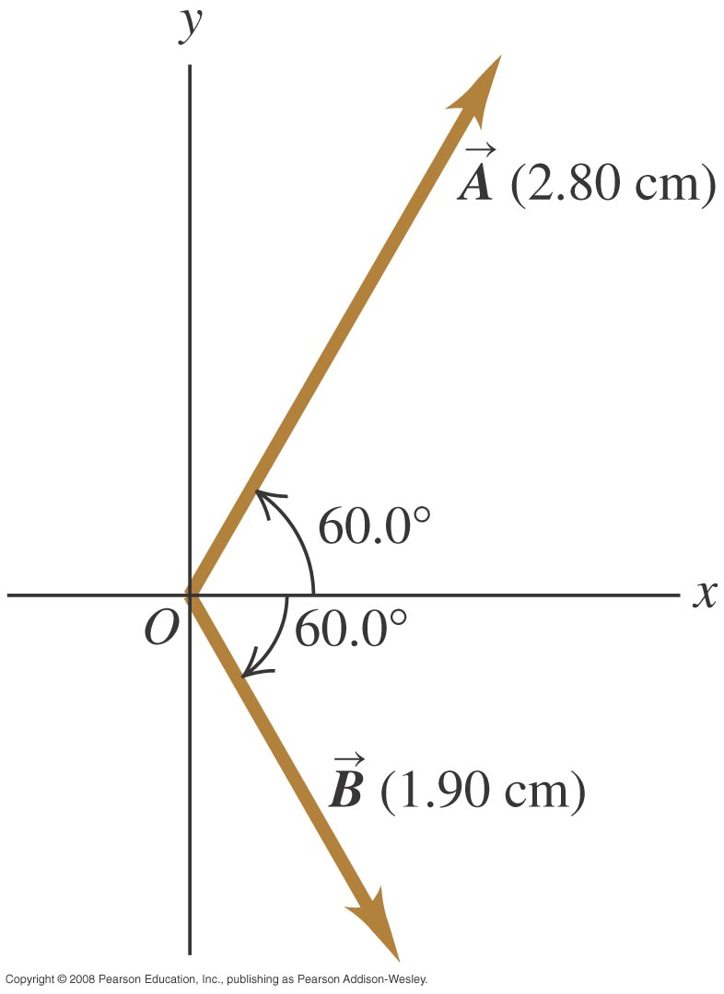
Adding Vectors 2

Slide 40
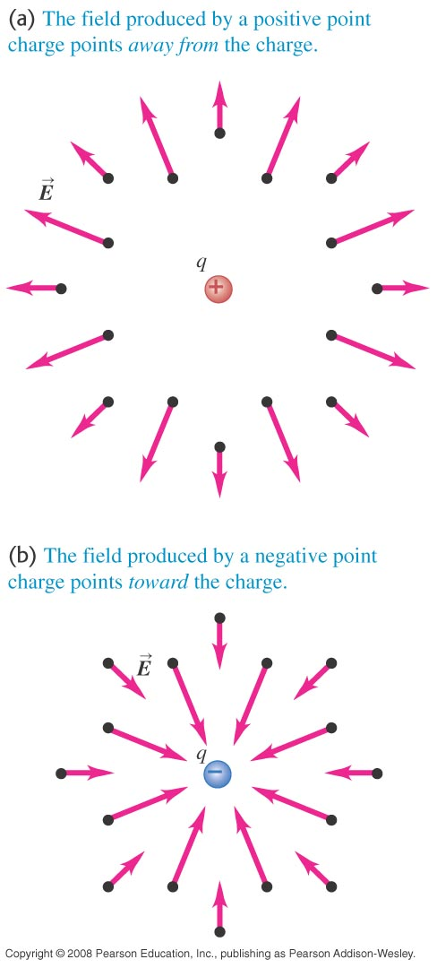
Electric field is a vector
The direction of the electric field is given below:

Slide 41
Vector Notation of E field
Charges produce electric field. The closer you are to the charge, the stronger is the electric field.
Unit: V/m = N/C
q

Slide 42
Another Notation

Slide 43
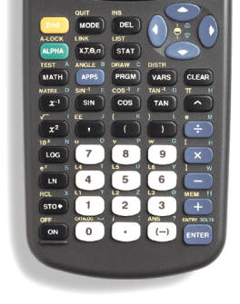
Store k in your calculator
Type:
“8.99E9” then “STO➔” then “ALPHA” then “K” then “ENTER”
If q=2C, r=1.3m, to find the E field, type:
“K*2/1.3²”

Slide 44
Electric Field (Magnitude)
The magnitude of the electric field produced by a single point charge q is give by:
Don’t forget the absolute value!
Magnitude is always positive.

Slide 45
Warnings
+
Observer
−

Slide 46
Direction of E (one charge)

Slide 47
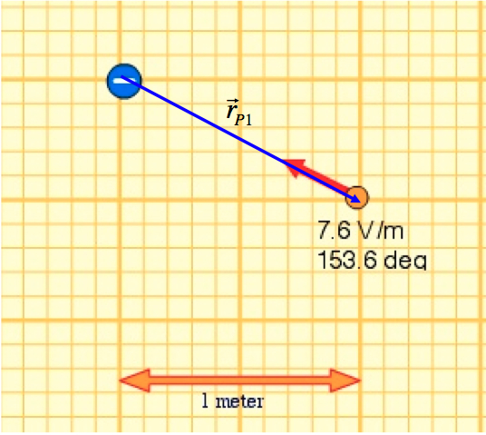
Example

Slide 48
Example (Continued)
The electric field vector is given by the red arrow.

Slide 49
The strategy in finding the electric field vector

Slide 50
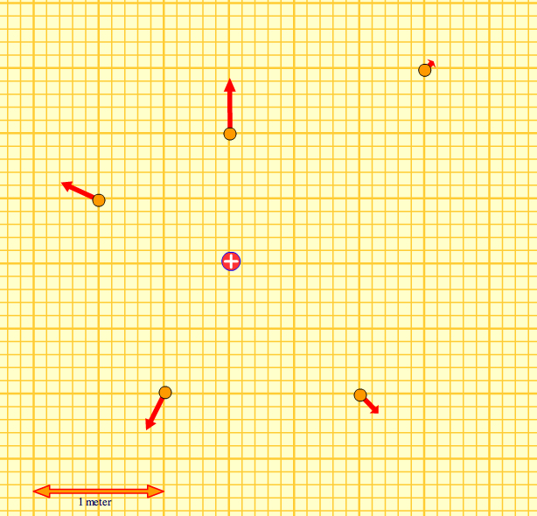
Find the unit vectors

Slide 51
Warnings

Slide 52
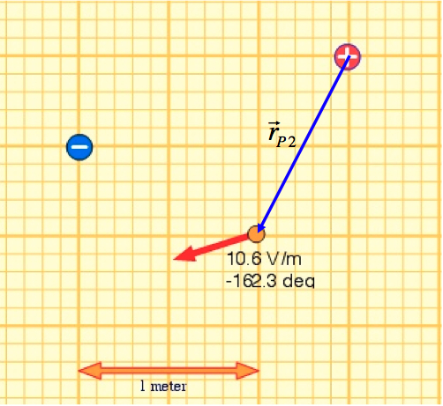
Example - Two Charges
See supplementary notes

Slide 53
More about r:
θ
θ
θ

Slide 54
Example
Find the E field at point P
P
q₁
q₂
4 cm
3 cm
Notes:
E1=56 250N/C
E2=200 000N/C
Etot=256 250N/C
If q1 is negative, Etot=143750N/C

Slide 55
Solution
P
q₁
q₂
4 cm
3 cm

Slide 56
Example
Find the point P such that E = 0.
7 cm
q₁
P
q₂
x
7-x

Slide 57
Example
q₁
P
q₂
7-x
x

Slide 58
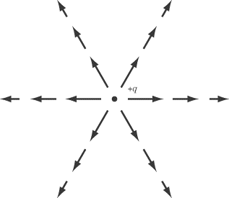
The difference between field vectors and field lines
Field vectors
Field lines

Slide 59
Properties of field lines
Field lines never cross each other
Field lines never terminate in vacuum
Field lines originate from positive charges and terminate at negative charge
Field lines may go off to infinity
The tangent of a field line gives the direction of the E field at that particular point

Slide 60
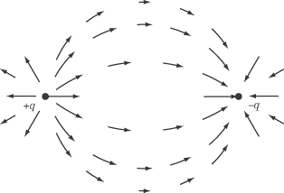
Dipole
Field vectors
Field lines

Slide 61
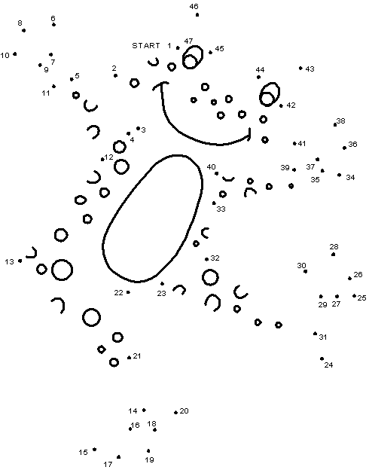
Similar to this
You connects the field vectors to find the field lines.

Slide 62
Electric Field and Electric Force
Electric field can be used to calculate the electric force:
F and E are parallel when q is positive.
F and E are opposite when q is negative.

Slide 63
Two point charges
q₁
r
q₂
E₁₂
E₂₁

Slide 64
Coulomb’s Law
The mutual force due to two point charges has magnitude:

Slide 65
Another Notation

Slide 66
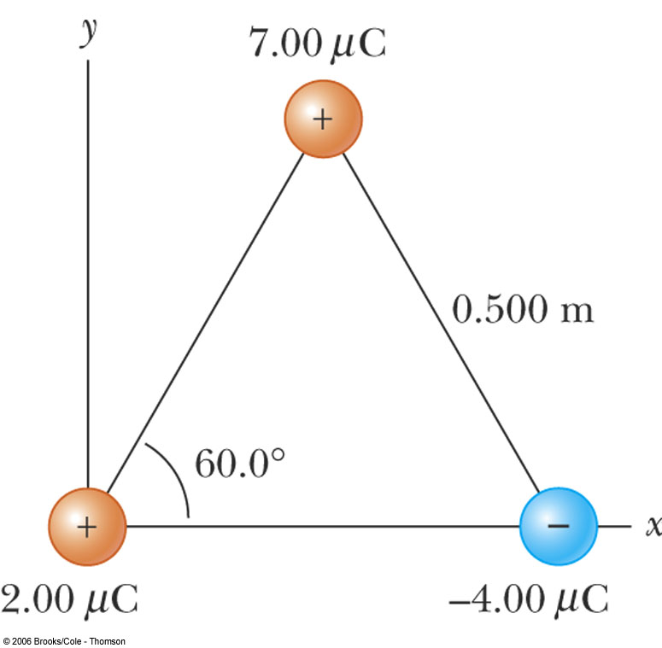
Finding the Electric Force
There are two (equivalent) methods of finding the force on a charge (say, q₁).

Slide 67
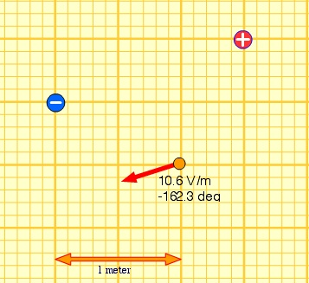
Finding the force on a charge
+1nC
-1nC
P

Slide 68
Motion of a charge in an E field

Slide 69
Example

Slide 70
Use the equation of motion
Suppose the charge is released from rest, where will it be after 0.5s?

Slide 71
Line of Charge

Slide 72
Solution

Slide 73
Solution (Cont.)

Slide 74
Solution (Cont.)

