Slide 1
Chapter 12
Fluid Mechanics

Slide 2
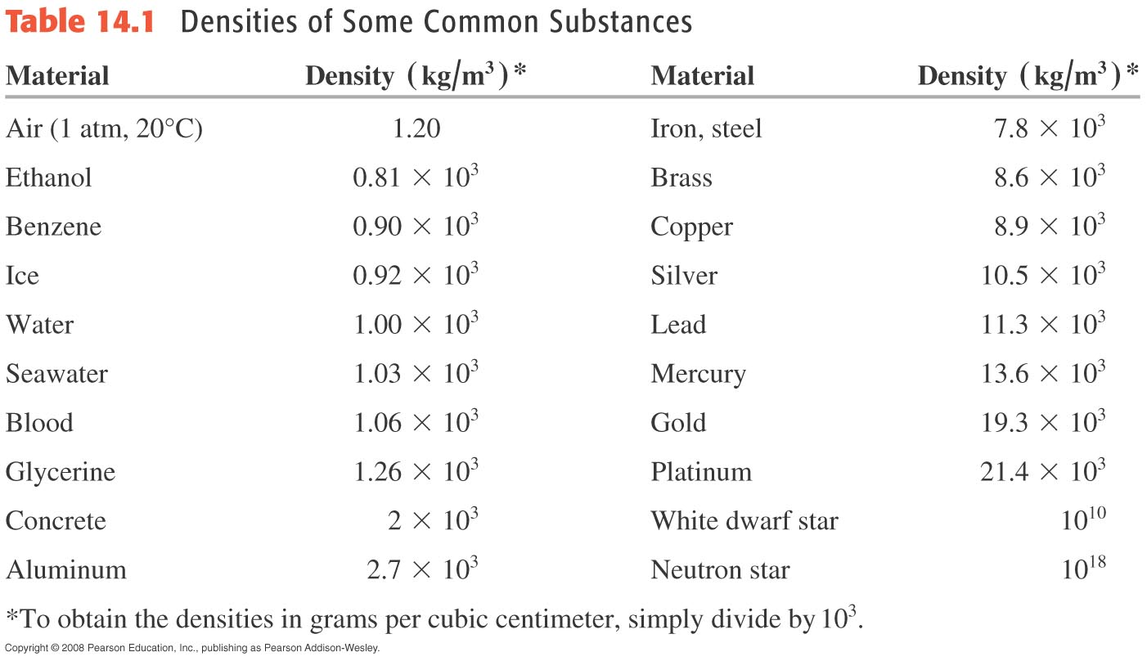
Density

Slide 3
Example
Find the density of an 4g mass with a volume of 2cm³.

Slide 4
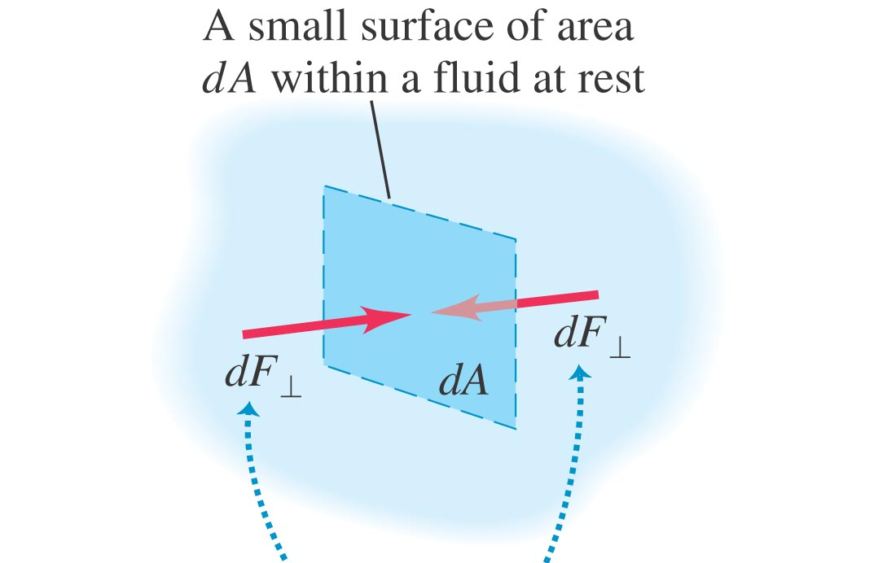
Pressure
For force uniform over the surface:

Slide 5
Force and Pressure

Slide 6
More on the Units of Pressure 1

Slide 7
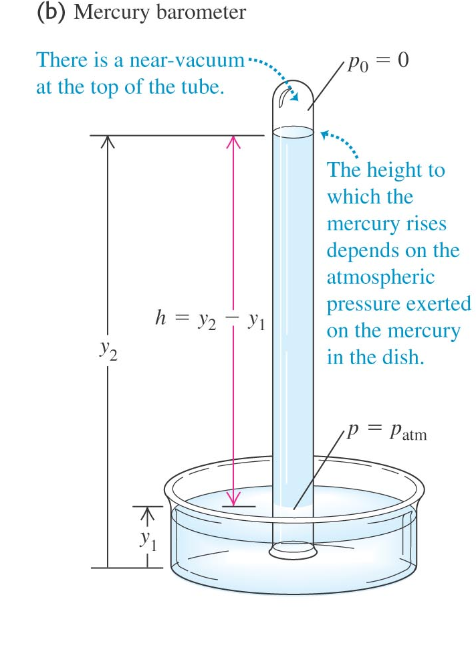
More on the Units of Pressure 2

Slide 8
Convert atm to mmHg

Slide 9
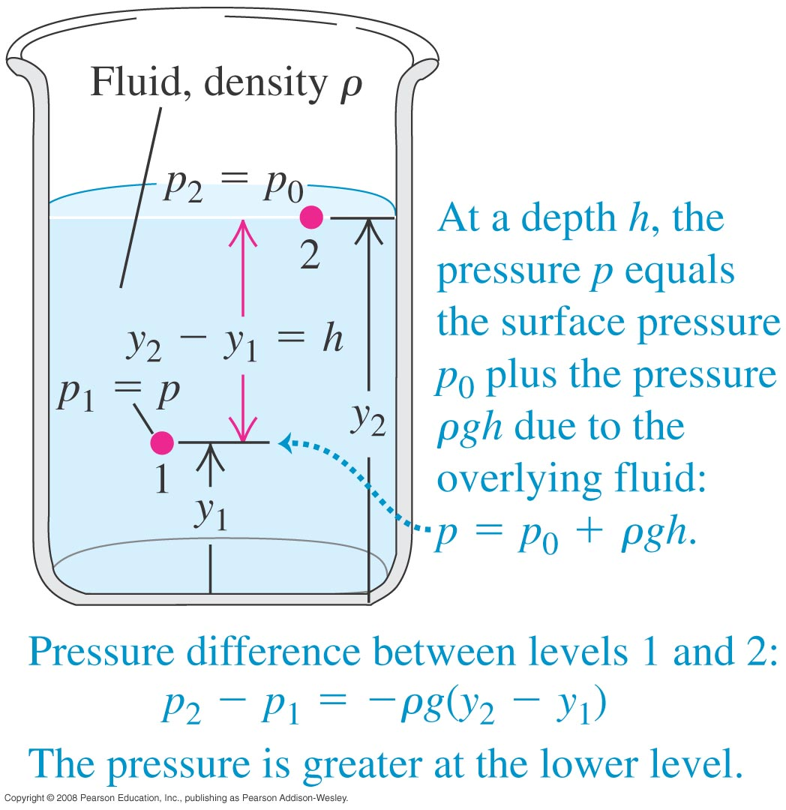
Pressure from Weight
The deeper you go, the more fluid you have above your head, the heavier it is, the higher the pressure on you.

Slide 10
Gauge vs Absolute Pressure
Gauge pressure = Absolute pressure – Atmospheric pressure

Slide 11
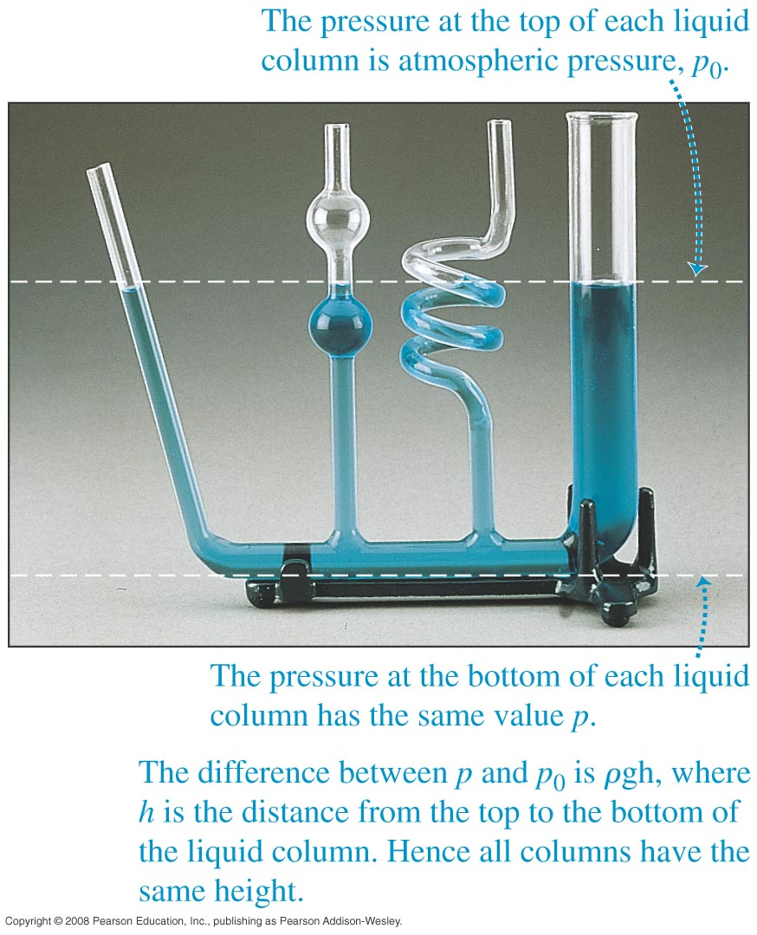
Static Fluid
The pressure in the static case depends ONLY on the depth. The shape of the container does not matter.
Pascal’s Law:
Pressure is transmitted undiminished to everywhere in the fluid.

Slide 12
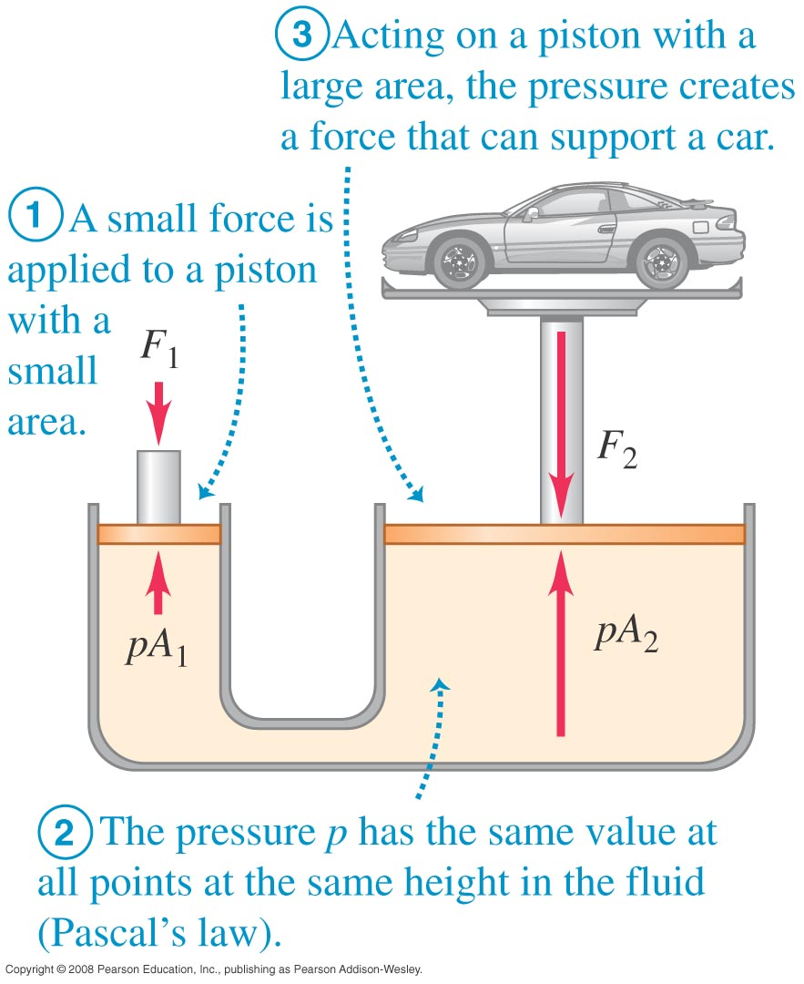
Hydraulic Lift

Slide 13
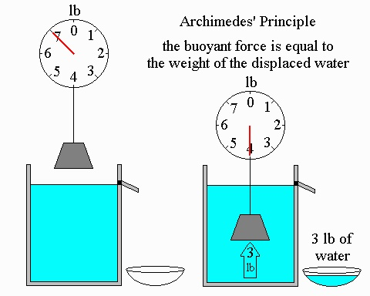
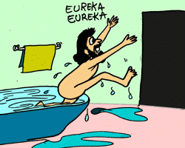
Buoyancy: Archimedes’ Principle
A fluid exerts an upward force on the body equal to the weight of the fluid displaced.

Slide 14
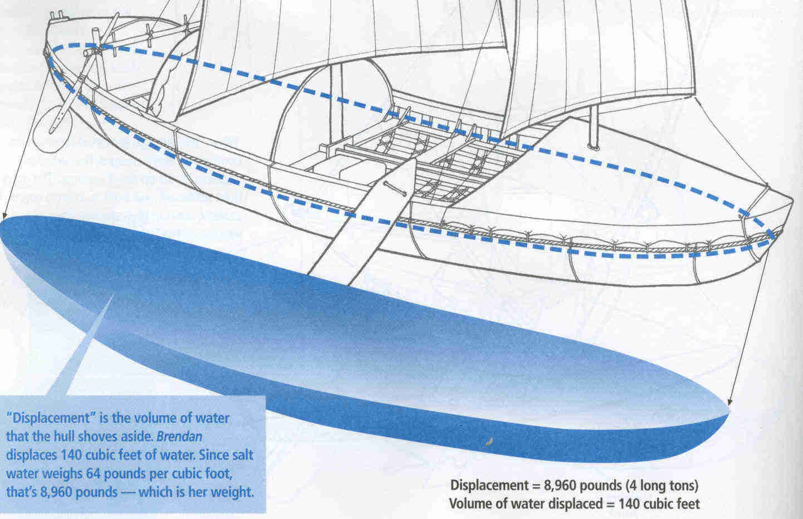
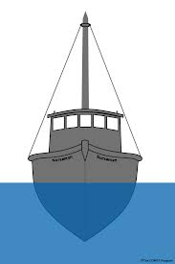
Archimedes’ Principle

Slide 15
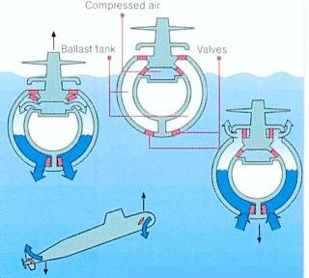
Archimedes’ Principle

Slide 16
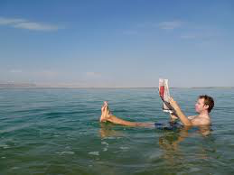
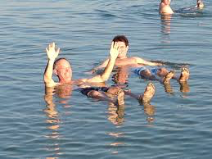
Dead Sea (very salty!)

Slide 17
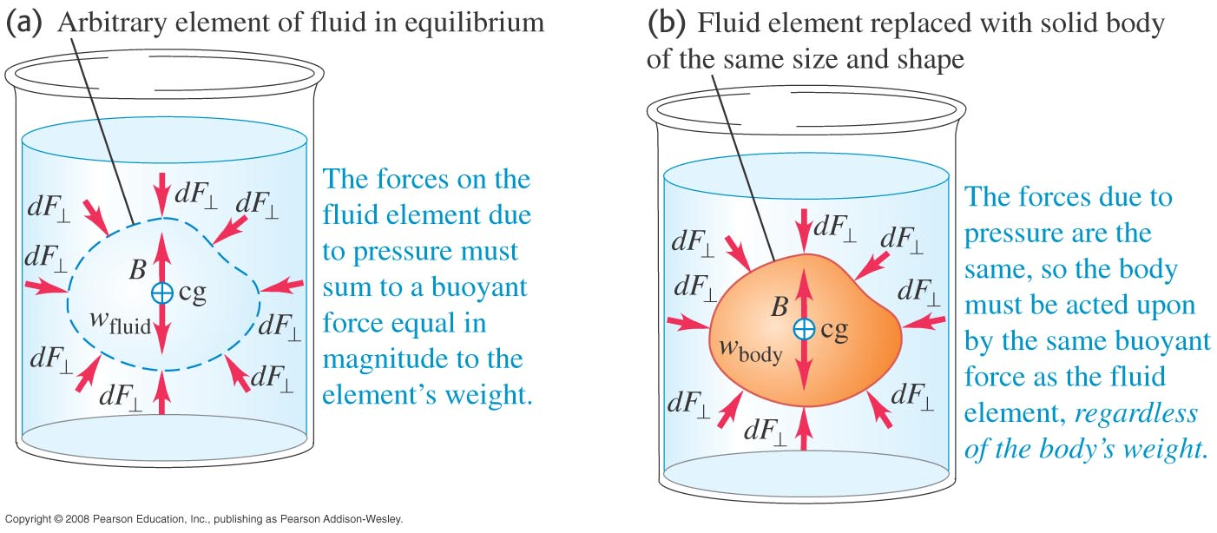
Archimedes’ Principle: Explanation

Slide 18
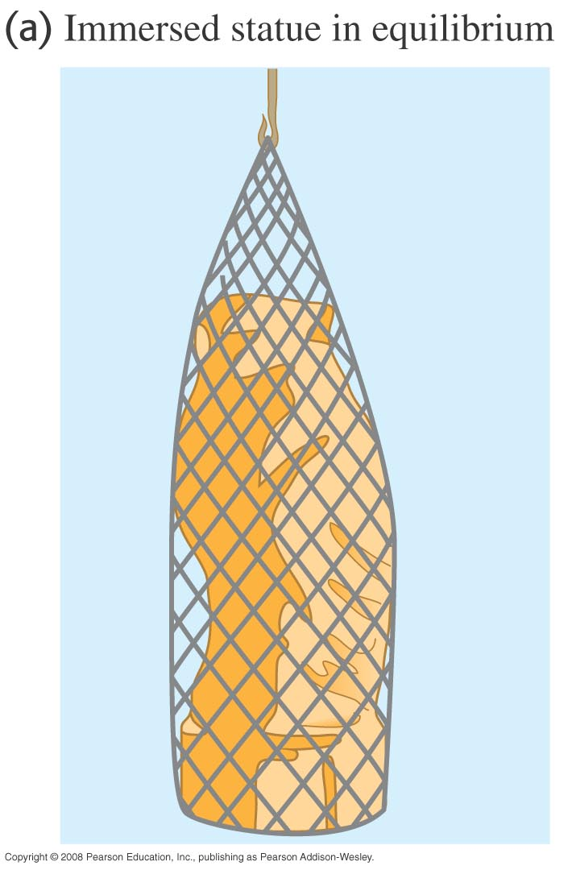
Weight of Gold in Water
The gold statue weighs 147N. Find the buoyant force and the weight of the statue in water.

Slide 19
Weight of Gold in Water (Method 2)
The gold statue weighs 147N. Find the buoyant force and the weight of the statue in water.

Slide 20
Finding Density

Slide 21
Finding Density (Alternative Method)

Slide 22
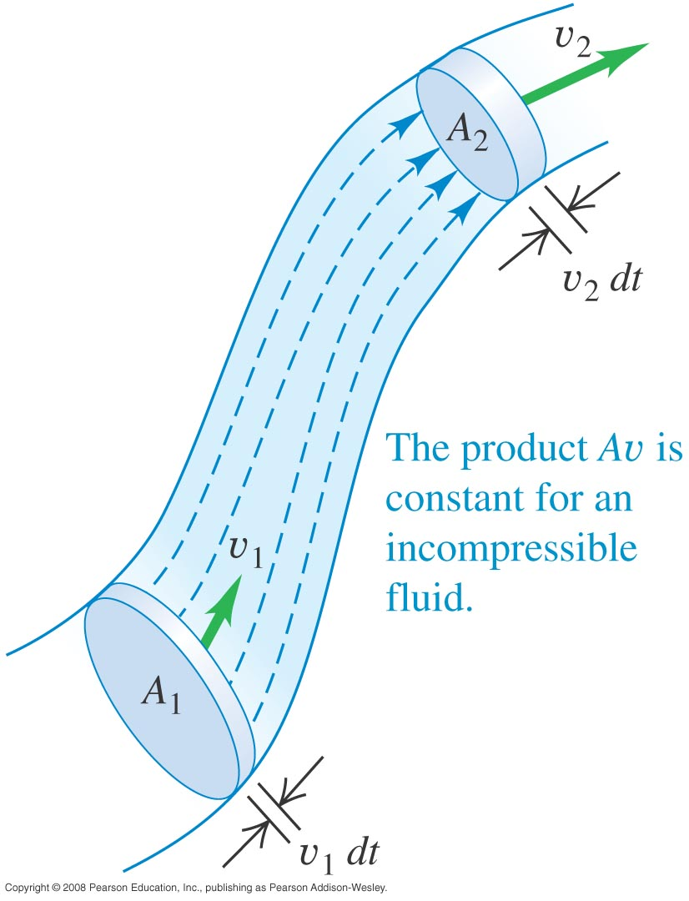
Incompressible Fluid Flow

Slide 23
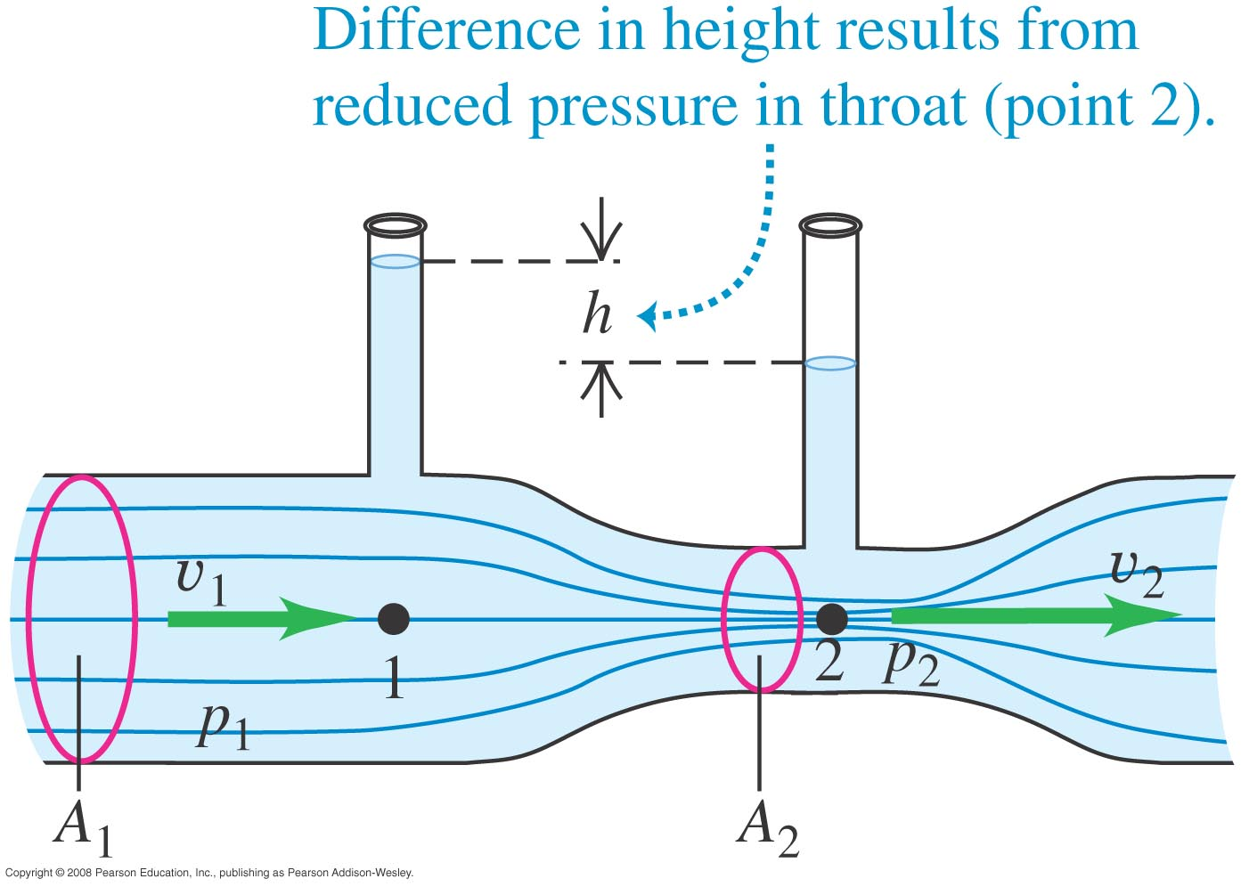
Bernoulli’s Equation
Usually used this way:

Slide 24
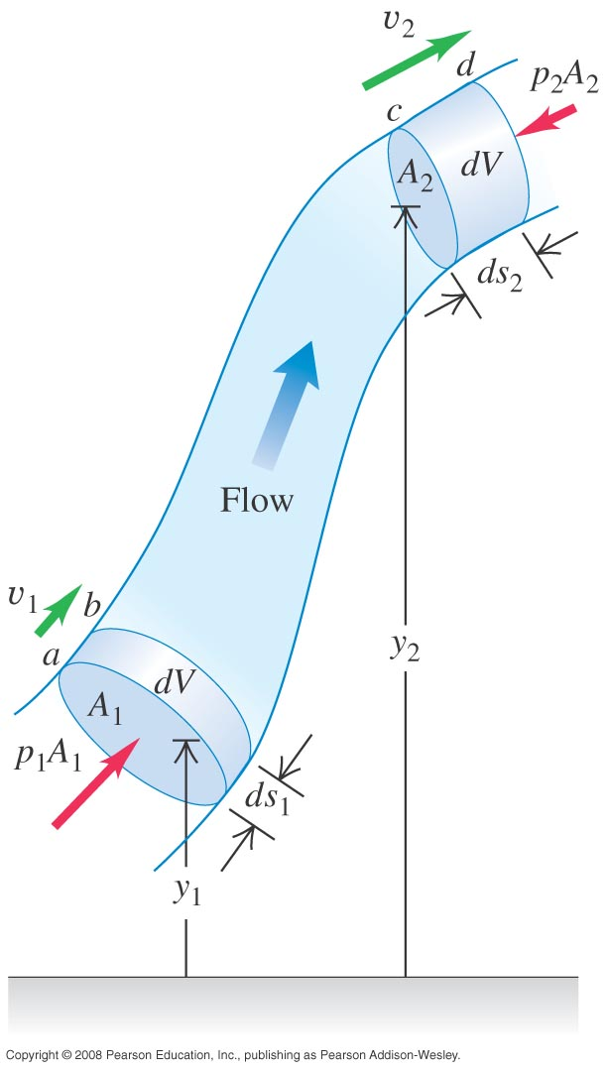
Derivation

Slide 25
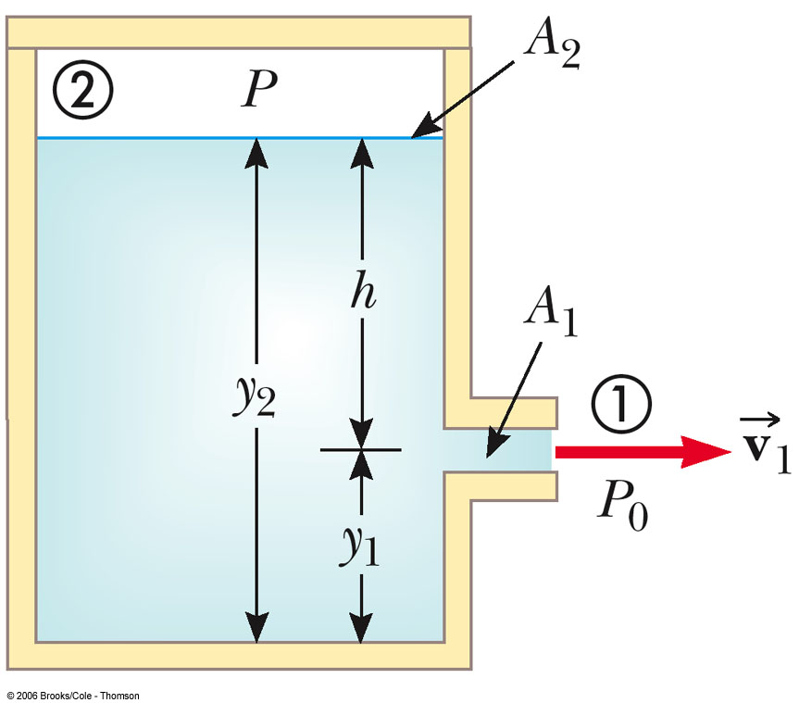
A Leaky Tank

Slide 26
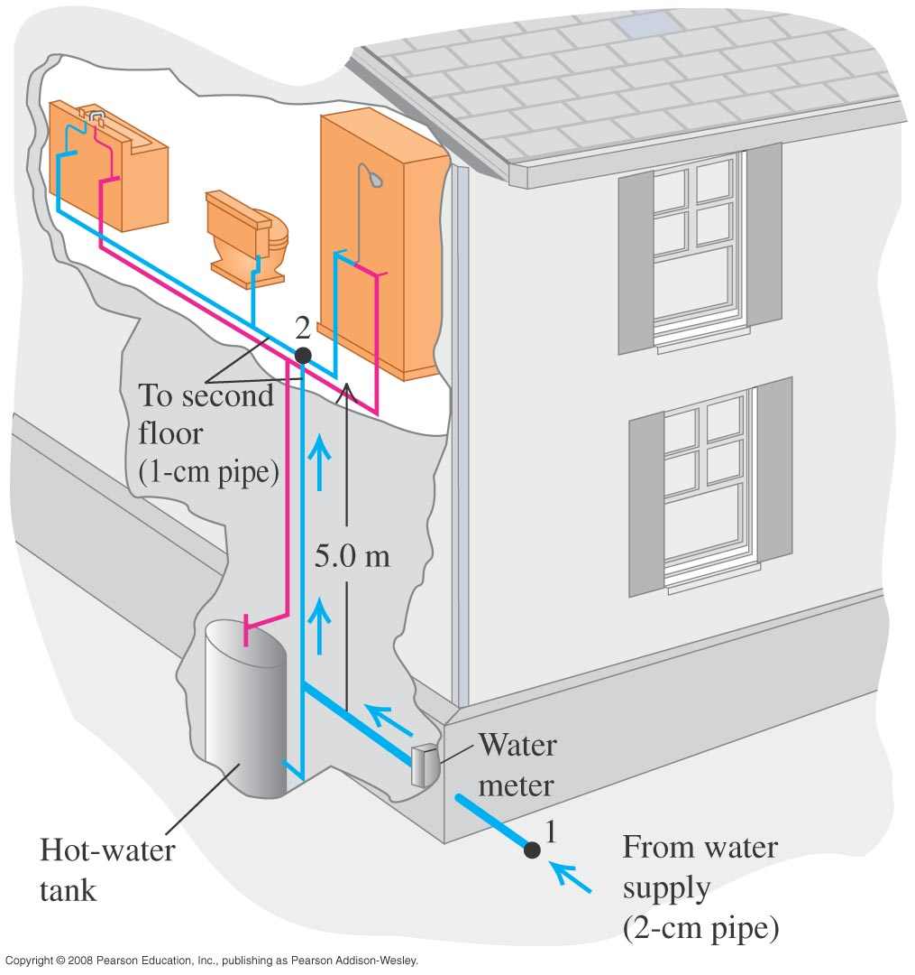
Example

Slide 27
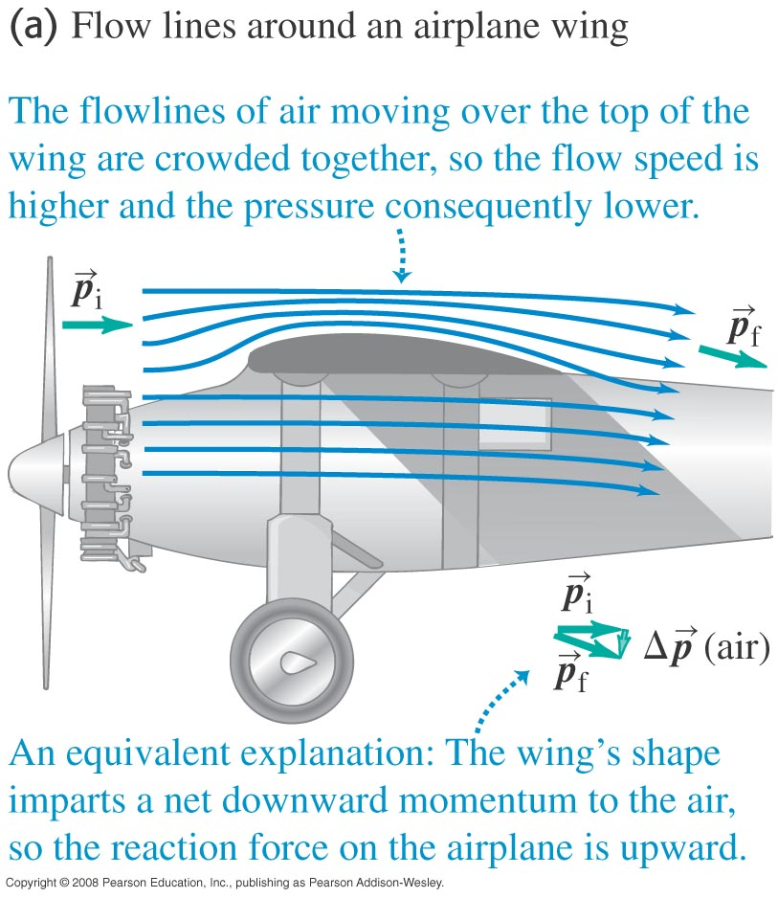
Applications

Slide 28
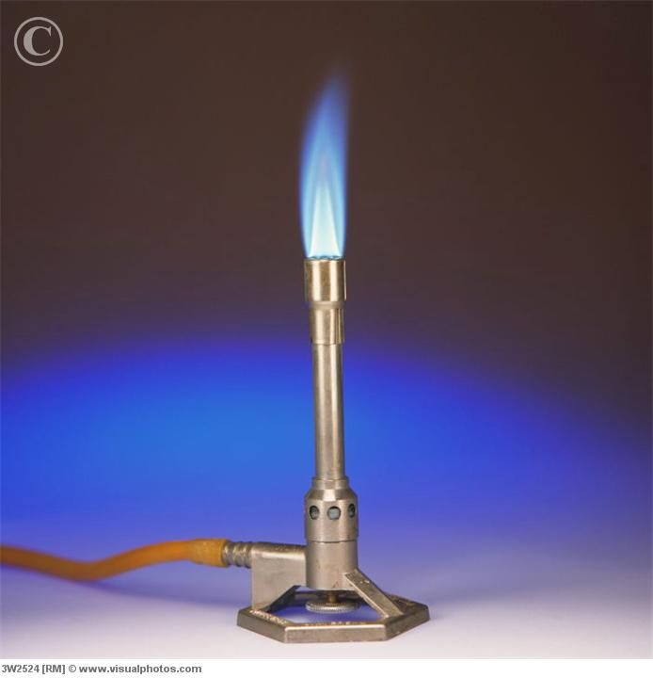
Bunsen Burner

Slide 29
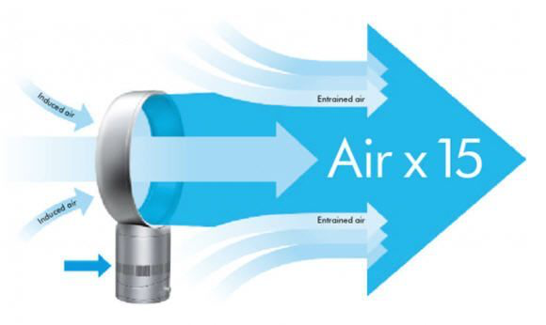
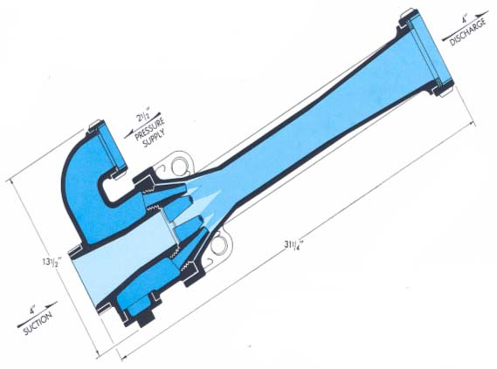
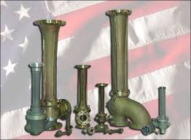
Air Multiplier & Eductor

Slide 30
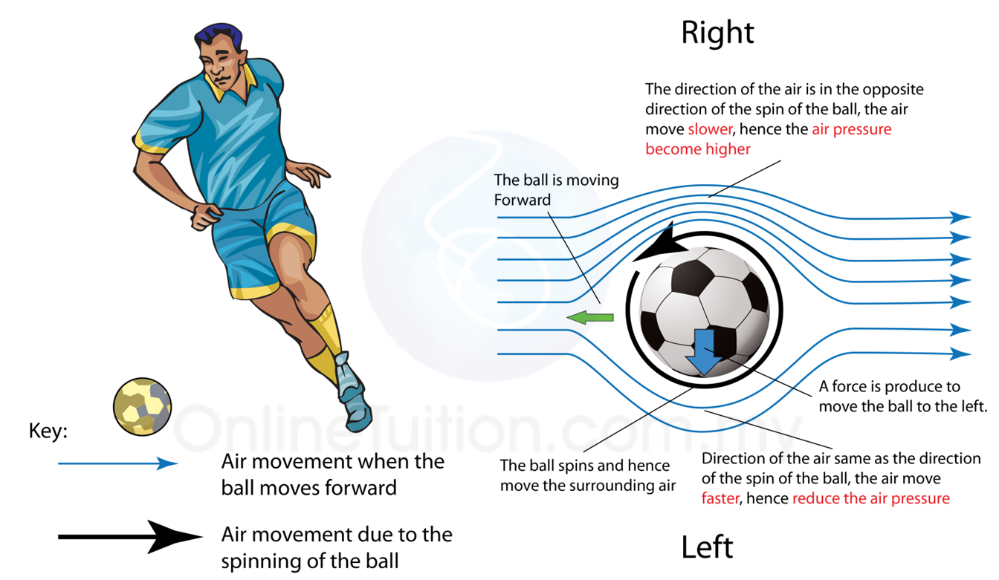
Curve Ball

Slide 31
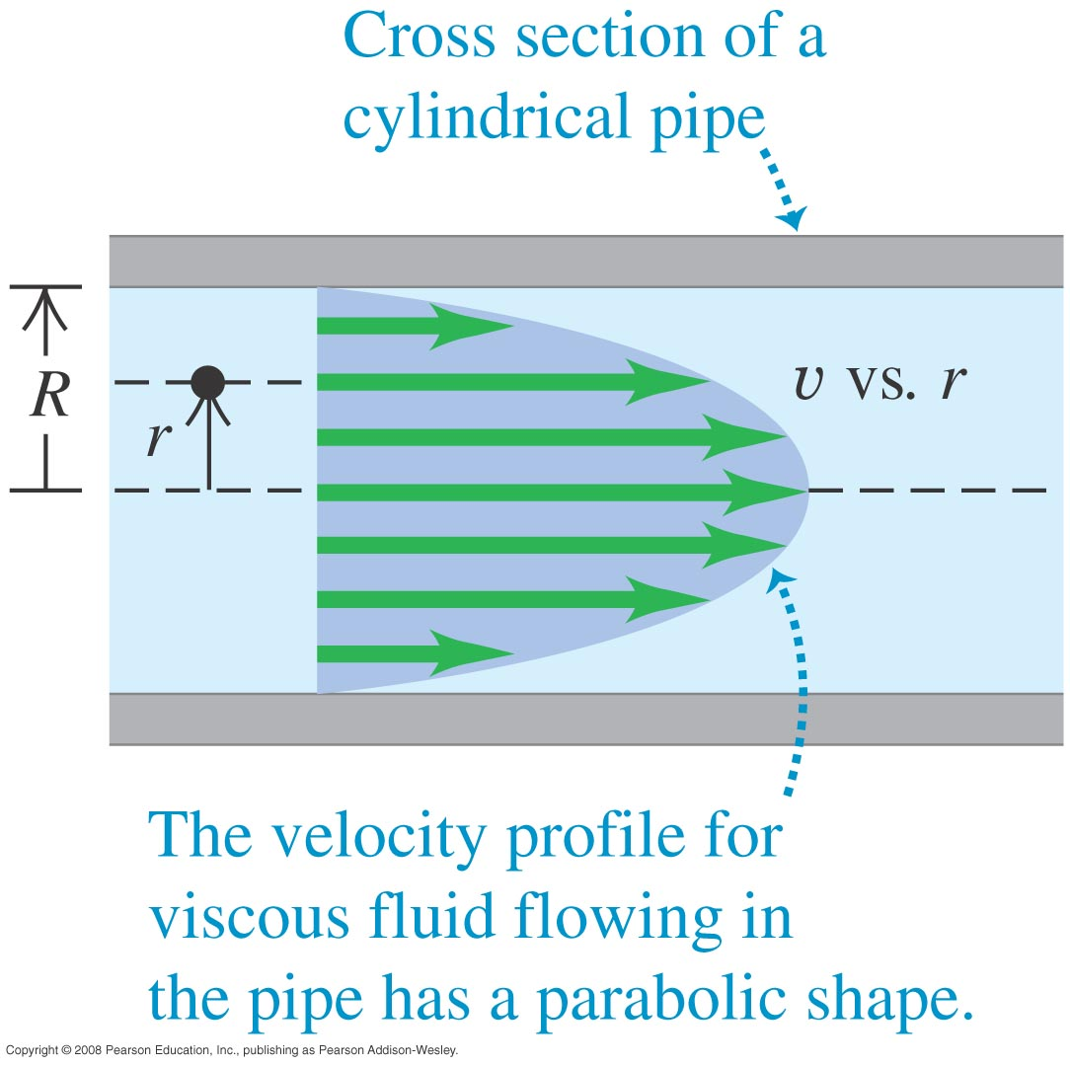
Viscosity

Slide 32
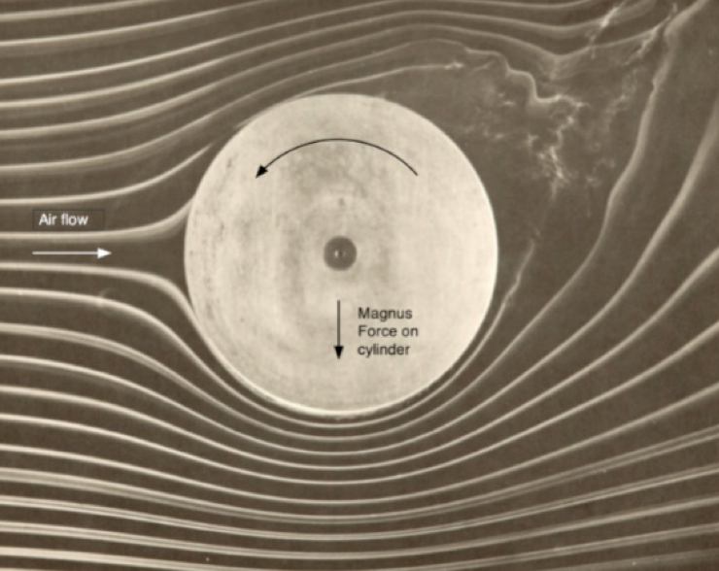
Turbulence vs Laminar Flow

